Slide 1
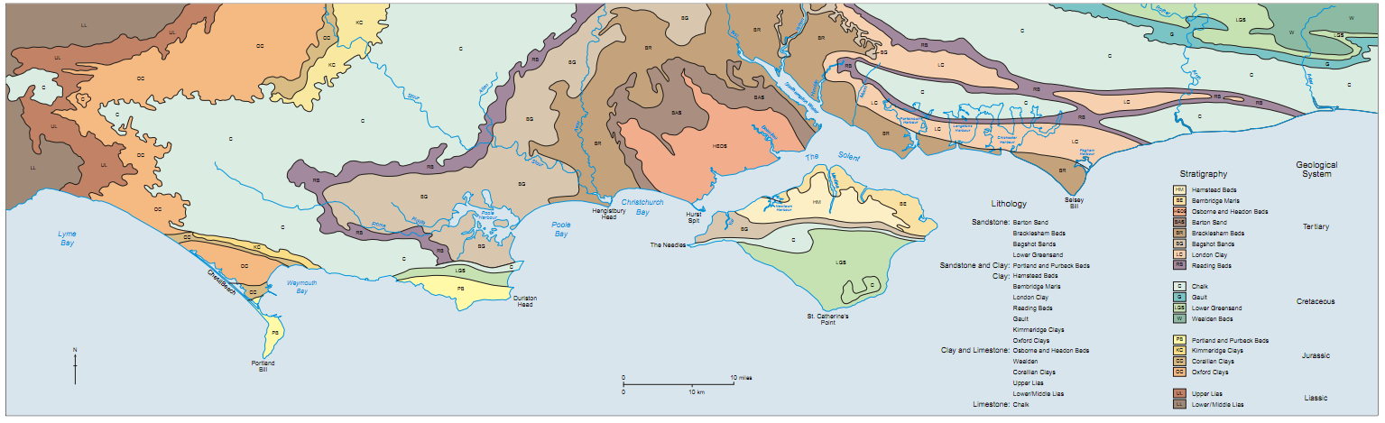
Dave Giles
SCHOOL OF EARTH & ENVIRONMENTAL SCIENCES
UNIVERSITY OF PORTSMOUTH
The Geology of the Isle of Wight

Slide 2
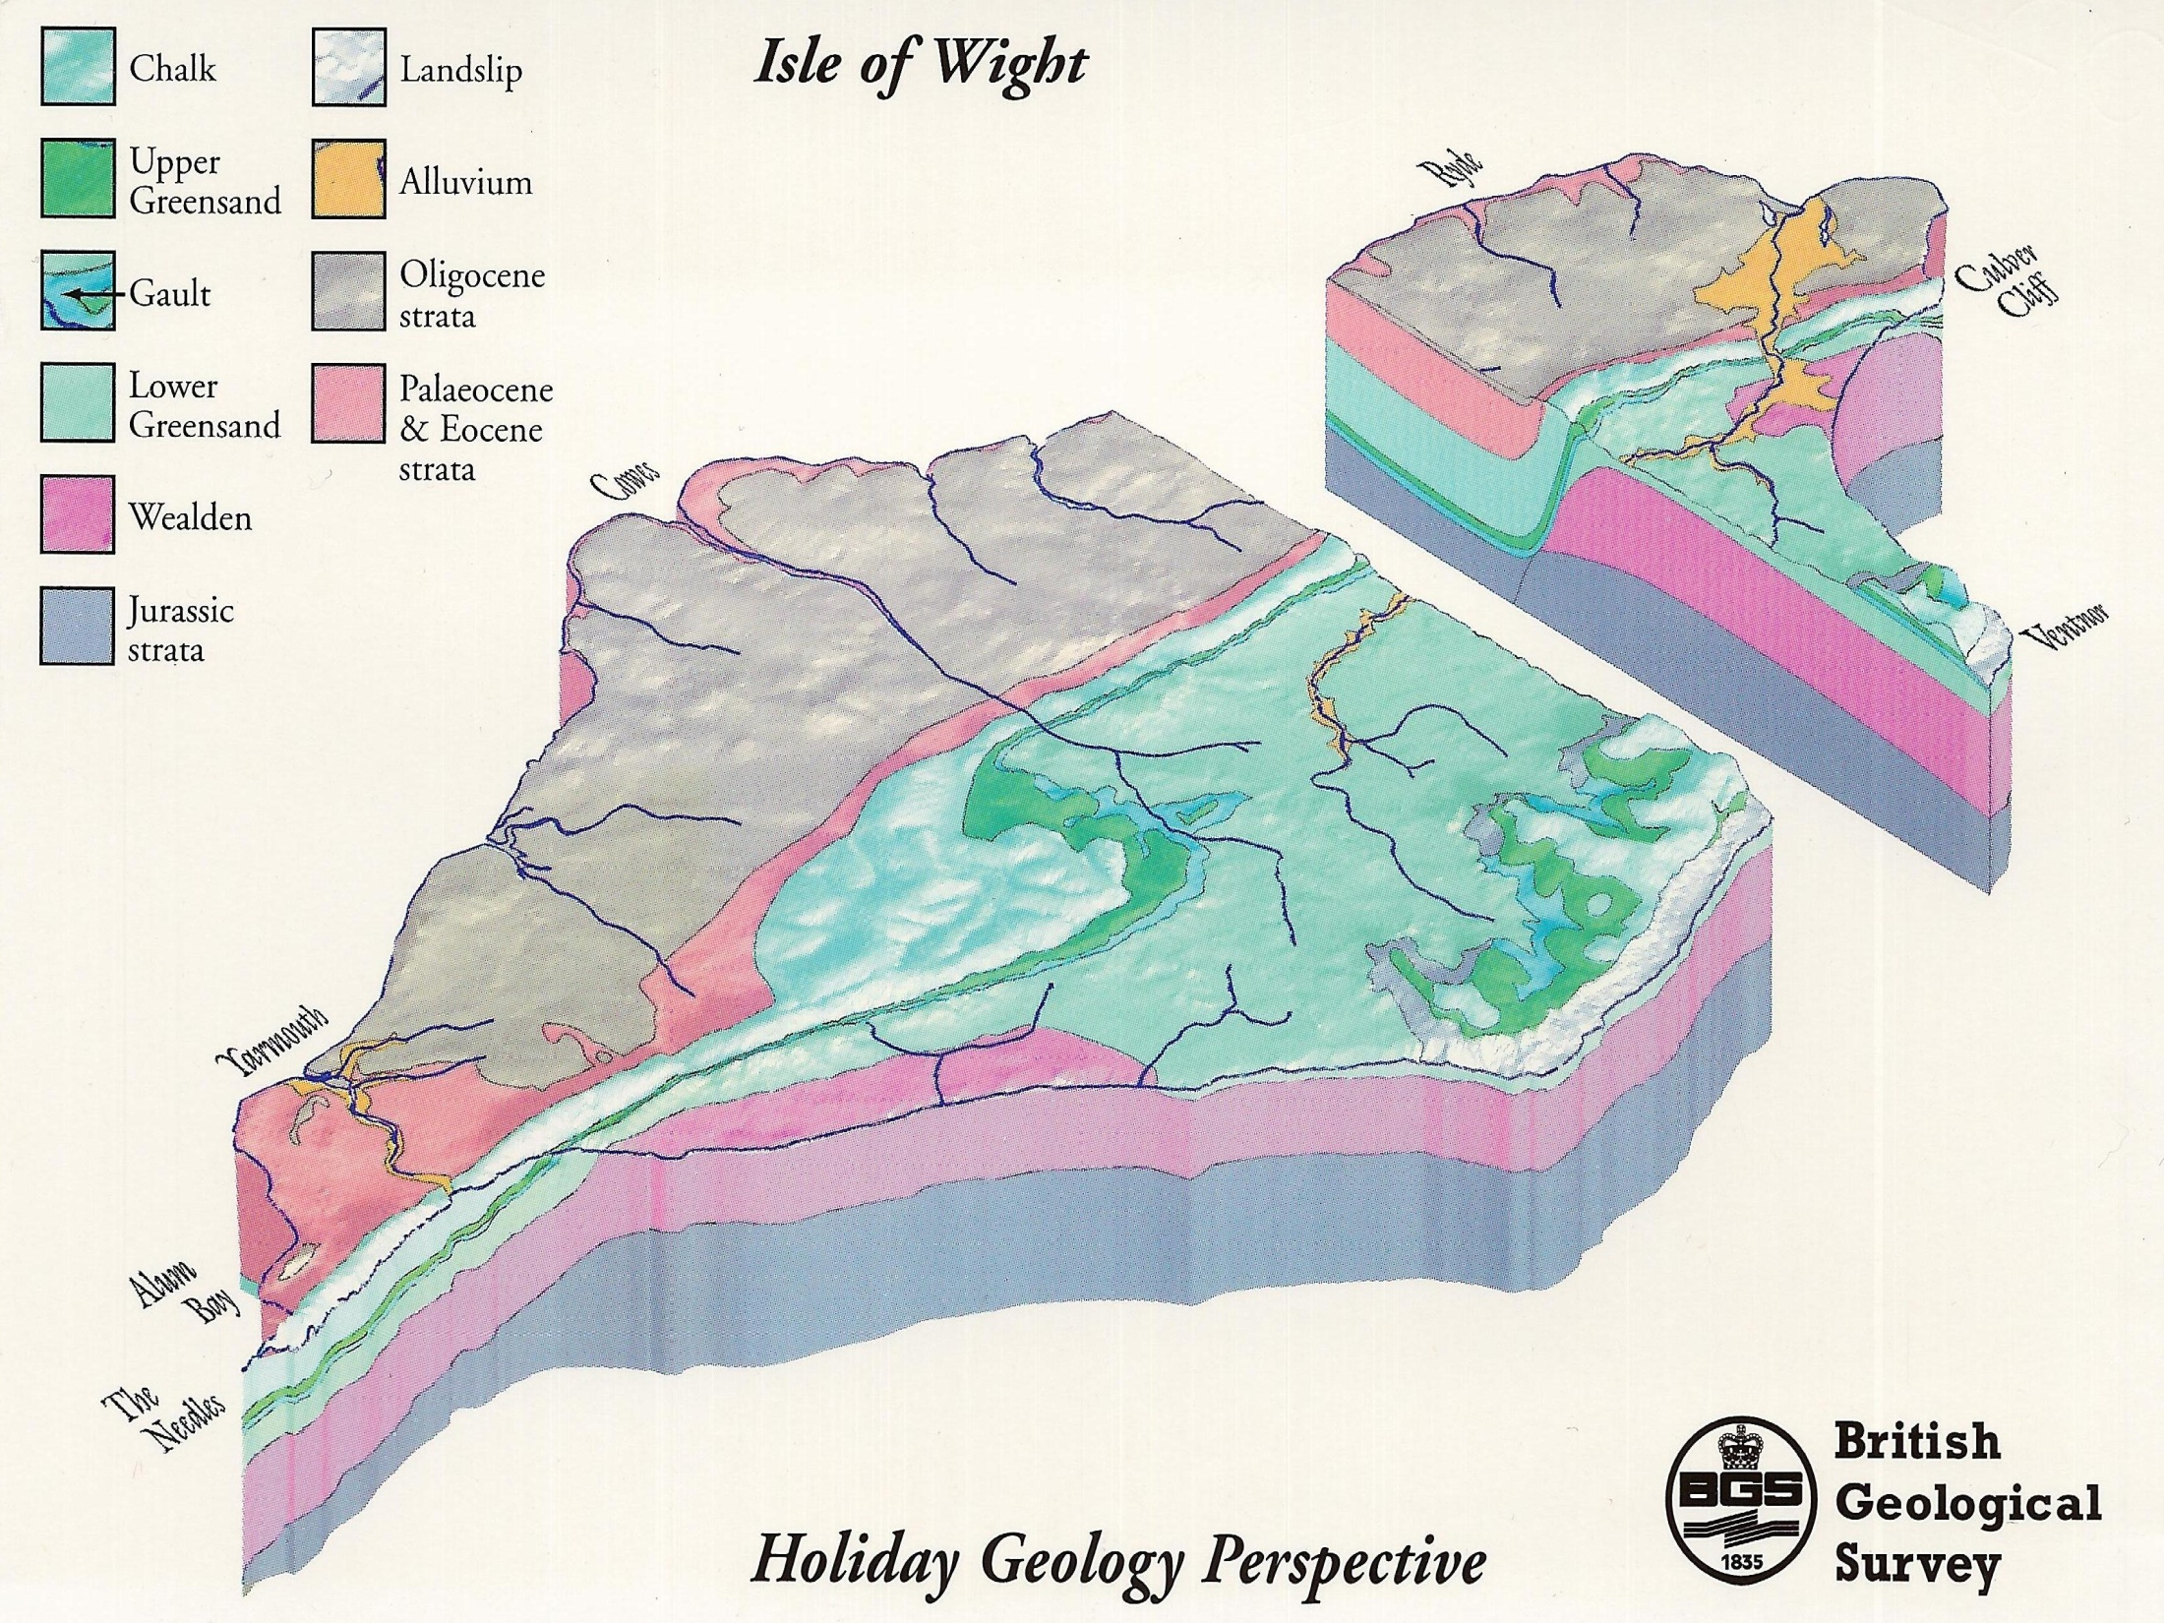
214m
Geology
Of the
Isle of Wight
Notes:
The isle of wight is separated from the mainland by the Solent
The isle forms a characteristic diamond shape about 38 km wide and 22km across (total area 388 sq.km)
Rock strata span the Cretaceous, Tertiary and Quaternary periods; Tertiary rocks outcropping to the north and Cretaceous rocks to the south, separated by a spine across the island known as the North Downs
The strata have been folded, with up-arched anticlines and down-warped synclines running roughly west to east
Outcrops of solid formations are partly obscured by superficial deposits, including landslide debris

Slide 3
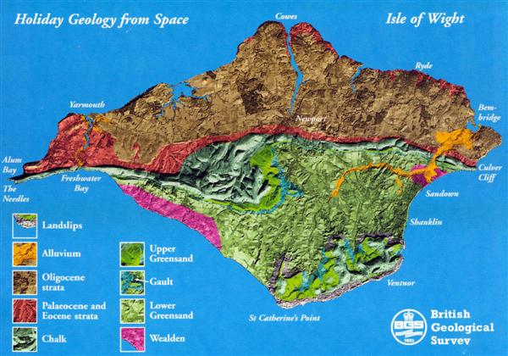
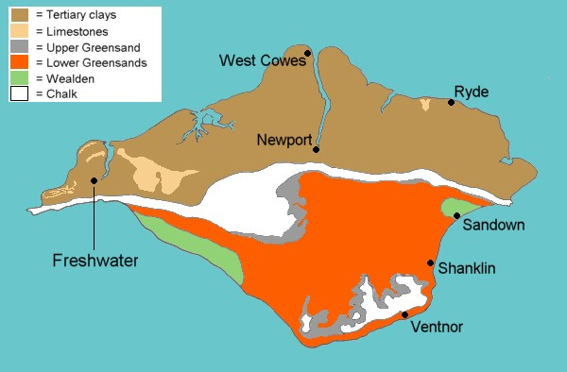
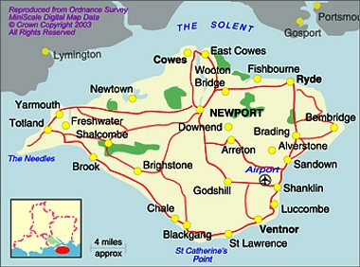
Objectives
To talk about the geology
To talk about the coastal erosion & landslides

Slide 4
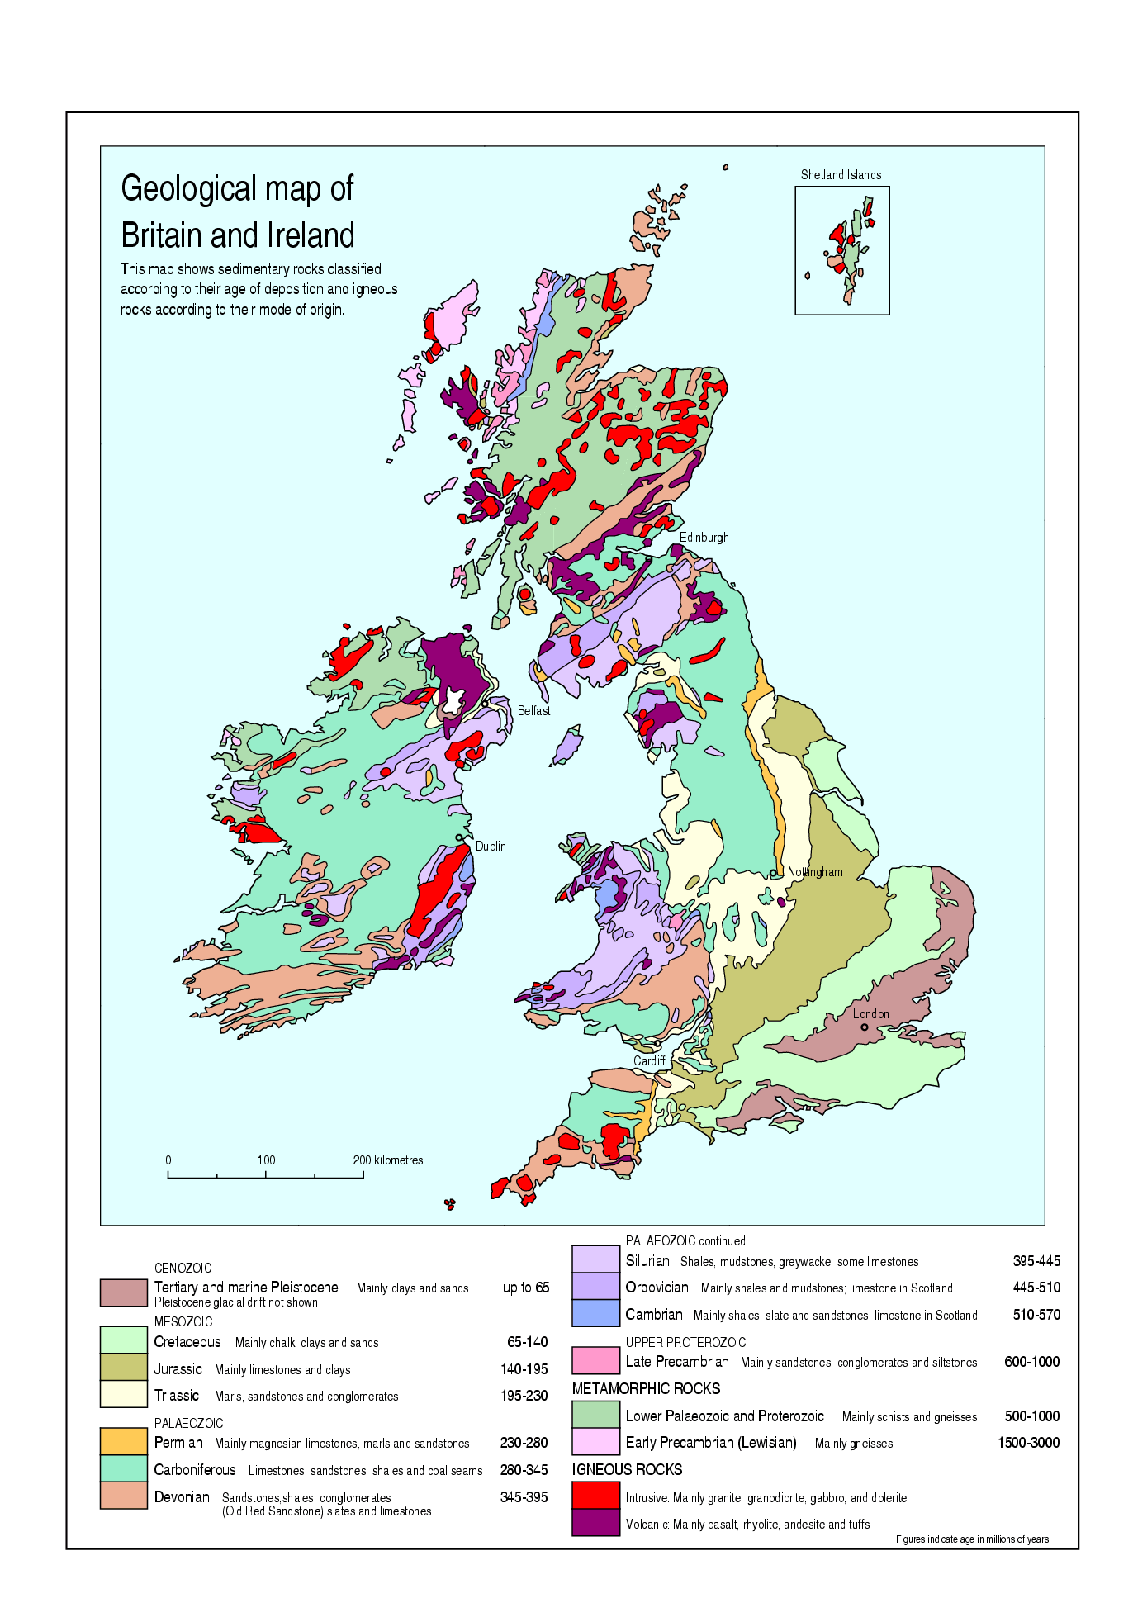
Geological Setting

Slide 5
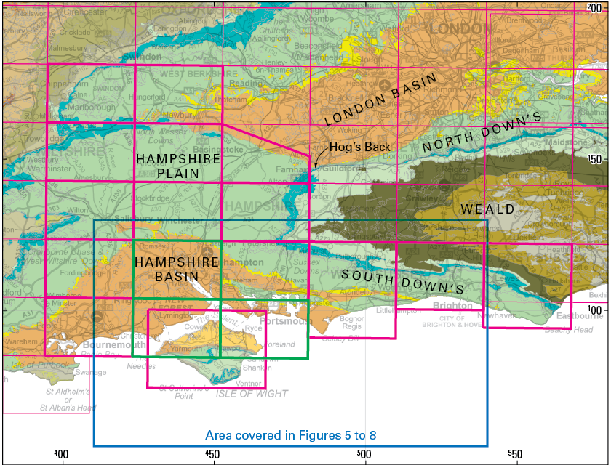
Generalised Geology of Southern England
Hopson, P.M. 2010 The geology of the Portsmouth region: a perspective of the Wessex and Hampshire Basins. In Walton, G (Ed.) Proceedings of the 16th Extractive Industry Geology Conference, EIG Conferences, Portsmouth, 2011.

Slide 6
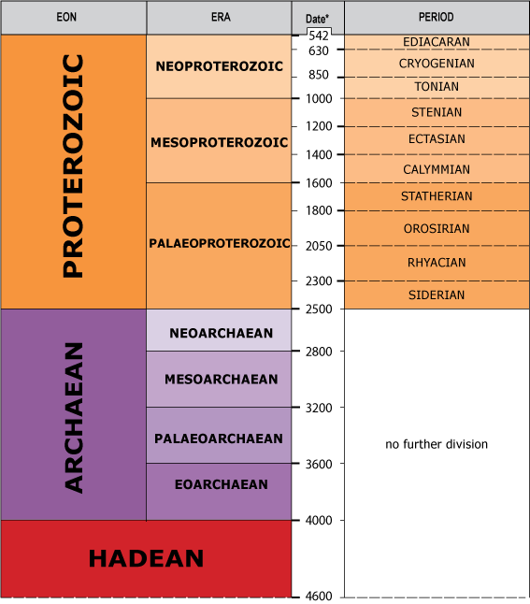
Geological Setting
Geological
Timechart
Geological Time
V
Historic Time
www.bgs.ac.uk/discoveringGeology/time/Timechart/phanerozoic/home.html

Slide 7
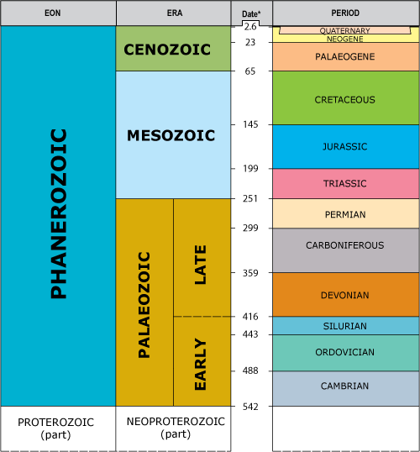
Geological Setting
Geological
Timechart
QUATERNARY
TERTIARY
CRETACEOUS
www.bgs.ac.uk/discoveringGeology/time/Timechart/phanerozoic/home.html

Slide 8
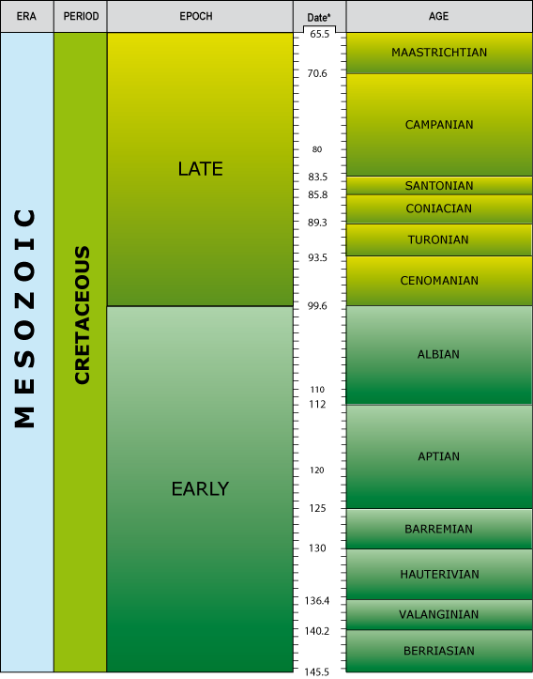
Geological Timescale
Cretaceous
The Latin word for Chalk
145 – 65 Mya

Slide 9
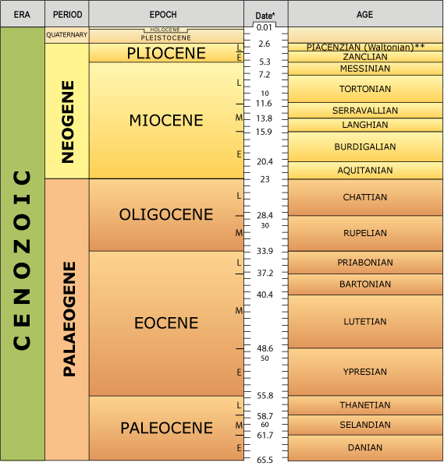
Geological Timescale
Tertiary
65 – 2.5 Mya

Slide 10
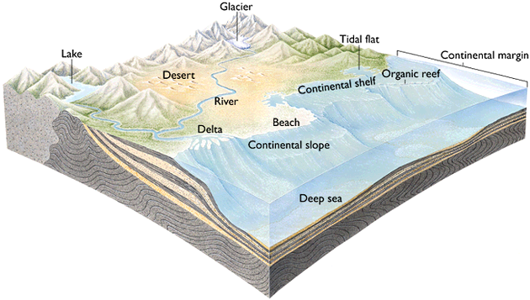
Sedimentary Environments

Slide 11
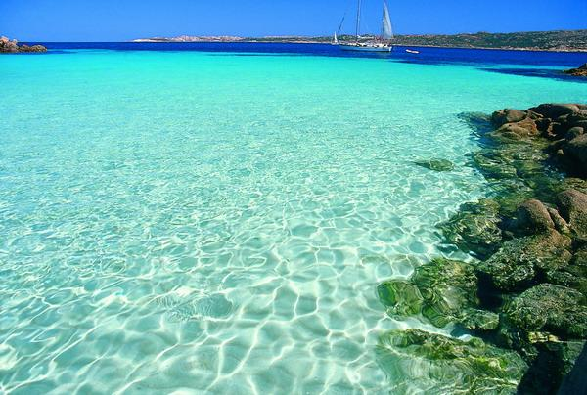
Environments of Deposition
Marine

Slide 12

Environments of Deposition
Deep Ocean

Slide 13
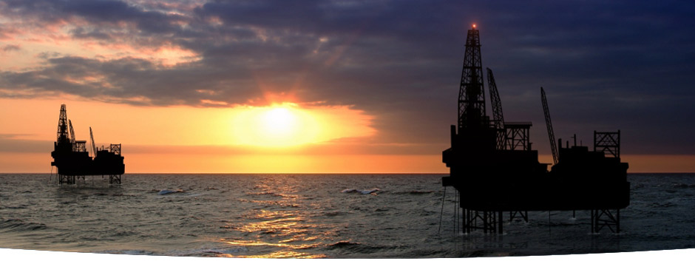
Environments of Deposition
Shallow Sea

Slide 14
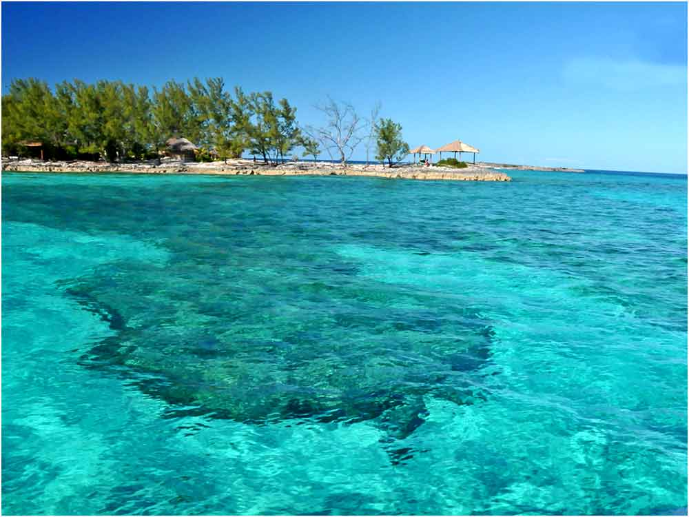
Environments of Deposition
Very Shallow Warm Sea

Slide 15
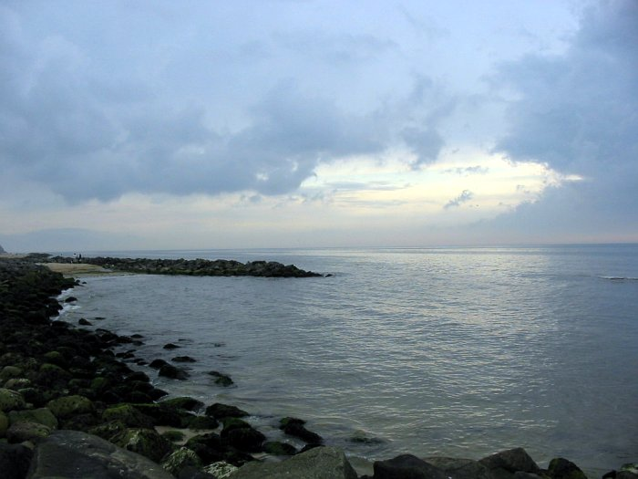
Environments of Deposition
Coastal

Slide 16
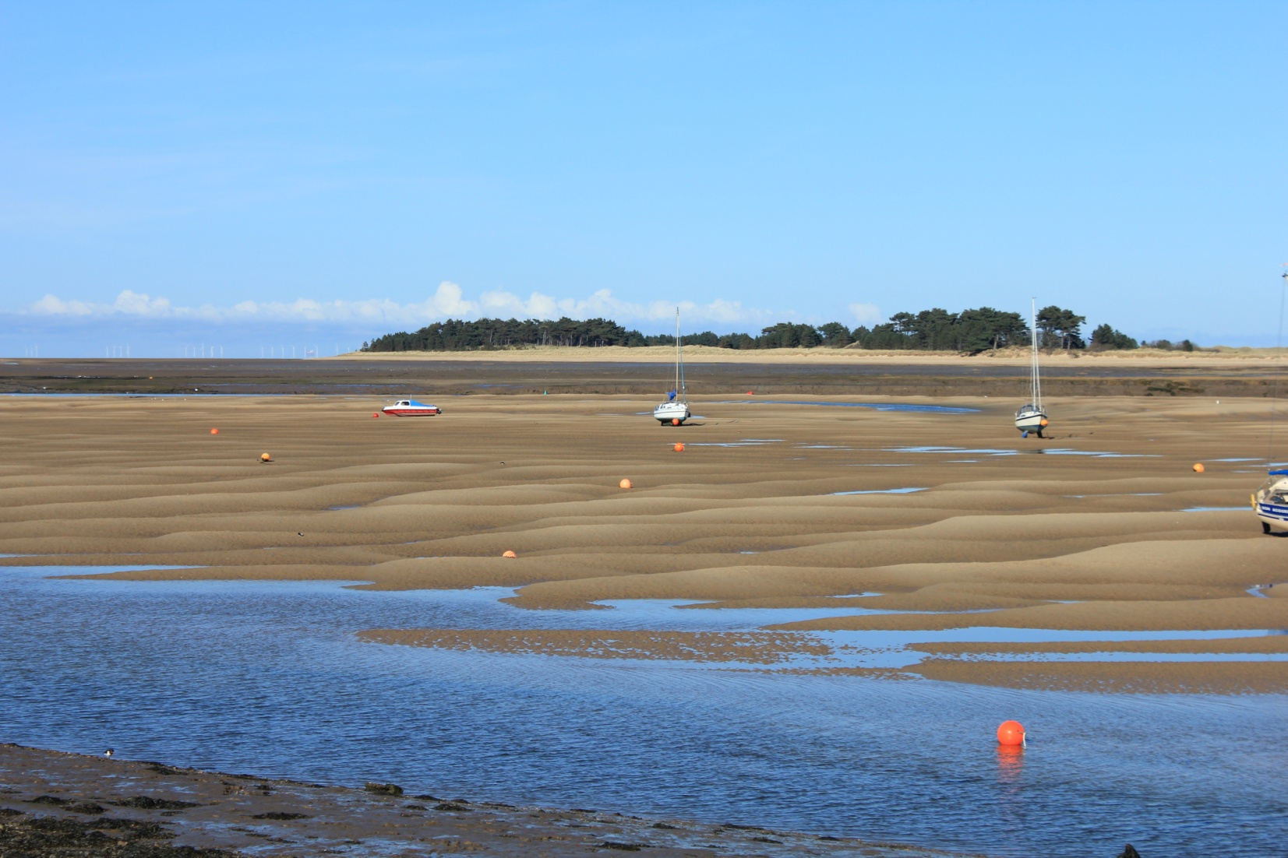
Environments of Deposition
Estuarine

Slide 17
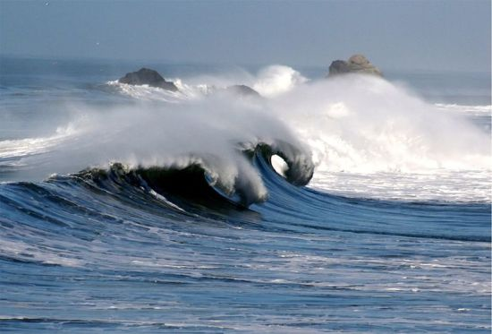
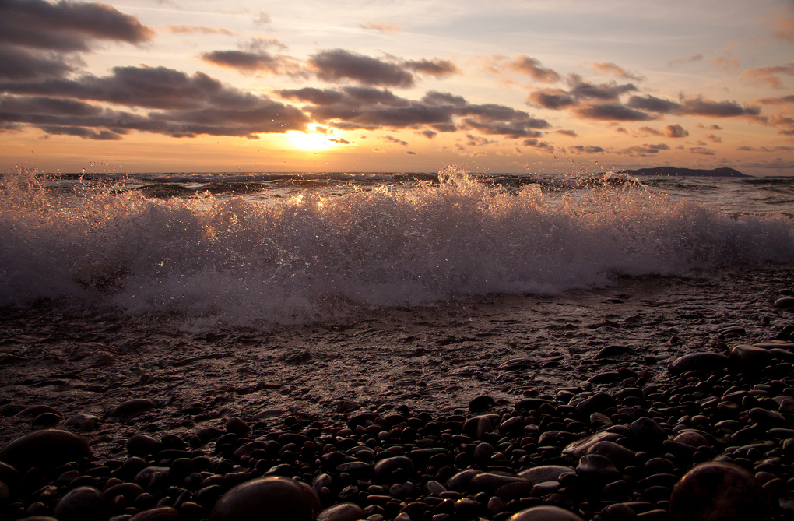
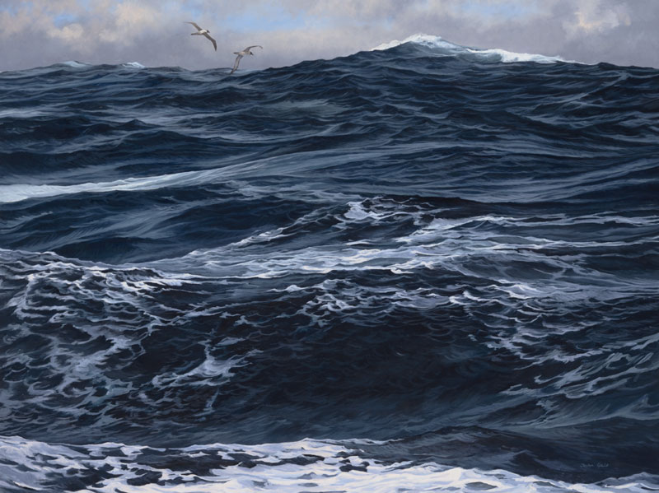
Environments of Deposition
Wave energy
Water depth
Distance form land

Slide 18
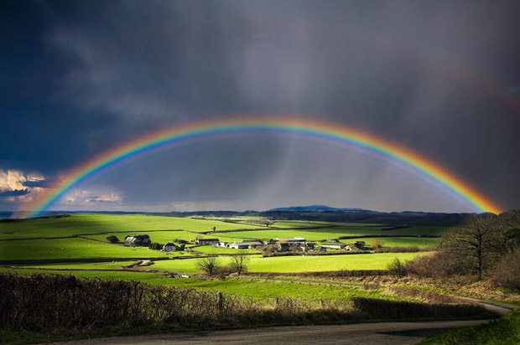
Environments of Deposition
Terrestrial
or
Non Marine

Slide 19
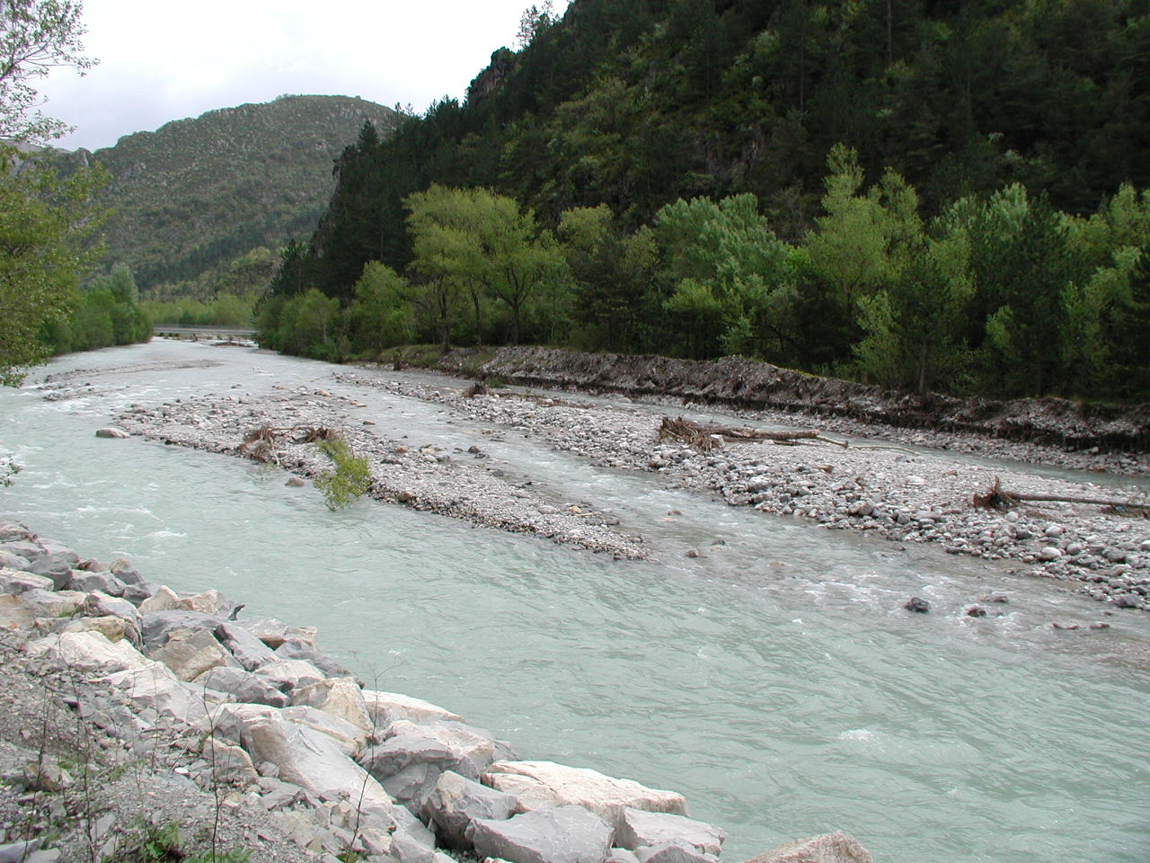
Environments of Deposition
Rivers

Slide 20
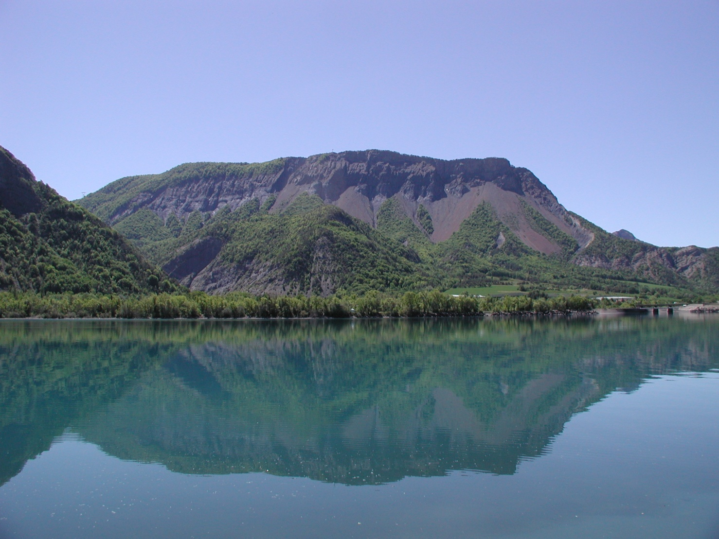
Environments of Deposition
Lakes

Slide 21
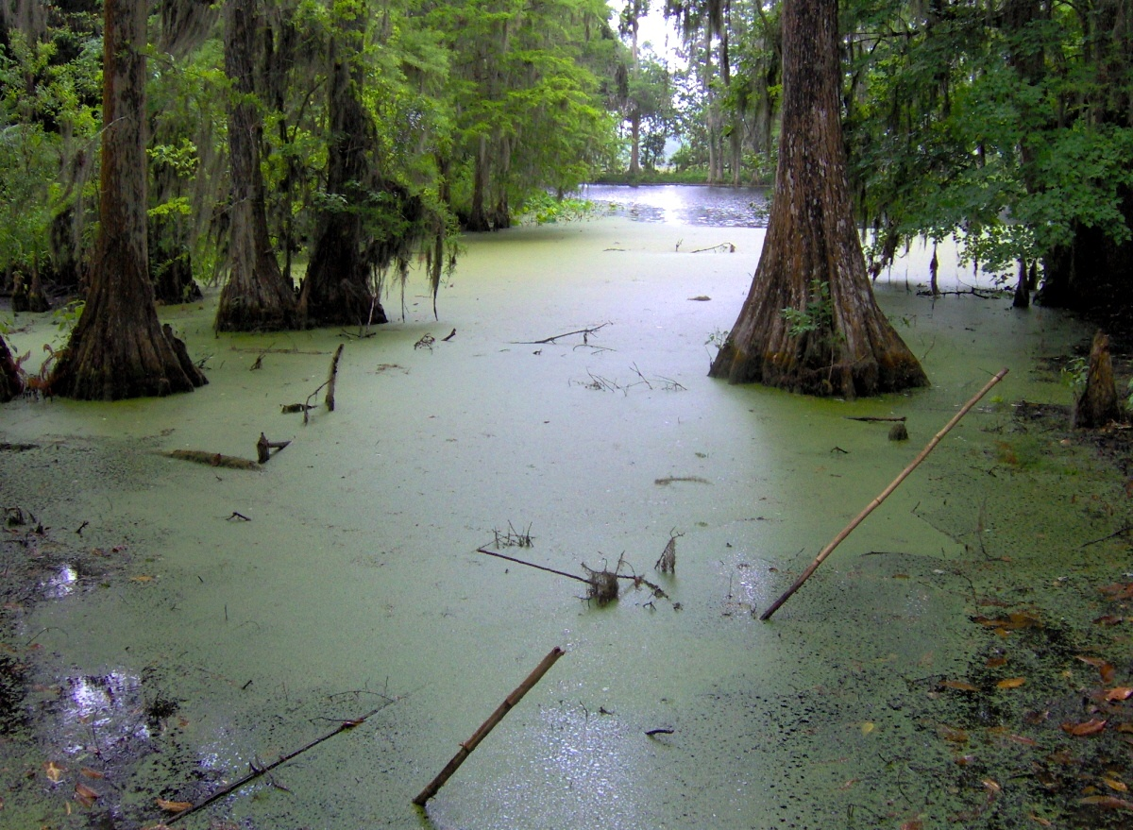
Environments of Deposition
Swamps

Slide 22
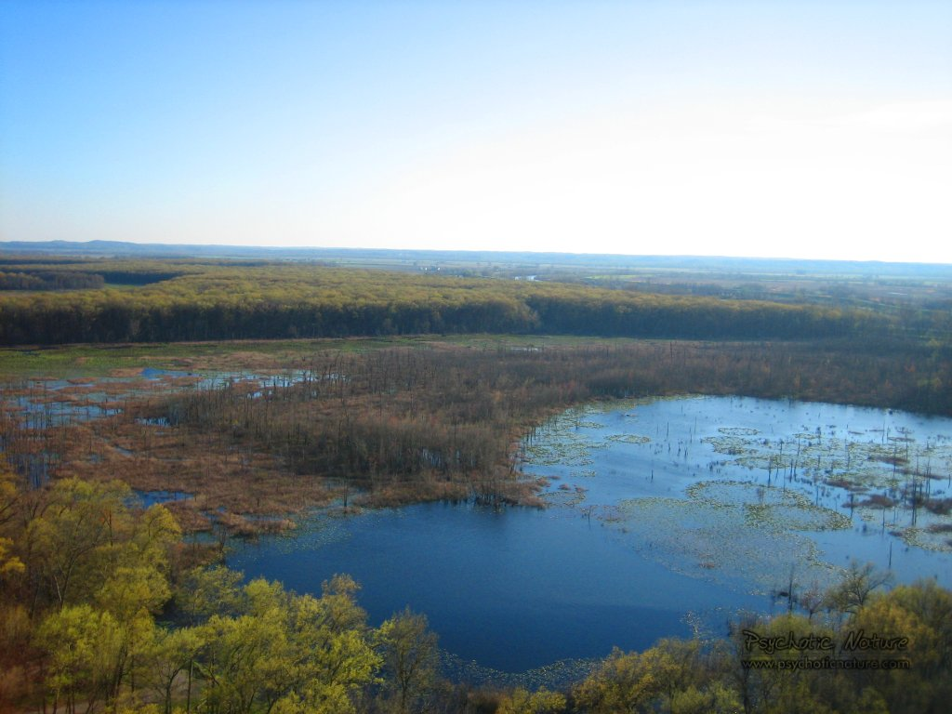
Environments of Deposition
Marshes

Slide 23
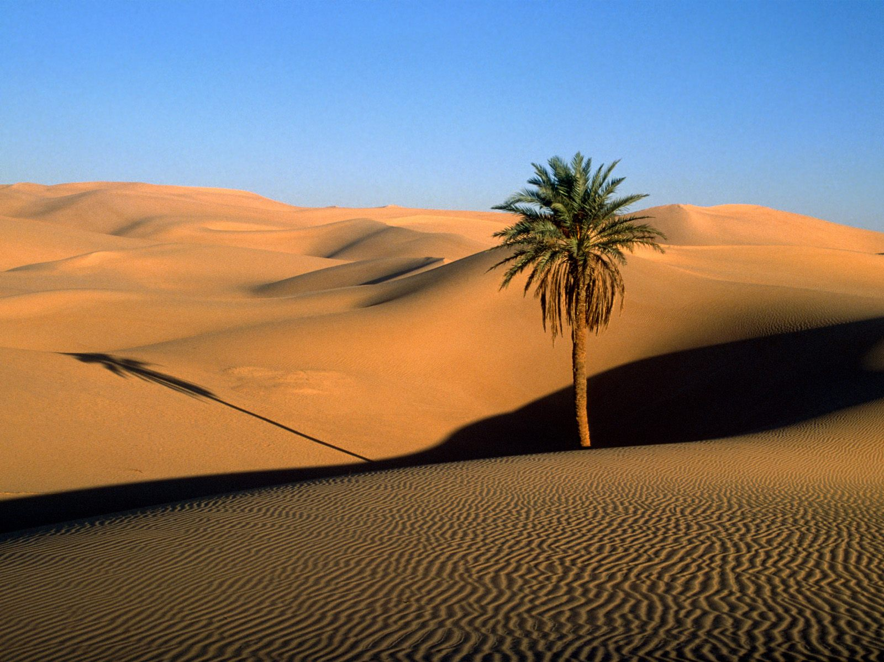
Environments of Deposition
Deserts

Slide 24
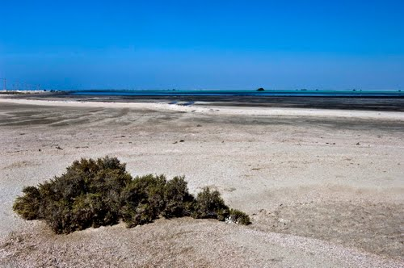
Environments of Deposition
Hot Coastal

Slide 25
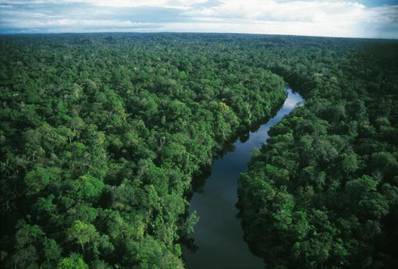
Environments of Deposition
Tropical

Slide 26
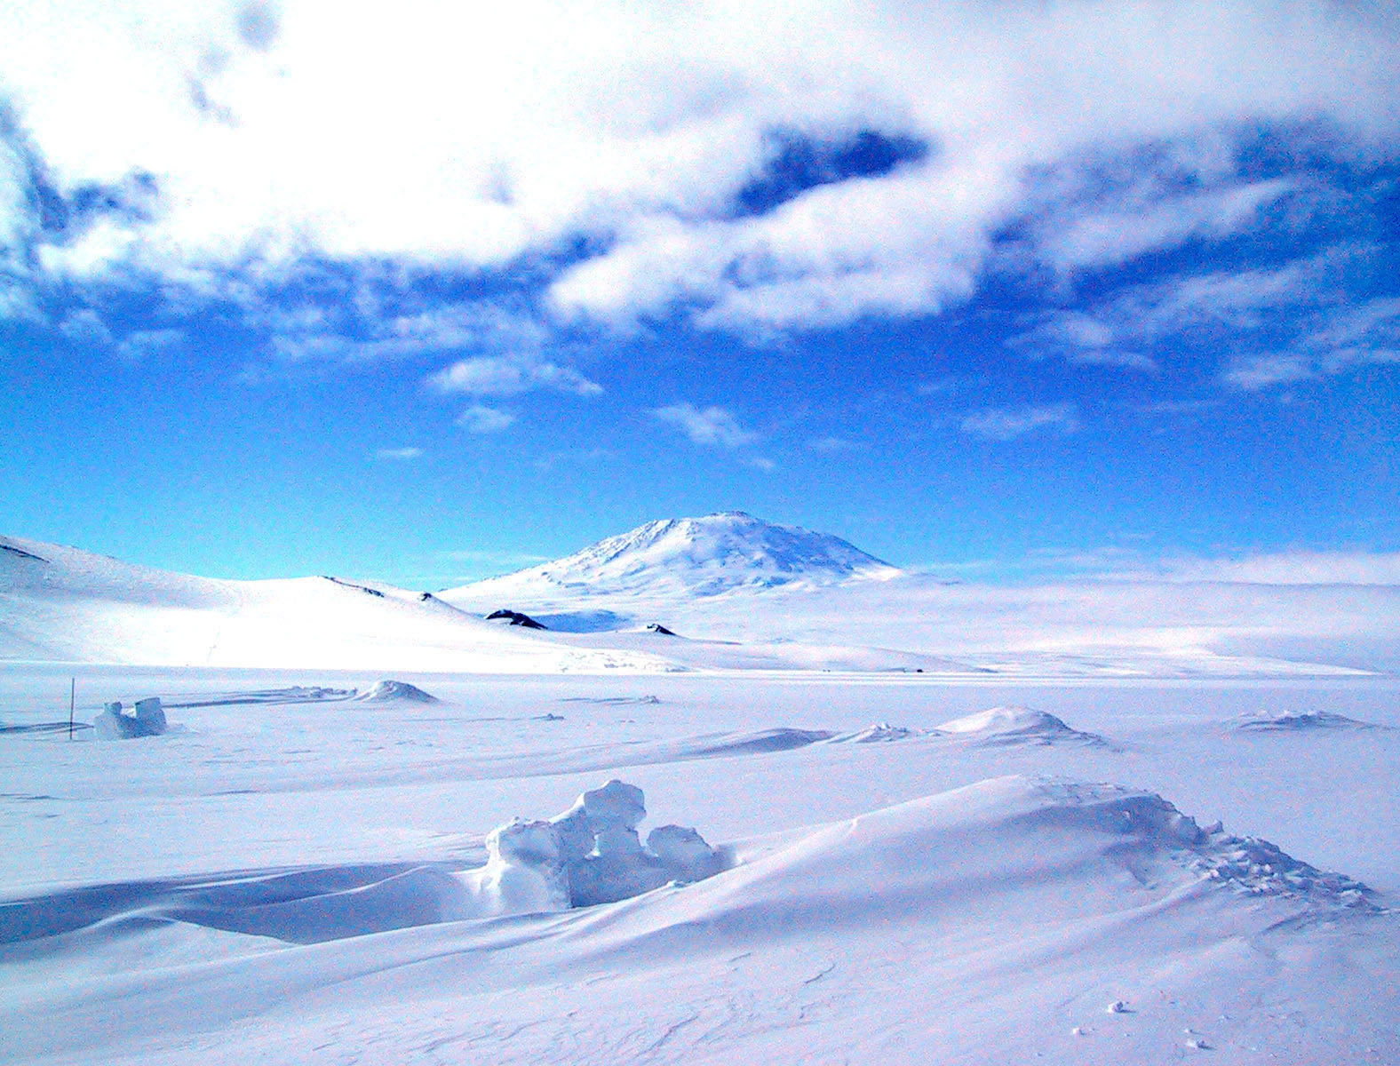
Environments of Deposition
Glacial

Slide 27
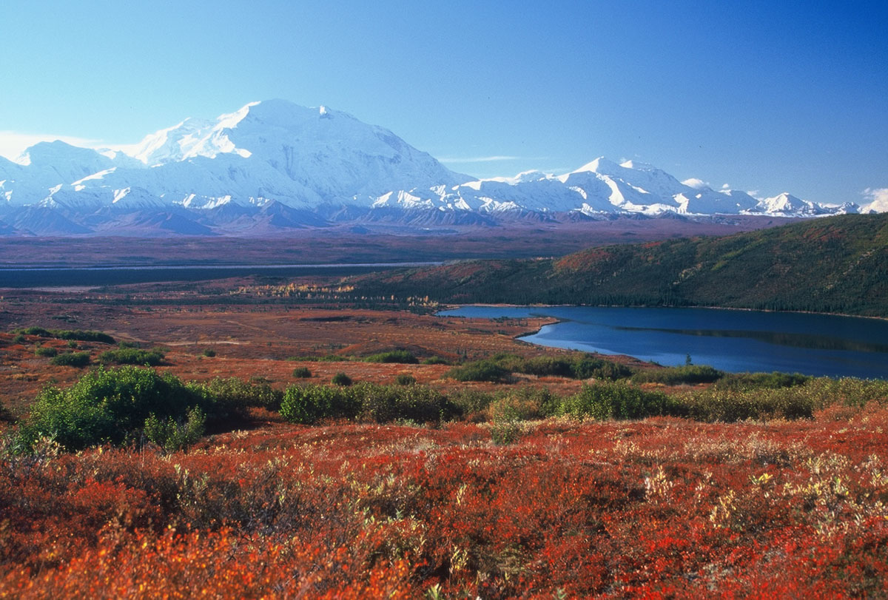
Environments of Deposition
Periglacial

Slide 28
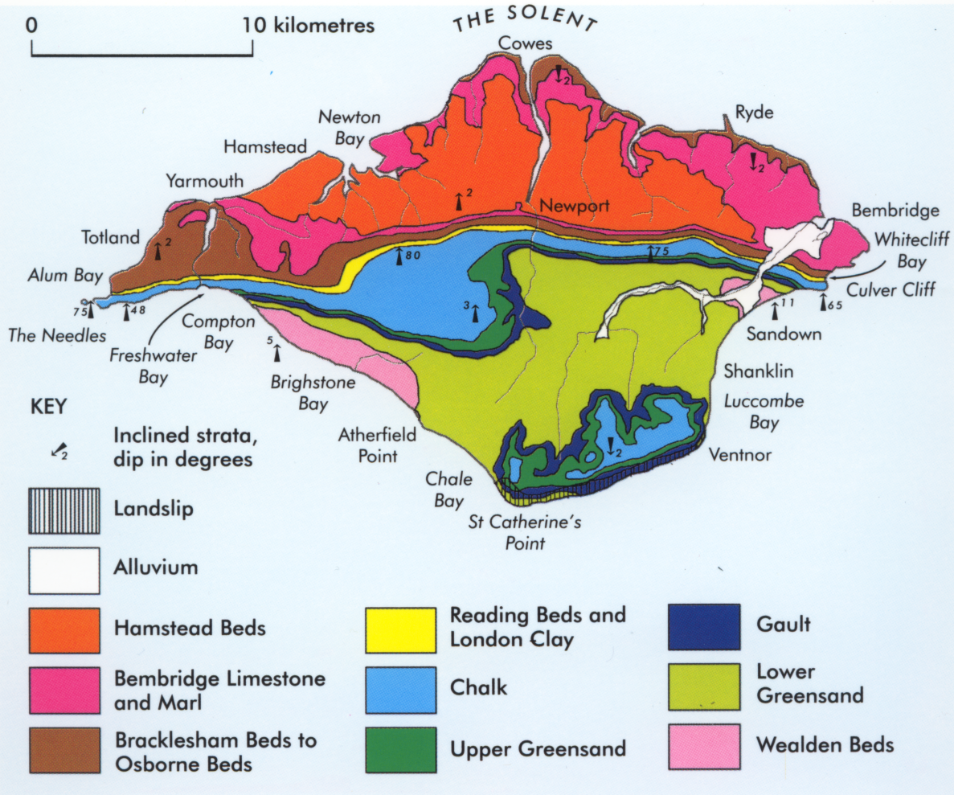

Isle of Wight Geology

Slide 29
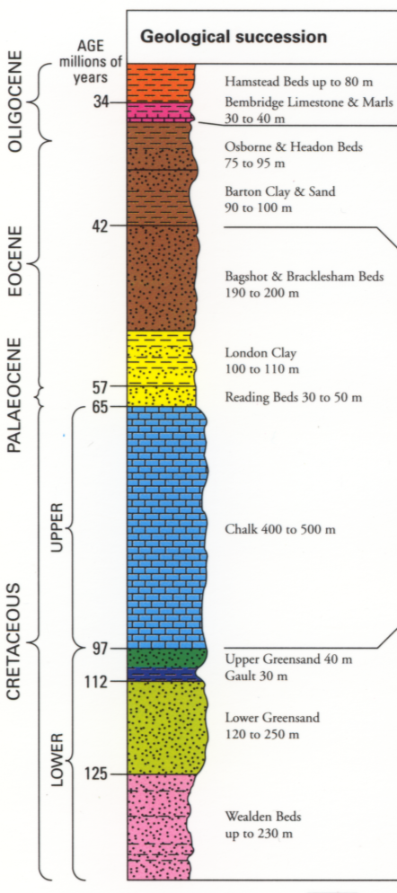
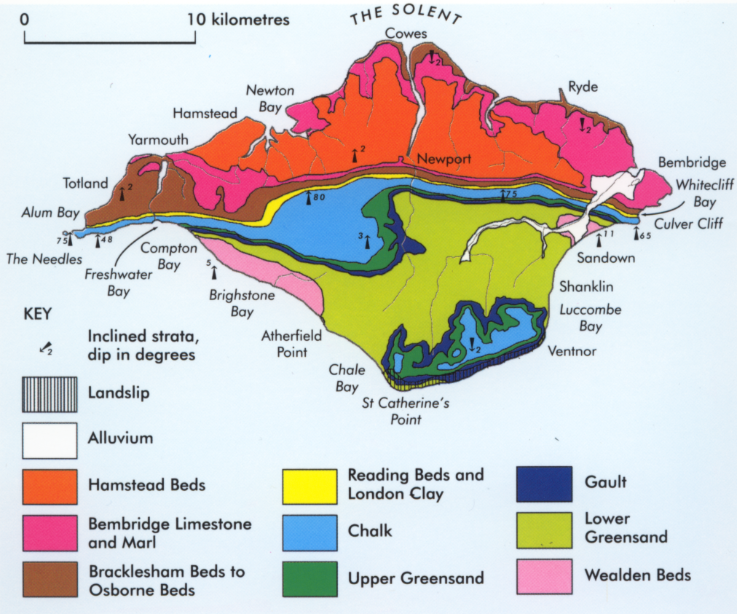
Isle of Wight Geology

Slide 30
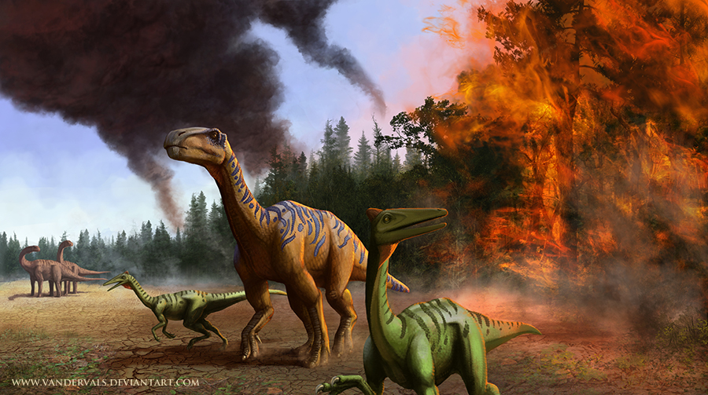
Cretaceous World

Slide 31

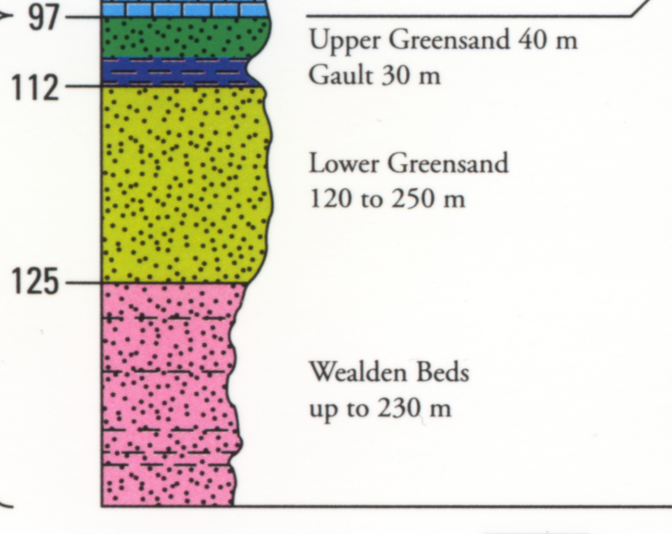
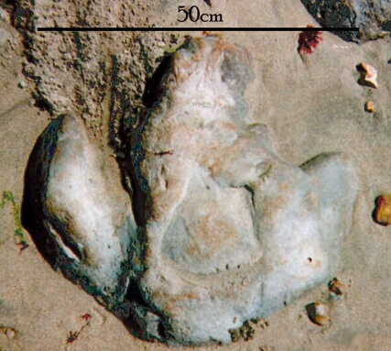
Wealden
Abundant freshwater bivalves & snails
Plant remains including ferns, pine cones & logs
Rare insects, turtles & dinosaur remains
Oldest rocks on island
Red, green, purple & grey mudstones
Limestone & sandstone
Freshwater rivers
Swamps & lakes
Brighstone Bay, Yaverland, Sandown Bay

Slide 32
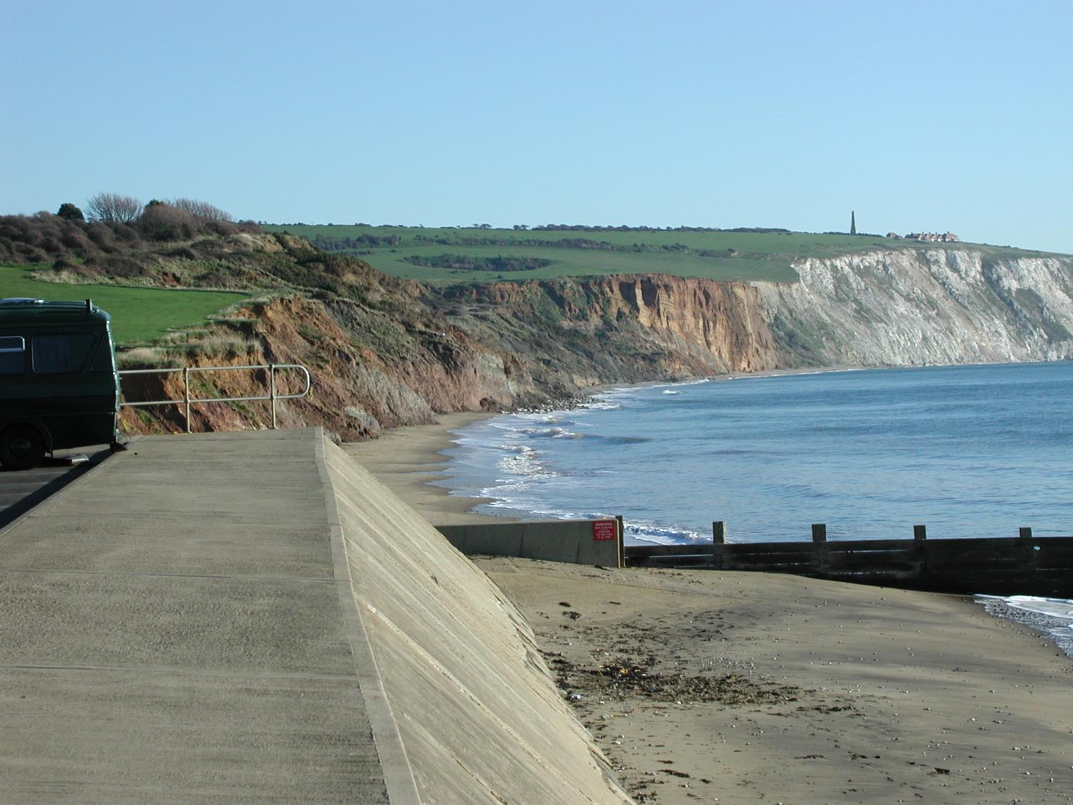
Yaverland

Slide 33
Lower Greensand Group
Sandstone
Ammonites, bivalves, echinoids & crabs
Fully marine
Shallow, current swept sea
Close to land
Calmer periods of mud deposition
Compton Bay, Chale Bay, Luccombe Bay, Yaverland

Slide 34
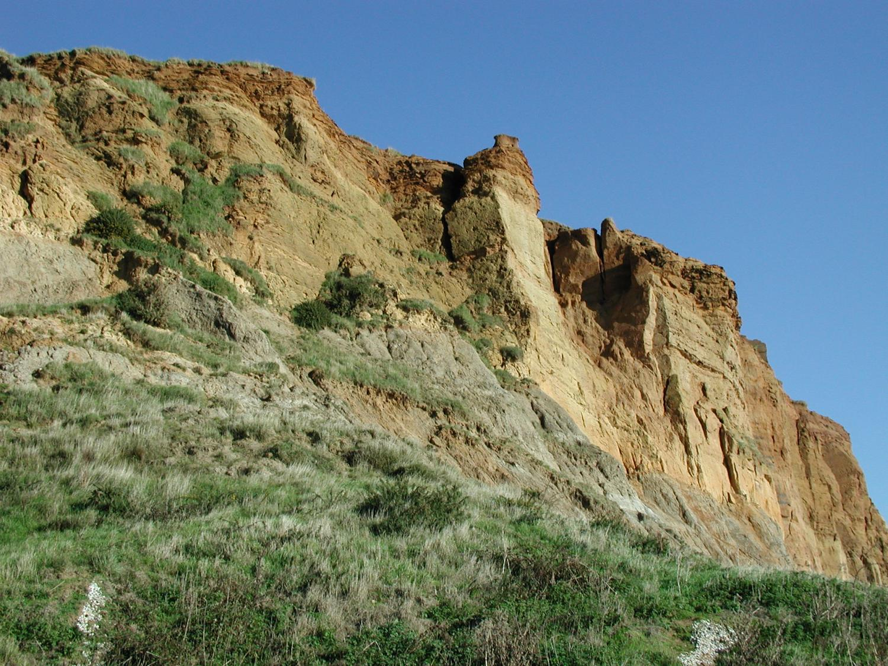
Sandown Bay

Slide 35
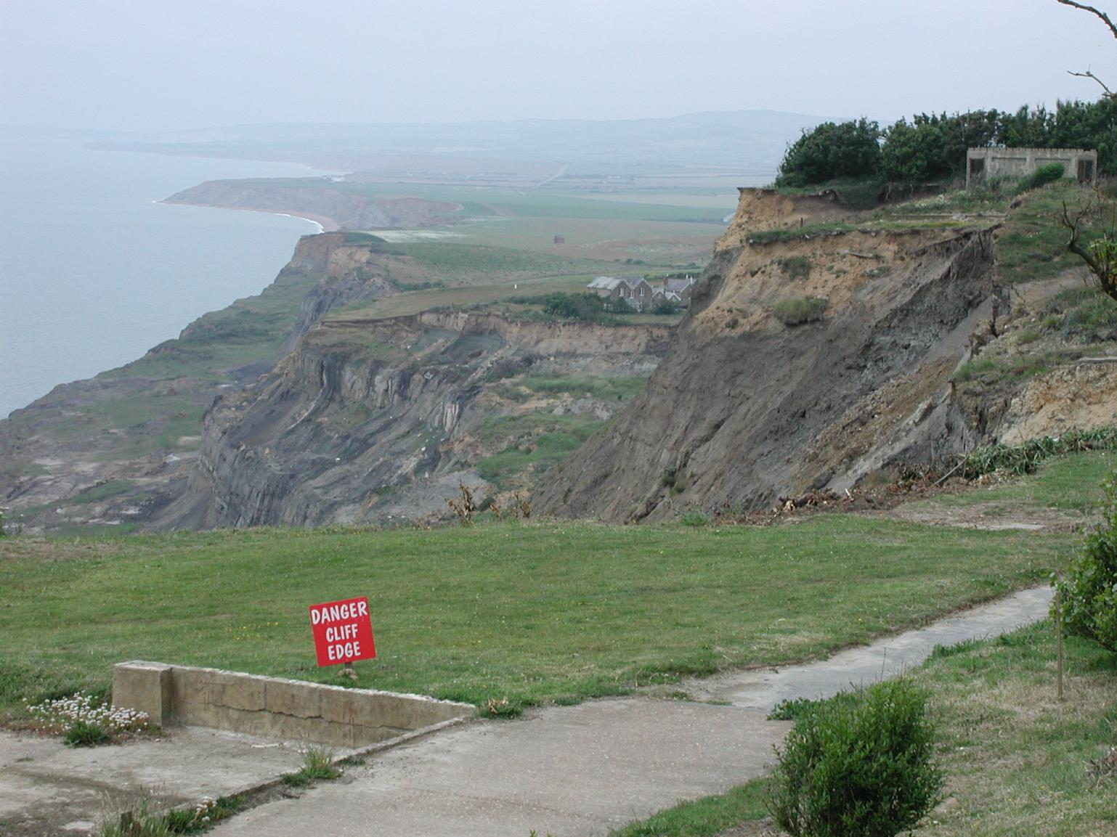
Chale Bay

Slide 36
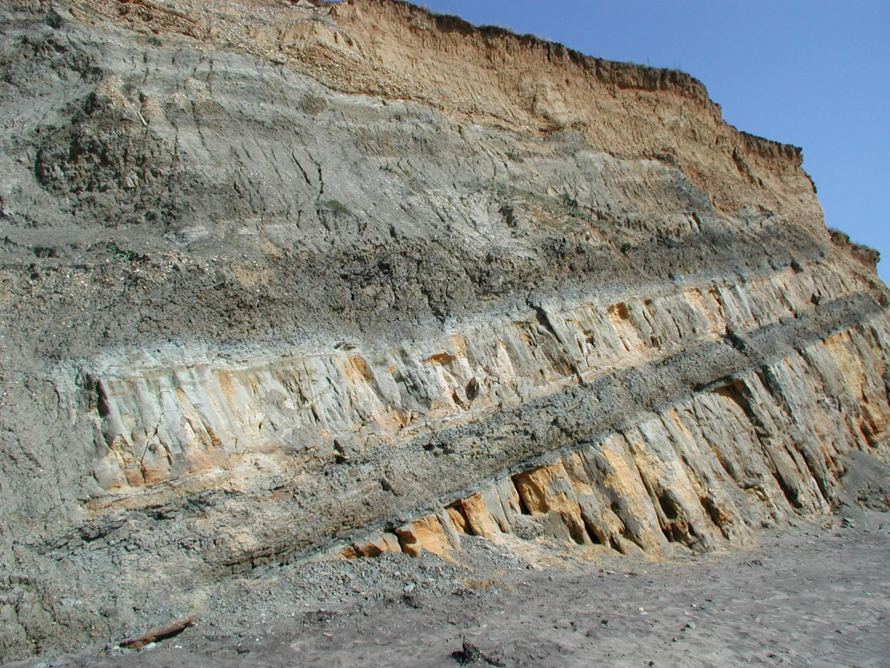
Brighstone Bay

Slide 37
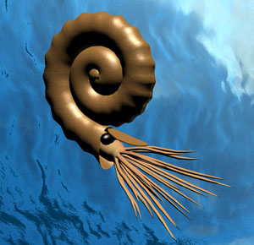
Gault Clay
Rich in ammonites & other marine shells
Rapidly breaks down into a soft clay
‘Blue Slipper’
Soft dark grey mudstone
Landslides!
Muddy sea
Compton Bay

Slide 38
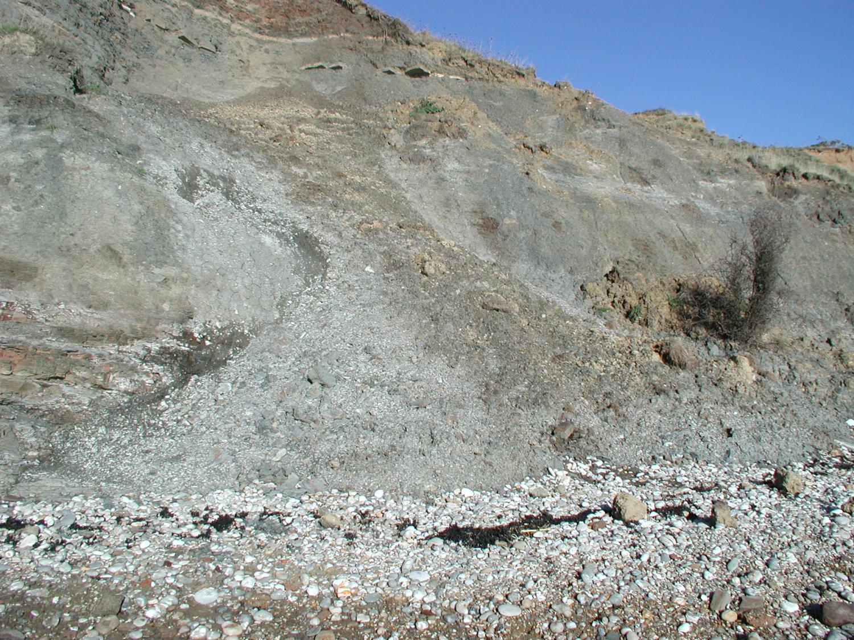
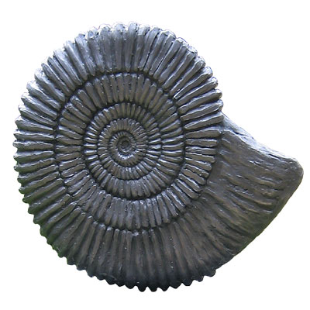
Sandown Bay

Slide 39
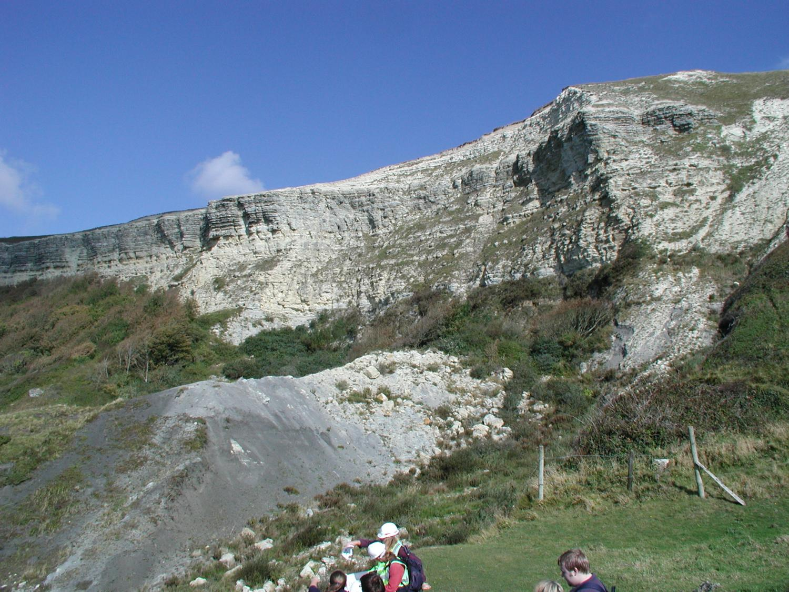
Gore Cliff

Slide 40
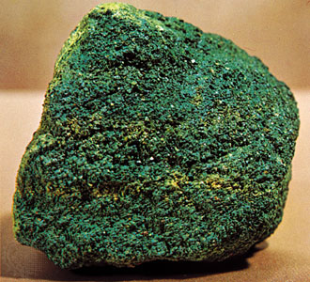
Upper Greensand
Sandstone
Rich in glauconite
Shallow, clear, turbulent sea
Compton Bay

Slide 41
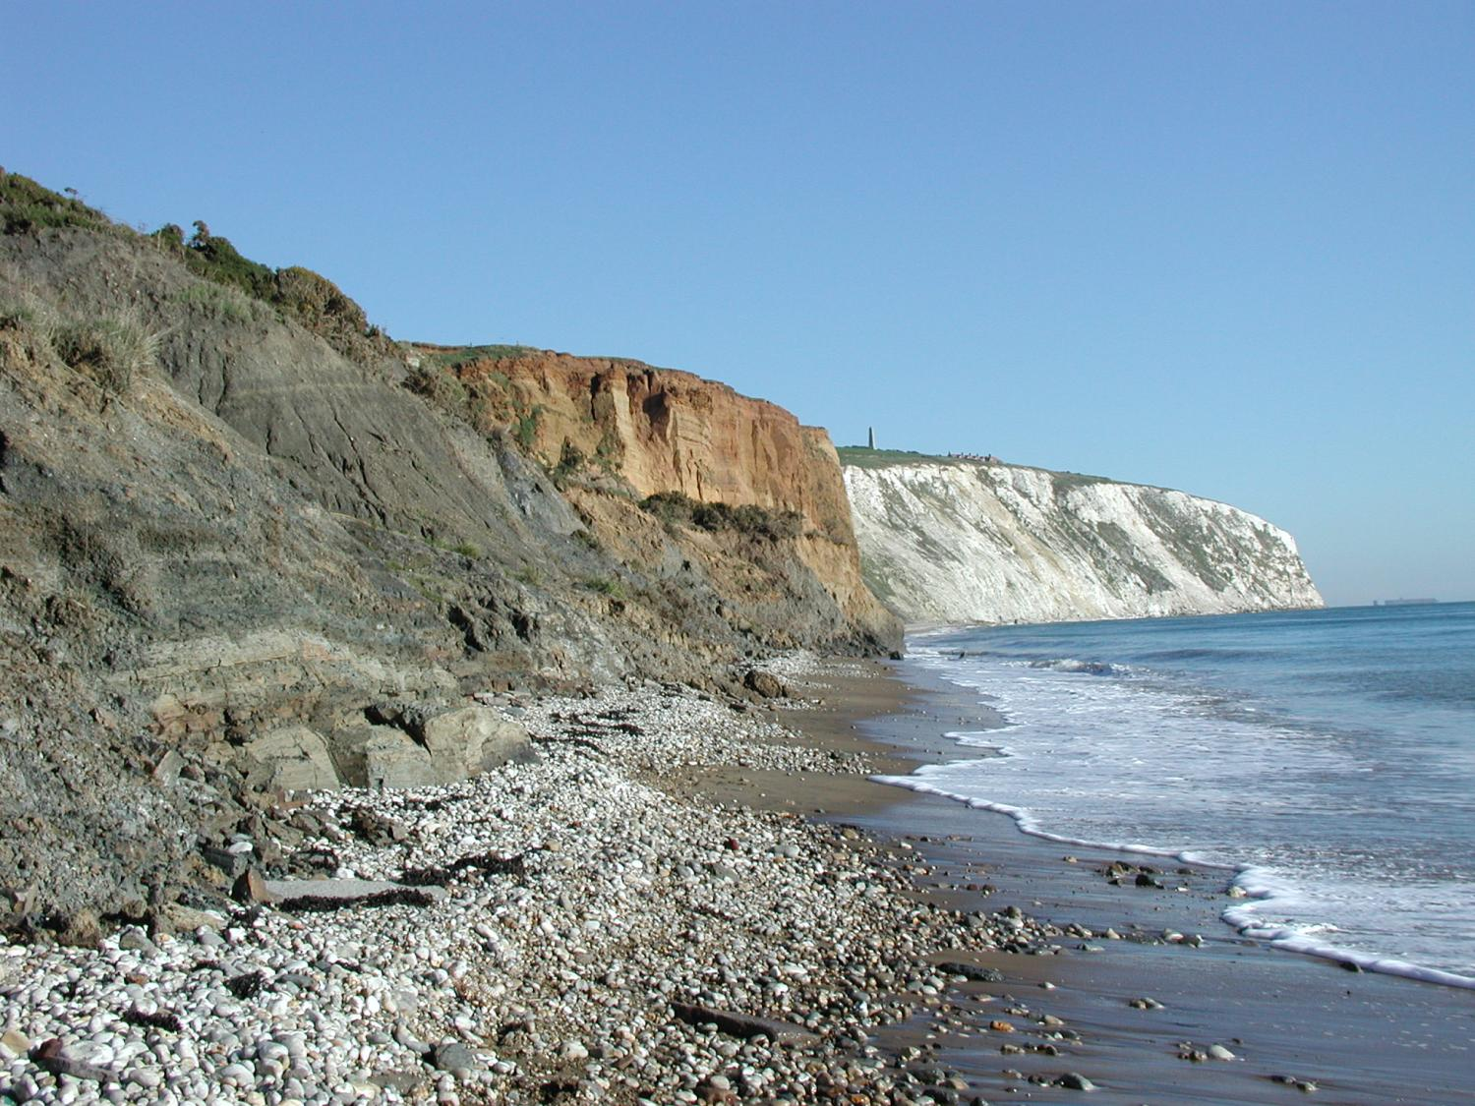
Sandown Bay

Slide 42
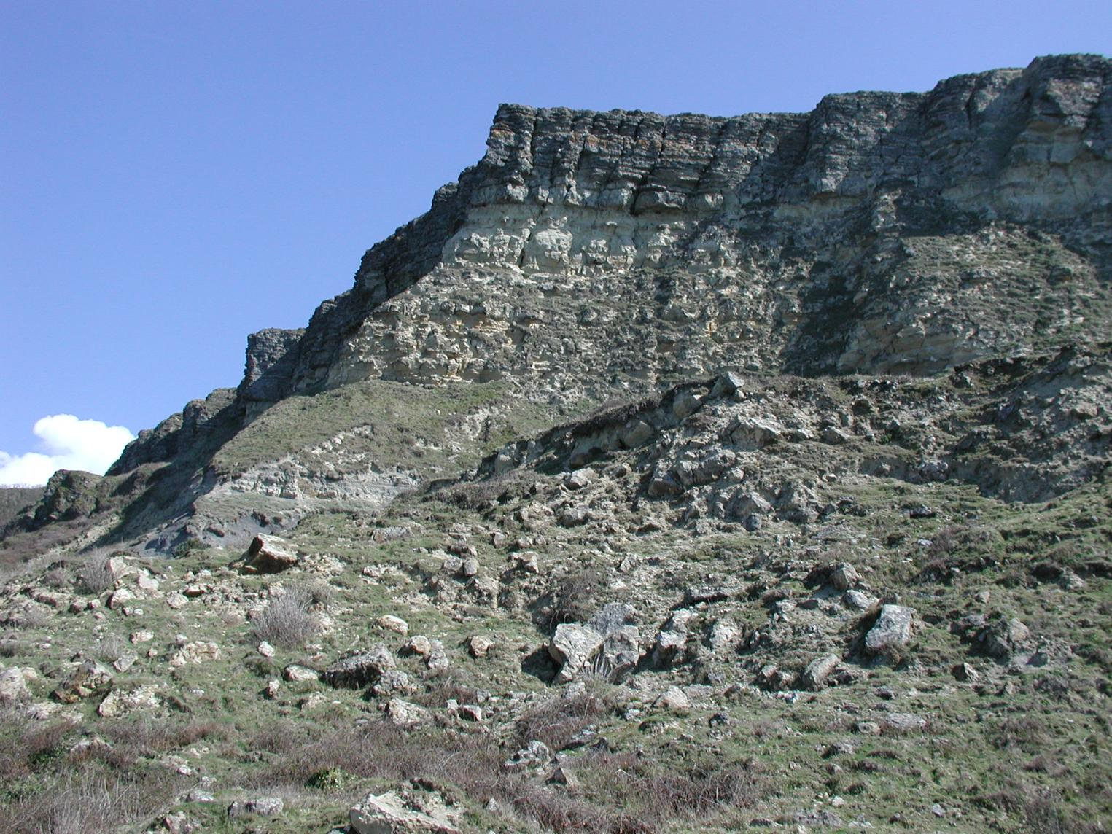
Blackgang

Slide 43
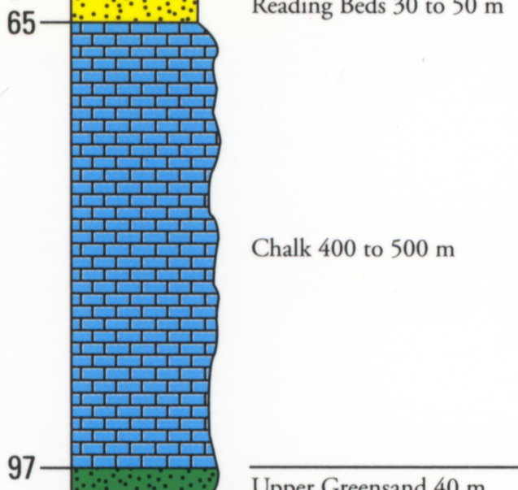
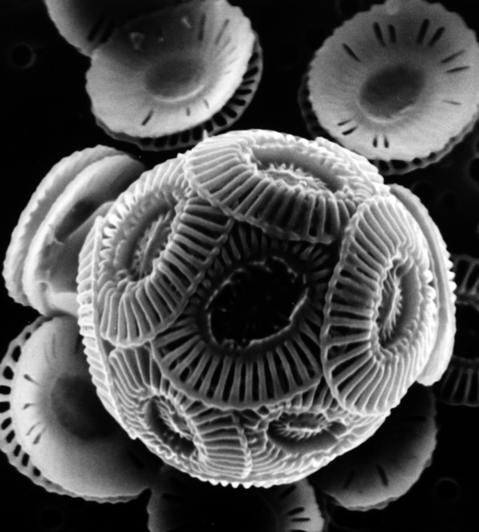
Chalk
Soft white limestone
Contains very little sand or mud
Almost entirely composed of broken up fossil remains
Minute algae (coccoliths)
Marine bivalves & sea-urchins
Lines of black flints
Shallow to moderately deep sea
Far from land
Freshwater Bay, Whitecliff Bay, Culver Cliff

Slide 44
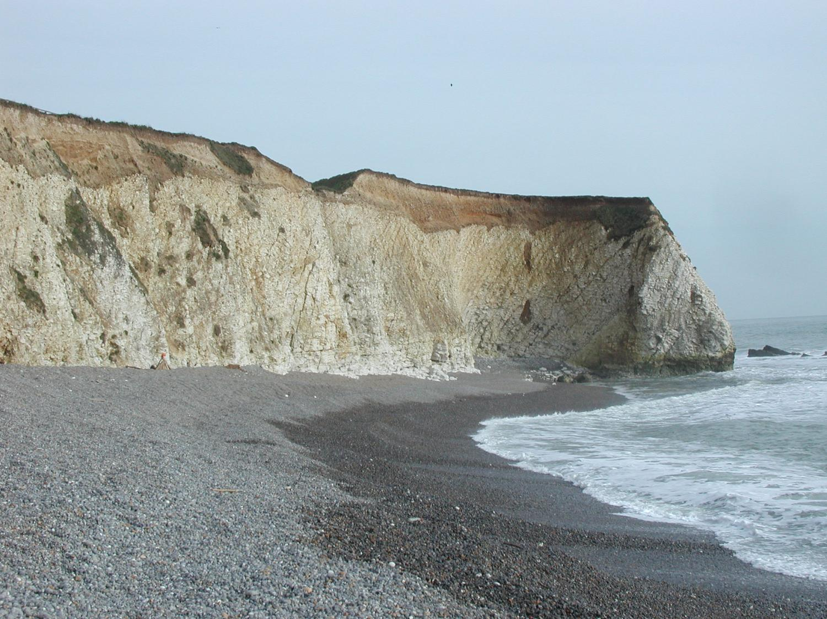


Freshwater Bay

Slide 45

Atherfield Point

Slide 46

Compton Bay

Slide 47

Alum Bay

Slide 48





That Was The Cretaceous World

Slide 49


Then – The End of the World !!!!!!

Slide 50


No More Dinosaur Isle ????
X

Slide 51





What Killed all the Dinosaurs?

Slide 52





Cretaceous/Tertiary Extinction Boundary
65 million years ago, earth experienced a global mass extinction event:
Dinosaurs disappeared

Slide 53

The Tertiary World

Slide 54


Reading Beds
Rapid alternations of brightly coloured sands & clays
Caused by oxidised iron minerals which coat the sand grains
Paler colours deposited in water
Deeper colours in environments that periodically dried out
Underwent tropical weathering
Rivers, lakes & estuaries
Alum Bay, Whitecliff Bay

Slide 55

Alum Bay

Slide 56

London Clay
Silts & Clays
Shallow muddy sea close to land
Alum Bay, Whitecliff Bay

Slide 57

Alum Bay

Slide 58

Bagshot & Bracklesham Beds
Rivers & brackish estuaries
Bivalves & gastropods
Plants common
Rare reptiles & mammals
Silts, Clays
& Sands
Alum Bay, Whitecliff Bay

Slide 59

Alum Bay

Slide 60

Alum Bay

Slide 61


Barton Clay & Sand
Clays & Sands
Gastropods & plants common
Large foraminifera locally abundant
Marine & brackish estuaries & lagoons
Alum Bay, Whitecliff Bay

Slide 62

Osborne & Headon Beds
Abundant bivalves & plants
Rare reptiles & mammals
Deposited in modern day equivalent of mangrove swamps
Varying degrees of saltiness
Limestones & Marls
Swamps, estuaries & brackish lagoons
Totland, Whitecliff Bay

Slide 63



Bembridge Limestone
Limestones & Marls
Crowded with freshwater & land snails
Contains rare fish
Also mammal teeth & bones
Plant remains
Some so well preserved contain original colour banding
Freshwater lakes & rivers
Bembridge, Newton Bay

Slide 64

Whitecliff Bay

Slide 65

Hamstead Beds
Clays & Sands
Cover much of the northern part of the island
Soft & rarely exposed
Multicoloured clays & sands
Prone to landslidding
Contain brackish & freshwater shells & plants
Including a dark clay crowded with the roots & leaves of water lilies
Freshwater & brackish swamps, lakes & estuaries
Hamstead Cliffs

Slide 66

The
Problems
Coastal Erosion & Landslides

Slide 67
The Undercliff

Slide 68

Castlehaven Undercliff

Slide 69

2002

Slide 70

2003

Slide 71

2003

Slide 72

2003

Slide 73

2003

Slide 74

The Orchard, major landslide 2001

Slide 75


Slide 76

2001

Slide 77

2001

Slide 78

2002

Slide 79

2002

Slide 80

Blackgang Chine

Slide 81


2001

Slide 82

2007

Slide 83

2001

Slide 84

2007

Slide 85

2007

Slide 86


Slide 87






Notes:
The system comprises vibrating wire piezometers installed within standard Casagrande piezometer tubes set in deep boreholes
Surface tiltmeters at the crest of the slope, where rotational movements can be expected, and
Surface long-range crackmeter and extensometers to detect horizontal displacements across established tension cracks
All these sensors are wired into data loggers with permanent power supply and telecom connections for remote interrogation and to enable alarms to be automatically raised.
Cost of system including ground works but not drilling costs £20-£25k.

Slide 88


Coastal Defence Options
Hold the line
  Retaining the existing line of defence through maintenance of existing defences or by constructing new defences where existing structures no longer provide sufficient protection.

Slide 89


Coastal Defence Options
Retreat the line
  Actively manage the rate and process by which the coast retreats (known as 'managed retreat')

Slide 90


Coastal Defence Options
Do nothing but monitor
  The option chosen for stretches of coastline where it is not technically, economically or environmentally viable to undertake defence works.
  The value of the built
  environment along all
  the stretches of
  coastline shaded
  blue on the map does
  not exceed the cost
  of installing coastal
  defences.

Slide 91


Coastal Defence Options
Advance the line
  Build new defences seaward of the existing line

Slide 92


Slide 93
Any
Questions?

