Slide 1

Annual Field Meeting
Engineering Geology of the French Alps, Grenoble
David Giles
Applied Geoscience Programme Manager
School of Earth & Environmental Sciences
University of Portsmouth

Slide 2
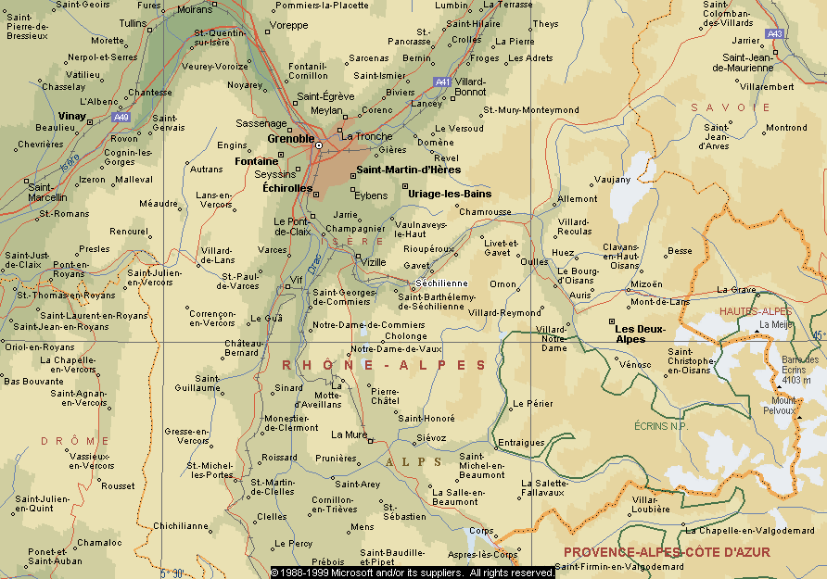
Itinerary

Slide 3
Itinerary
Stop No. | Location | Site | Topic
1 | Trièves | Montenyard Dam | Dam engineering
2 | Trièves | EDF Quarry | Glacial, fluvioglacial & glaciolacustrine deposits
3 | Trièves | Harmallière and Mas d’Avignonet Landslides | Glaciolacustrine deposits and associated slope instability
4 | Trièves | Sinard Tunnel | A51 Autoroute
Stop No. | Location | Site | Topic
5 | Trièves | Echarennes Rock Avalanche Shelter | Rock avalanche, rock avalanche shelter
6 | Trièves | Pont de Ponsonnas | Fluvioglacial deposits
7 | Matheysine | La Mure | Coal mining
8 | Matheysine | Laffrey | Romanche valley glaciations
9 | Romanche Valley | Mont Sec and Sechilienne | Deep Seated Gravitational Landslides
10 | Bourg D’Oisans | Falaise de Prégentil | Debris flows, rock avalanches
11 | Bourg D’Oisans | Torrent du Saint-Antoine | Debris flow and rock avalanche mitigation
12 | Bourg D’Oisans | Charmonetier | Rock fall
13 | Romanche Valley | Chambon Dam | Gravity dam (Time permitting)

Slide 4
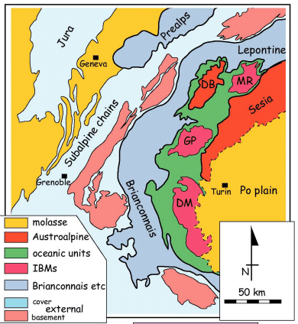
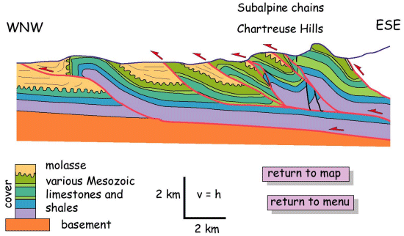
Geological
Setting

Slide 5
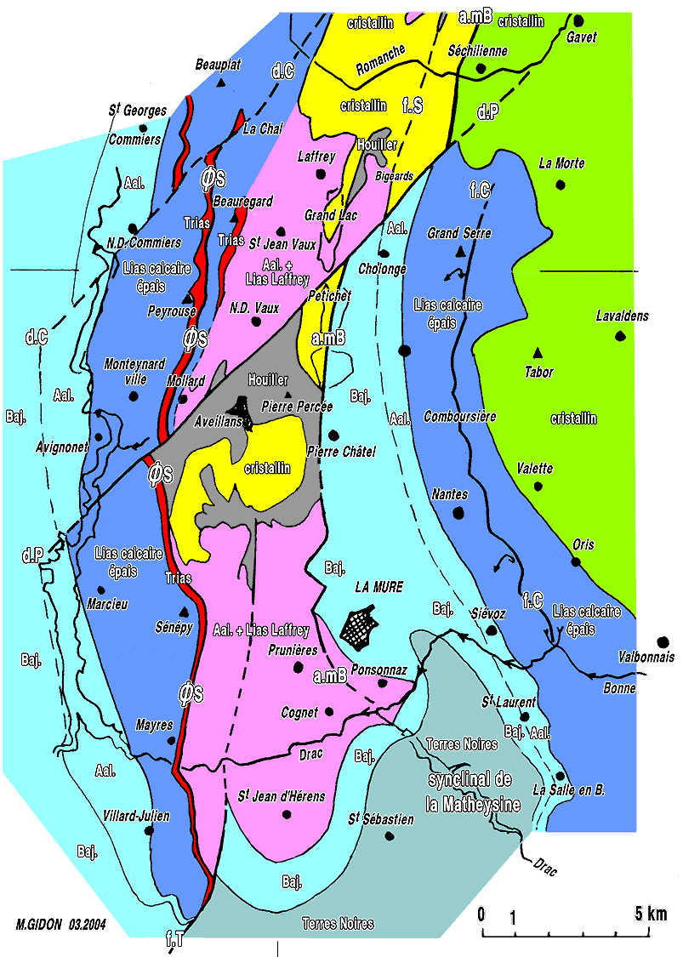
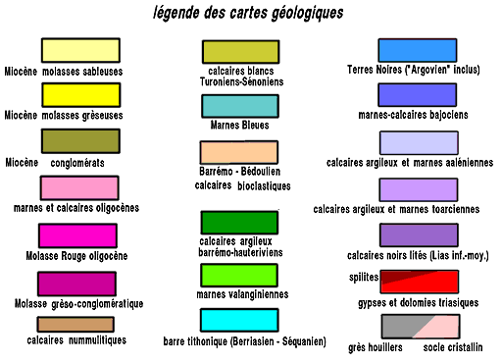
Geological
Setting

Slide 6
Some French Geo terms
Term | Translation
Sableuses | Sandy
Greseuses | Sandstone
Conglomerat | Conglomerates
Marnes | Shales
Calcaires | Limestones
Argileux | Clays
Terres Noires | ‘Black Earths’
Calcaires Argileux | Marls
Gypses | Gypsum
Dolomies | Dolomites
Houillers | Coal
Socle Cristallin | Crystalline Basement
a.mB | Belledonne Suture (accident median)
d.C | La Chal Strike Slip Fault (écrochement)
d.P | Pétichet Strike Slip Fault (écrochement)
ØS | Sénépy Thrust (chevauchement)
f.T | Thaud and Touage Faults (faille)
f.C | Comboursière Fault (faille)
f.S | Sabot Fault (faille)

Slide 7
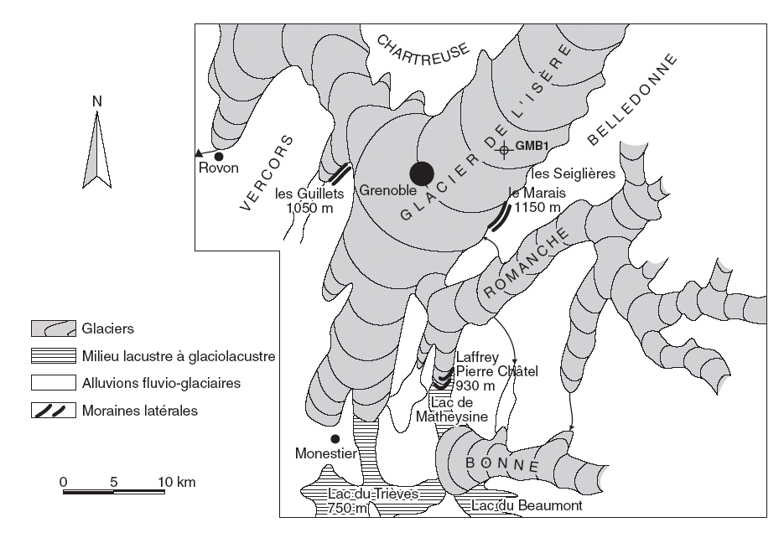
Quaternary Setting
Glacial | Interglacial
Wurm
 | Riss – Wurm
Riss
 | Mindel – Riss
Mindel
 | Gunz - Mindel
Gunz
(Donau)

Slide 8
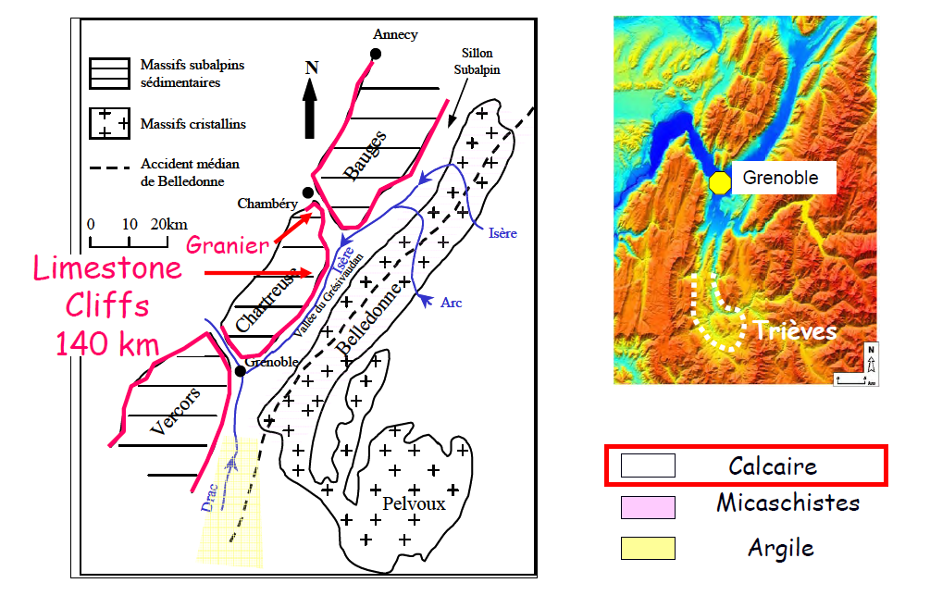
Geological Hazards
Rock Avalanche

Slide 9
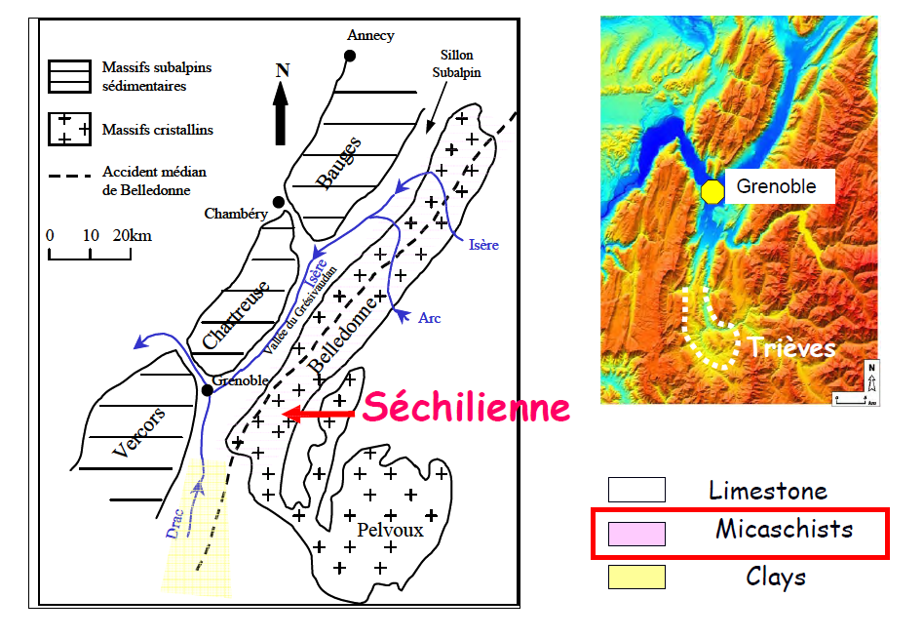
Geological Hazards
DSGS

Slide 10
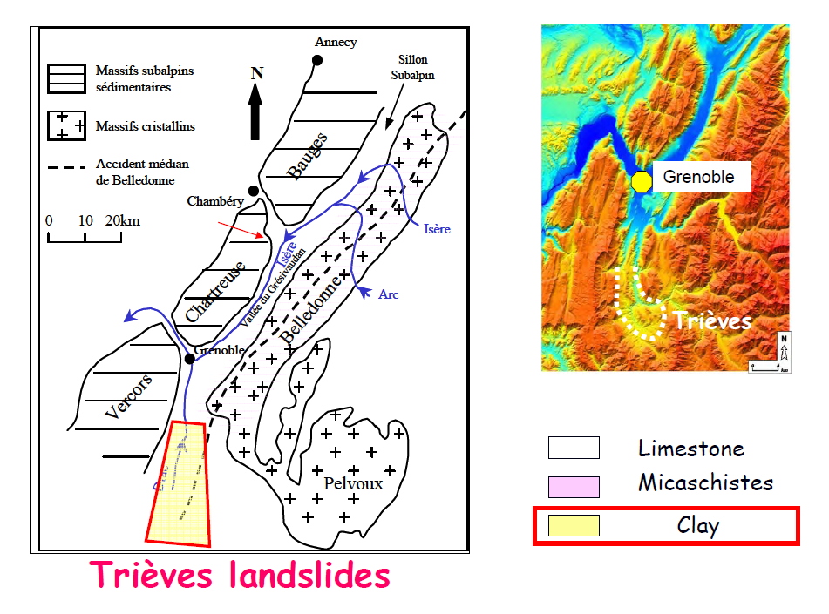
Geological Hazards
Glaciolacustrine Deposits

Slide 11
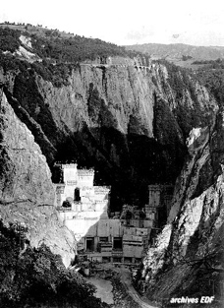
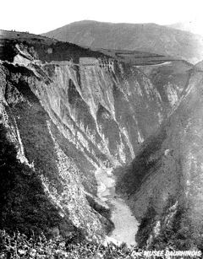
Barrage de Montenyard

Slide 12
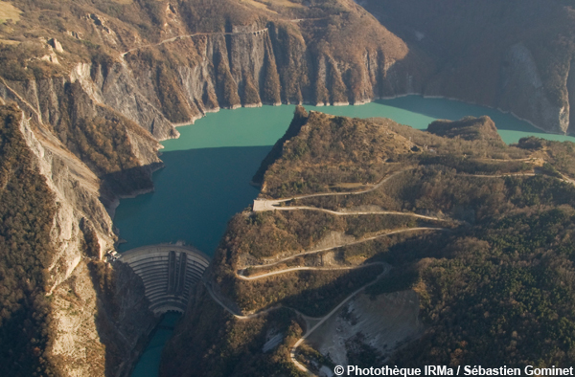
Drac Dams

Slide 13
Mas d’Avignonet and Harmallière Landslides

Slide 14
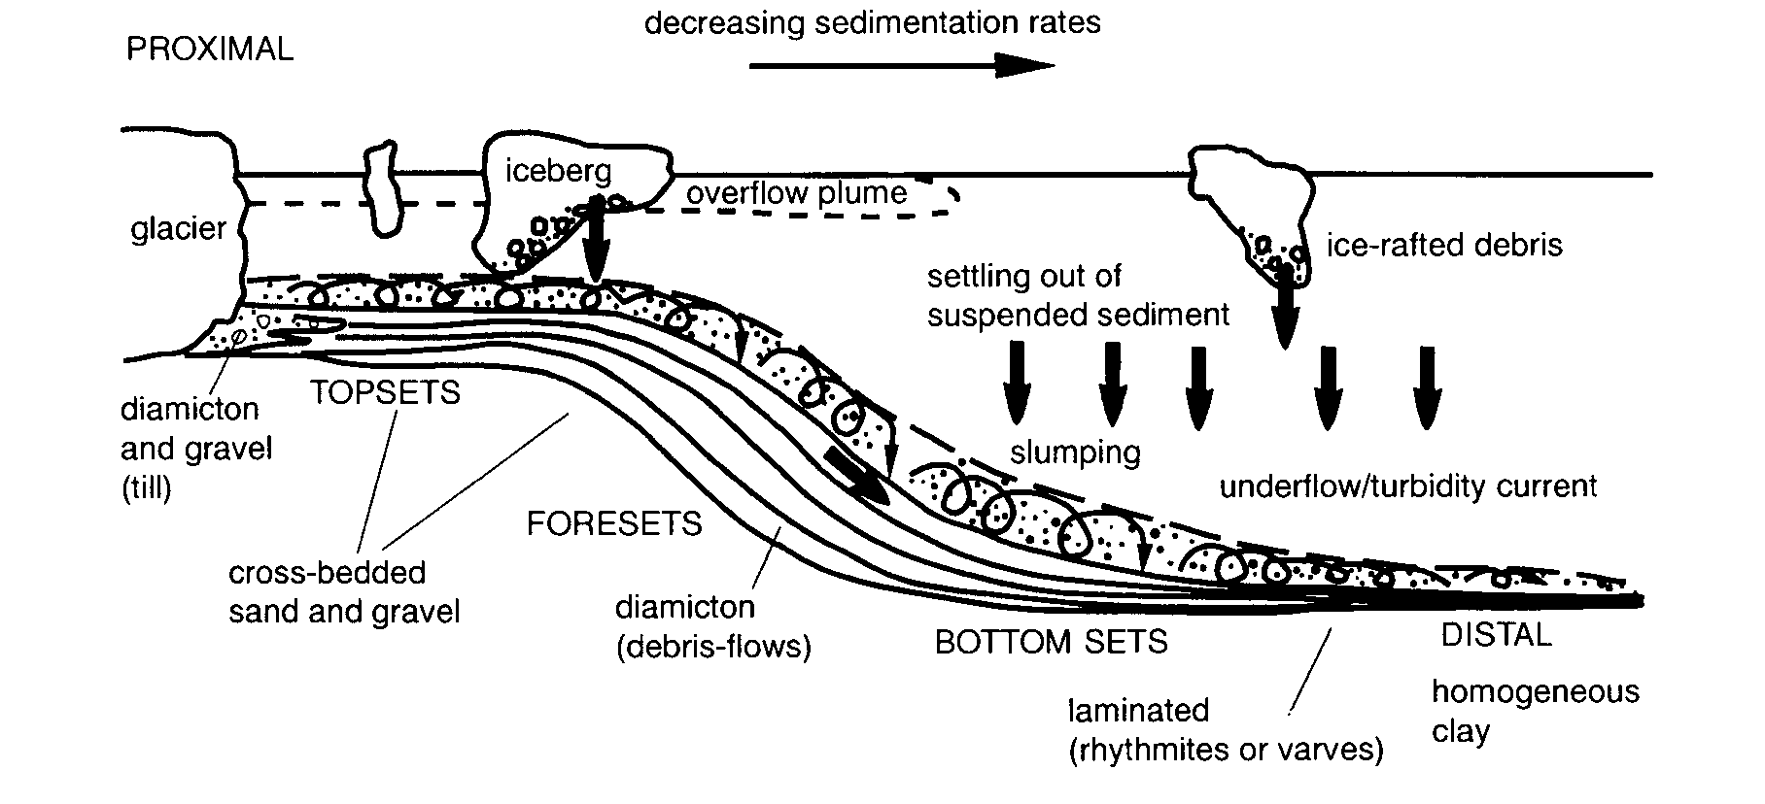
Mas d’Avignonet and Harmallière Landslides

Slide 15
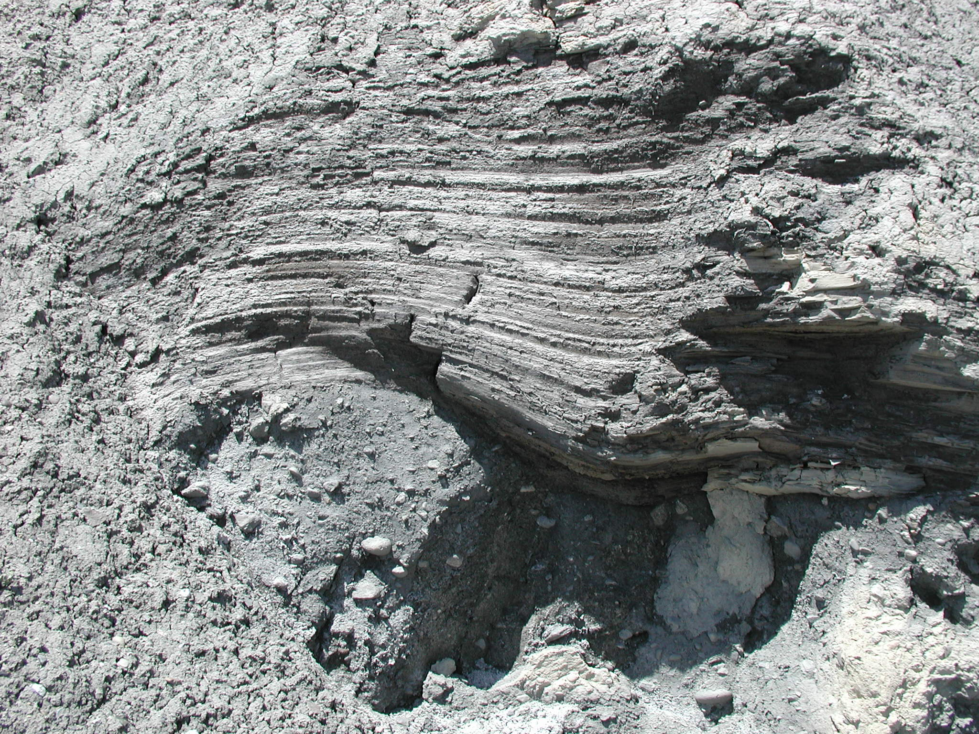
Mas d’Avignonet and Harmallière Landslides

Slide 16
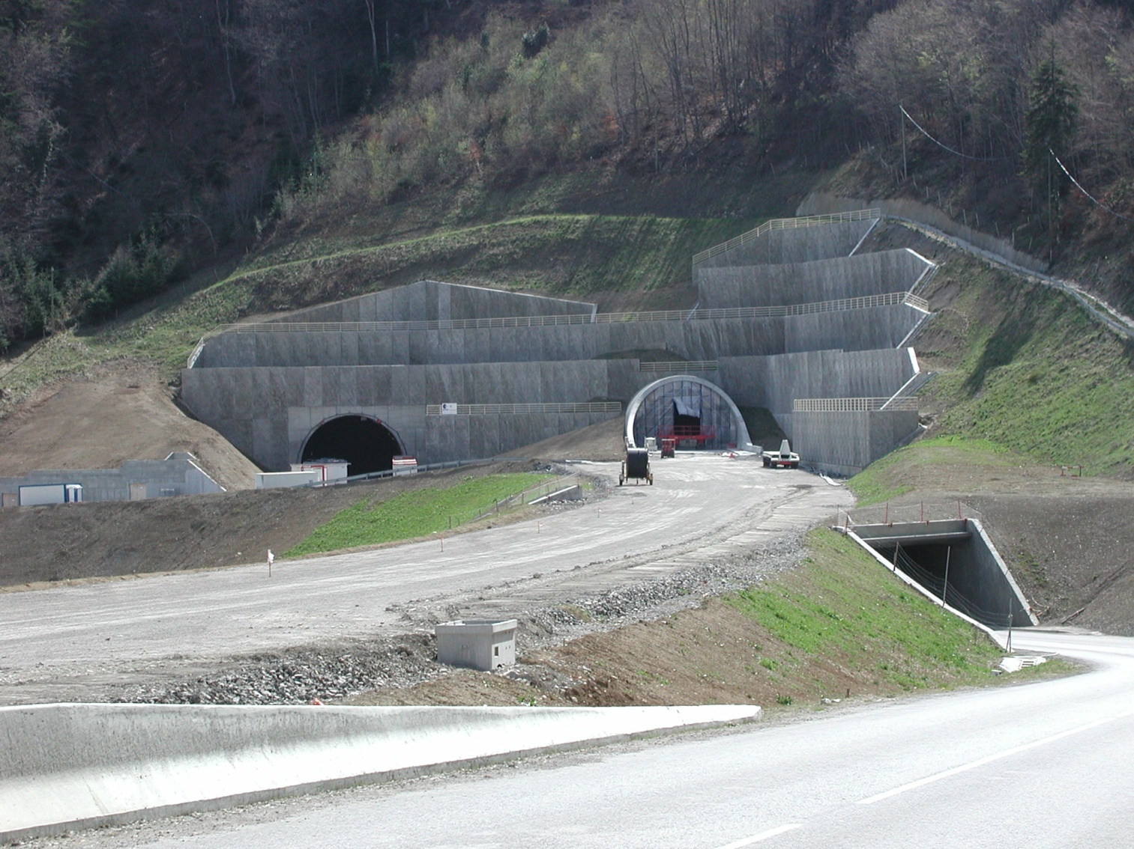
Sinard Tunnel

Slide 17
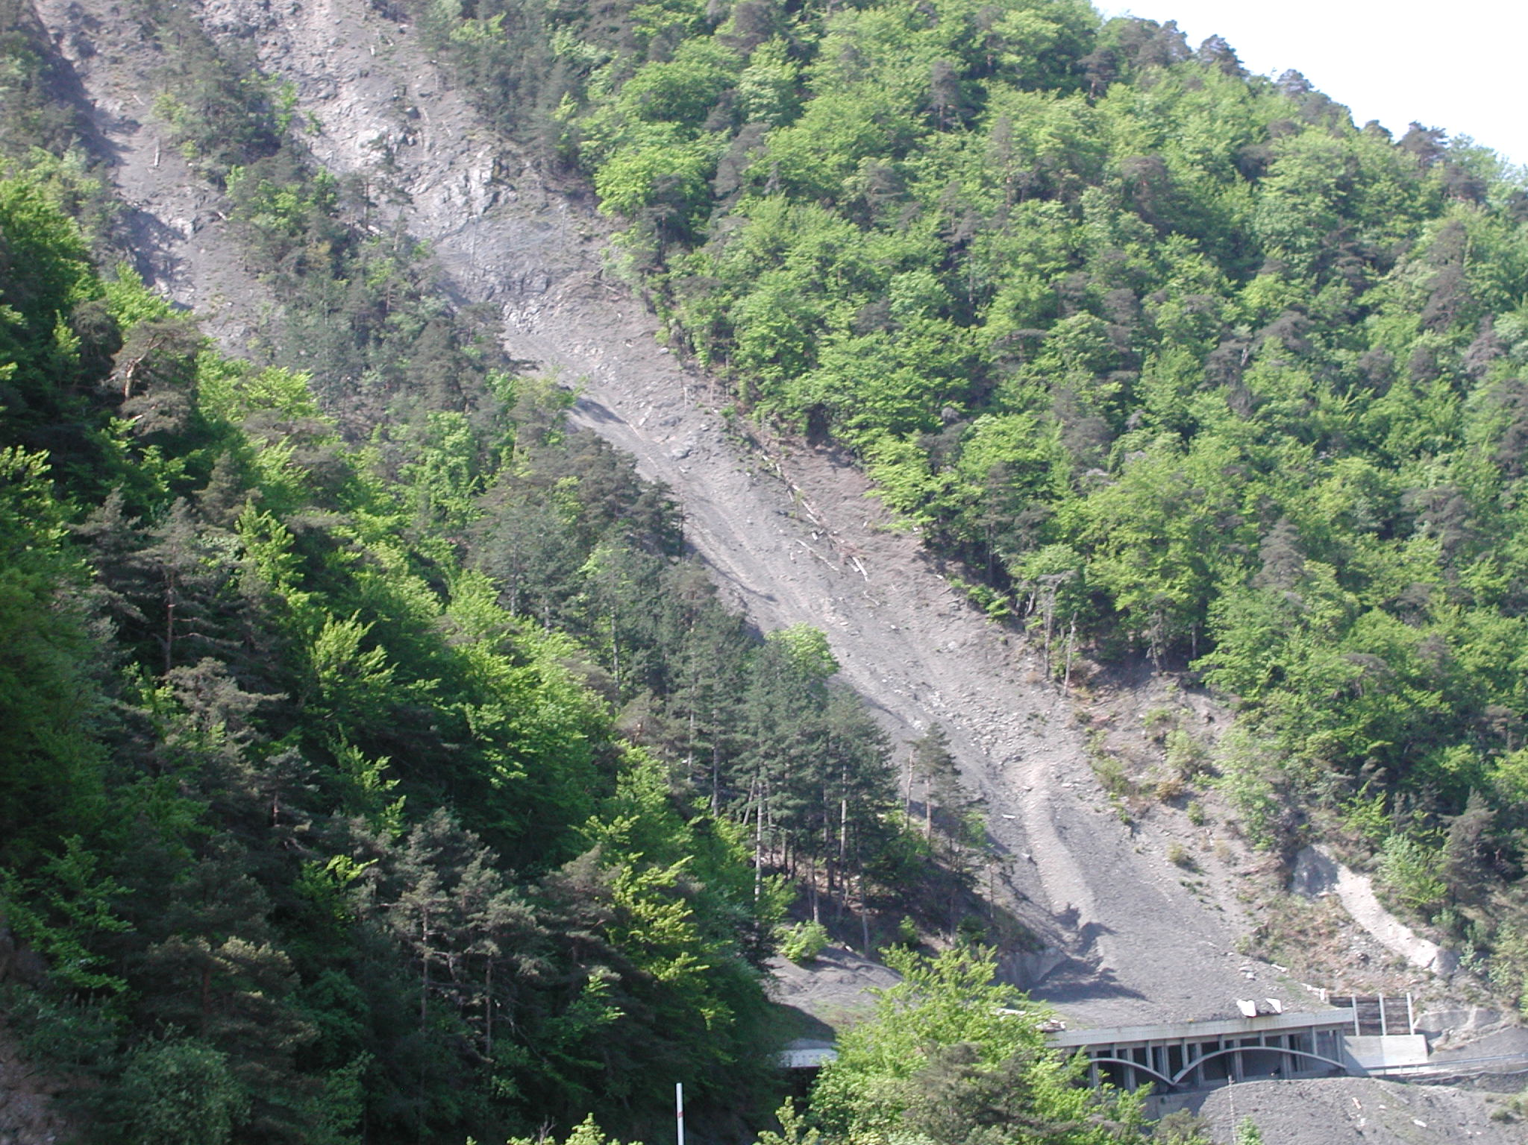
Echarennes Rock Avalanche Shelter

Slide 18
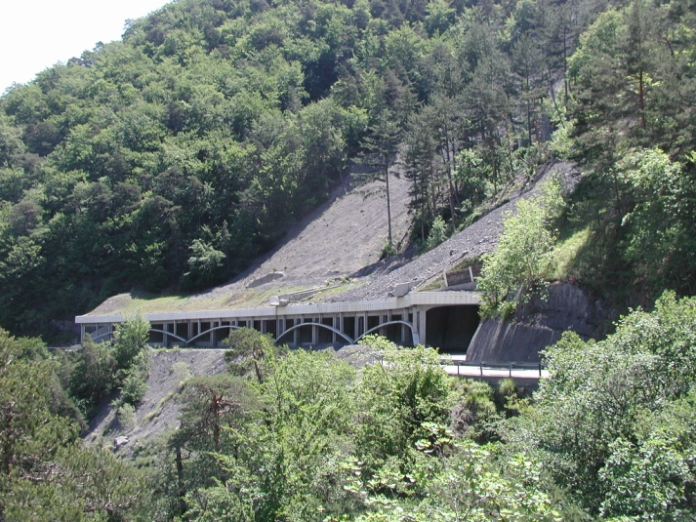
Echarennes Rock Avalanche Shelter

Slide 19
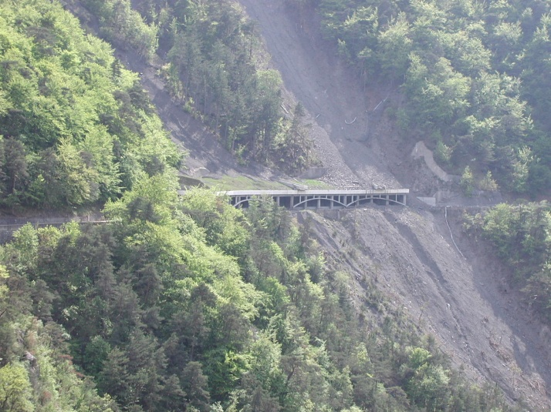

Echarennes Rock Avalanche Shelter

Slide 20
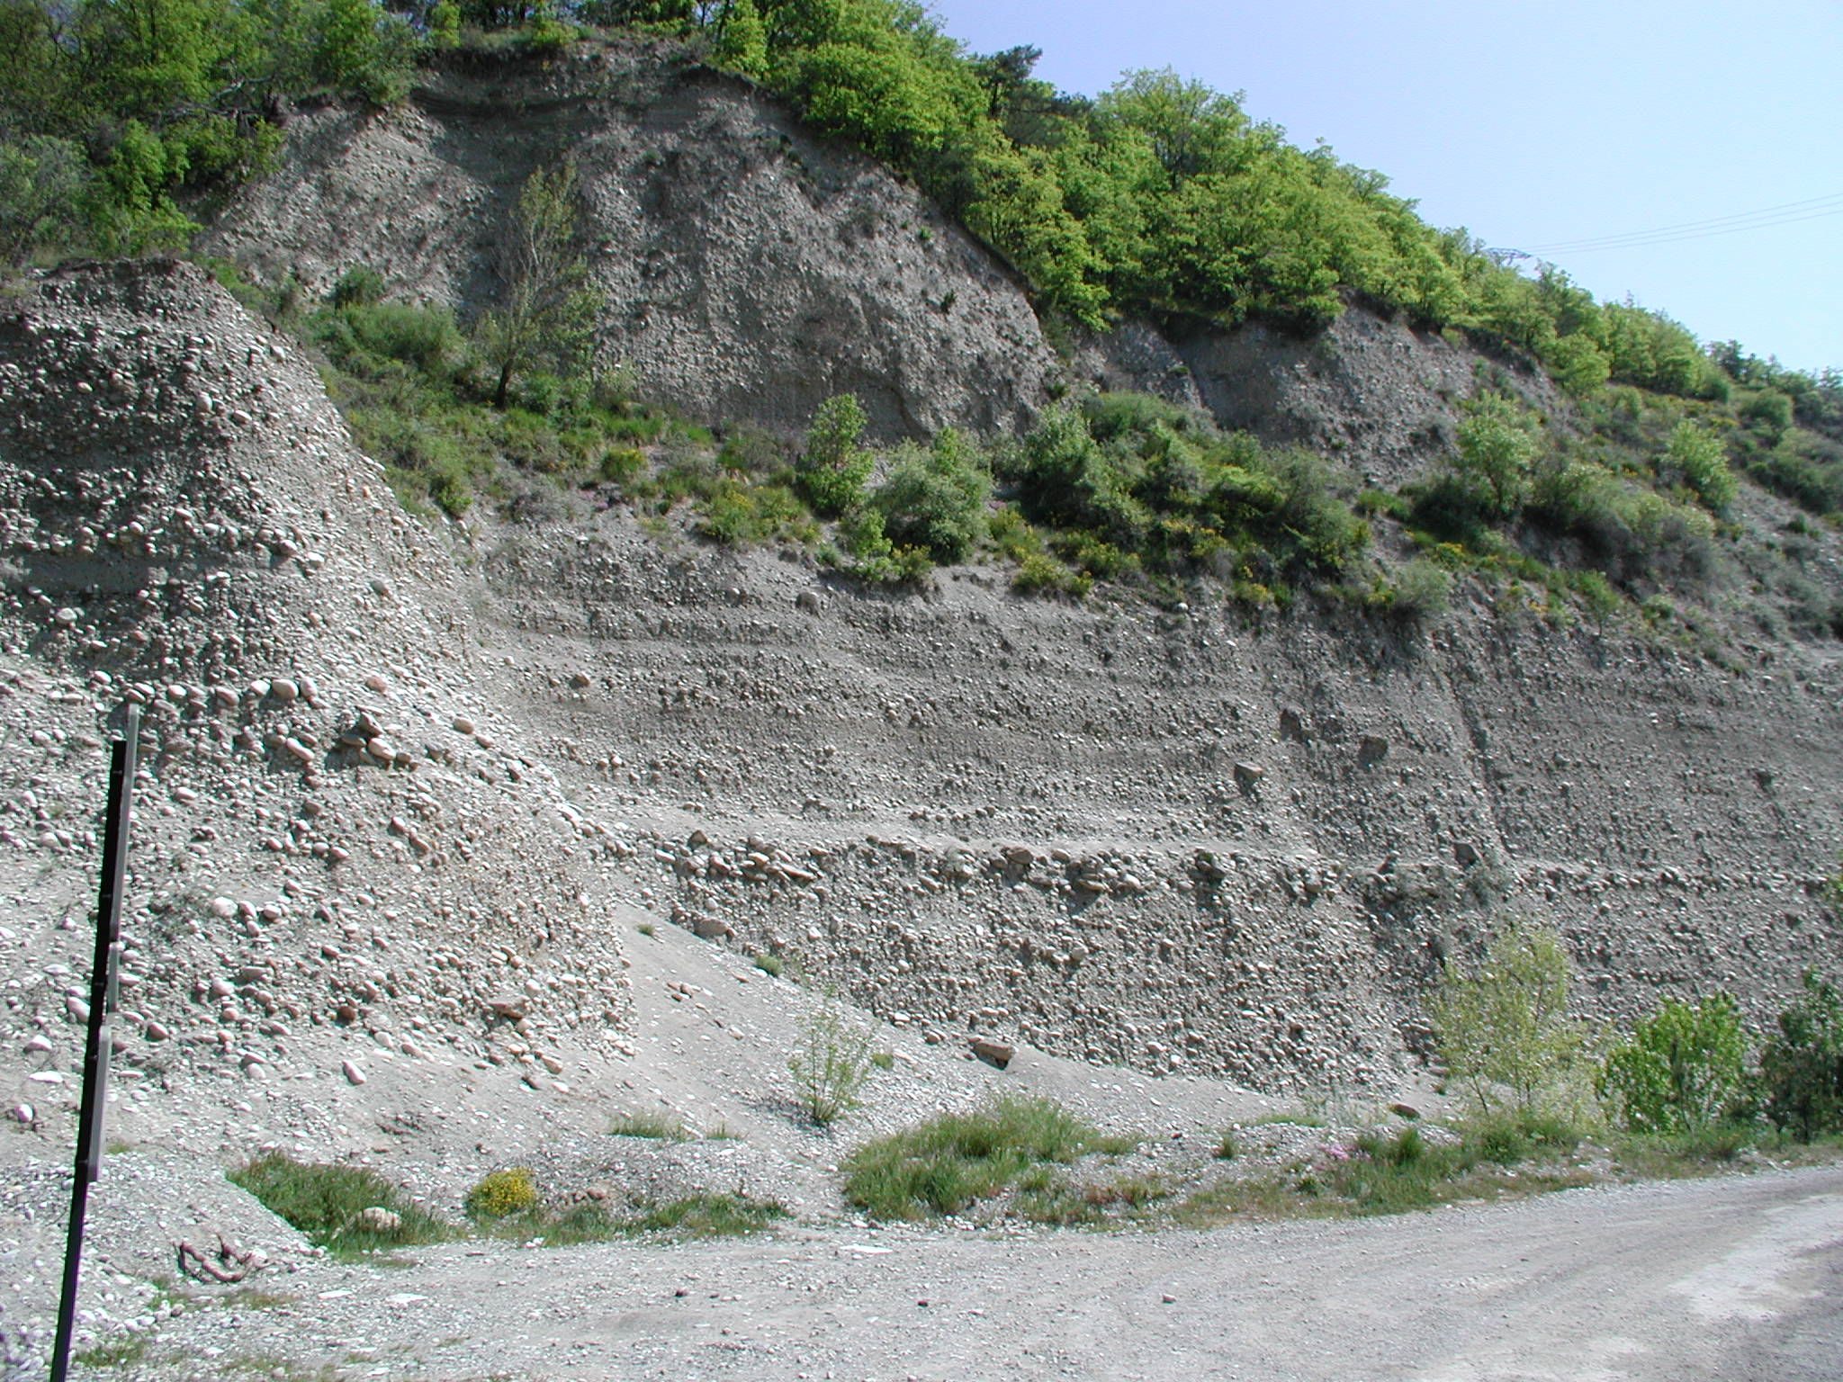
Pont de Ponsonnas

Slide 21
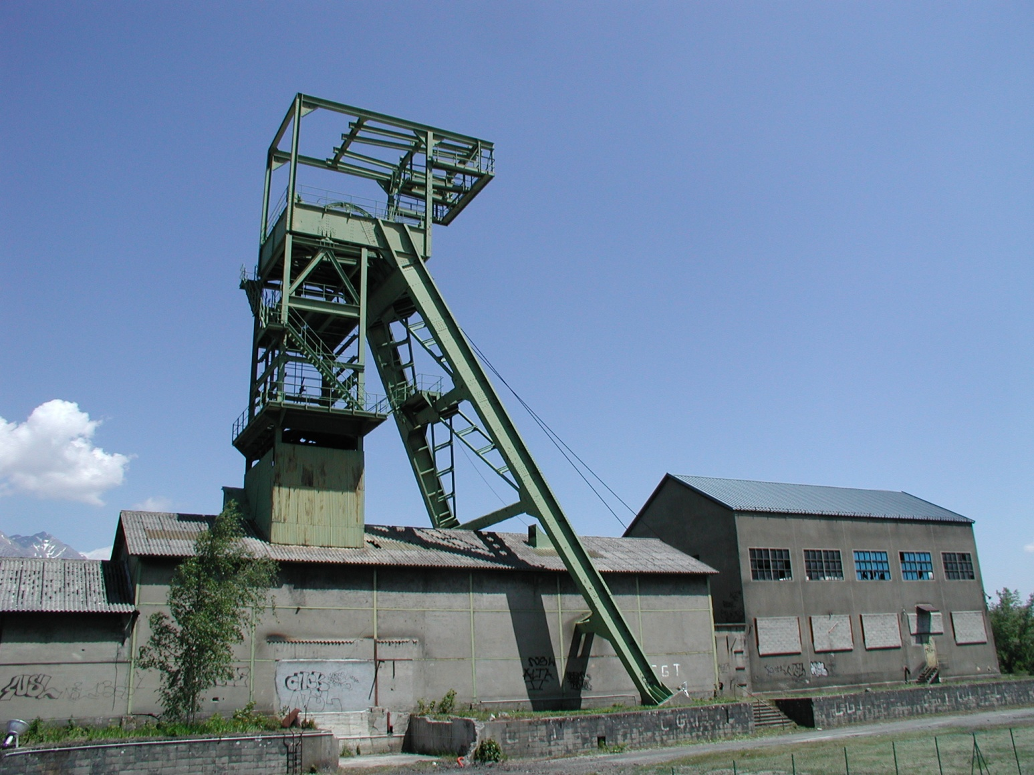
La Mure

Slide 22
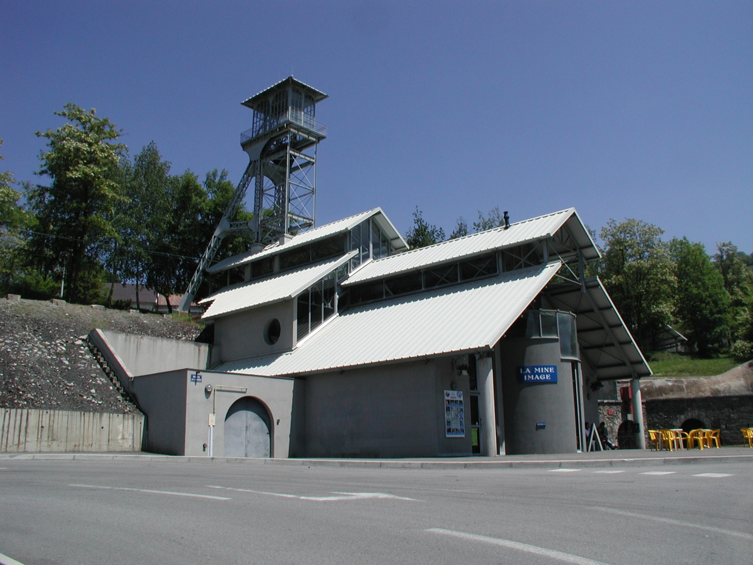
La Mure

Slide 23
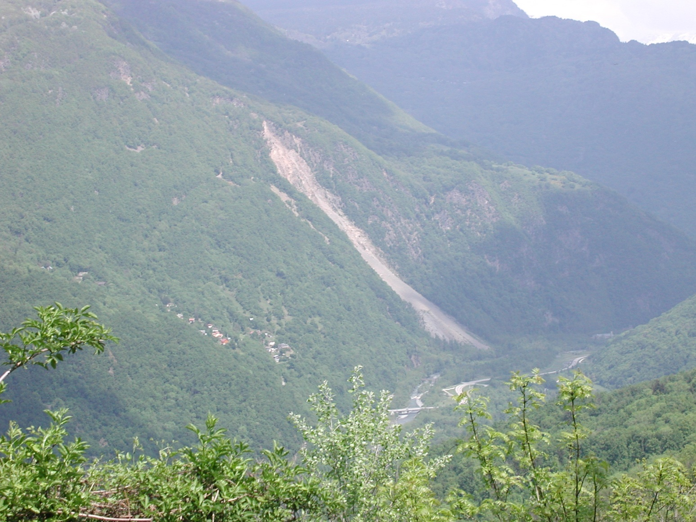
Ramp de Laffrey

Slide 24
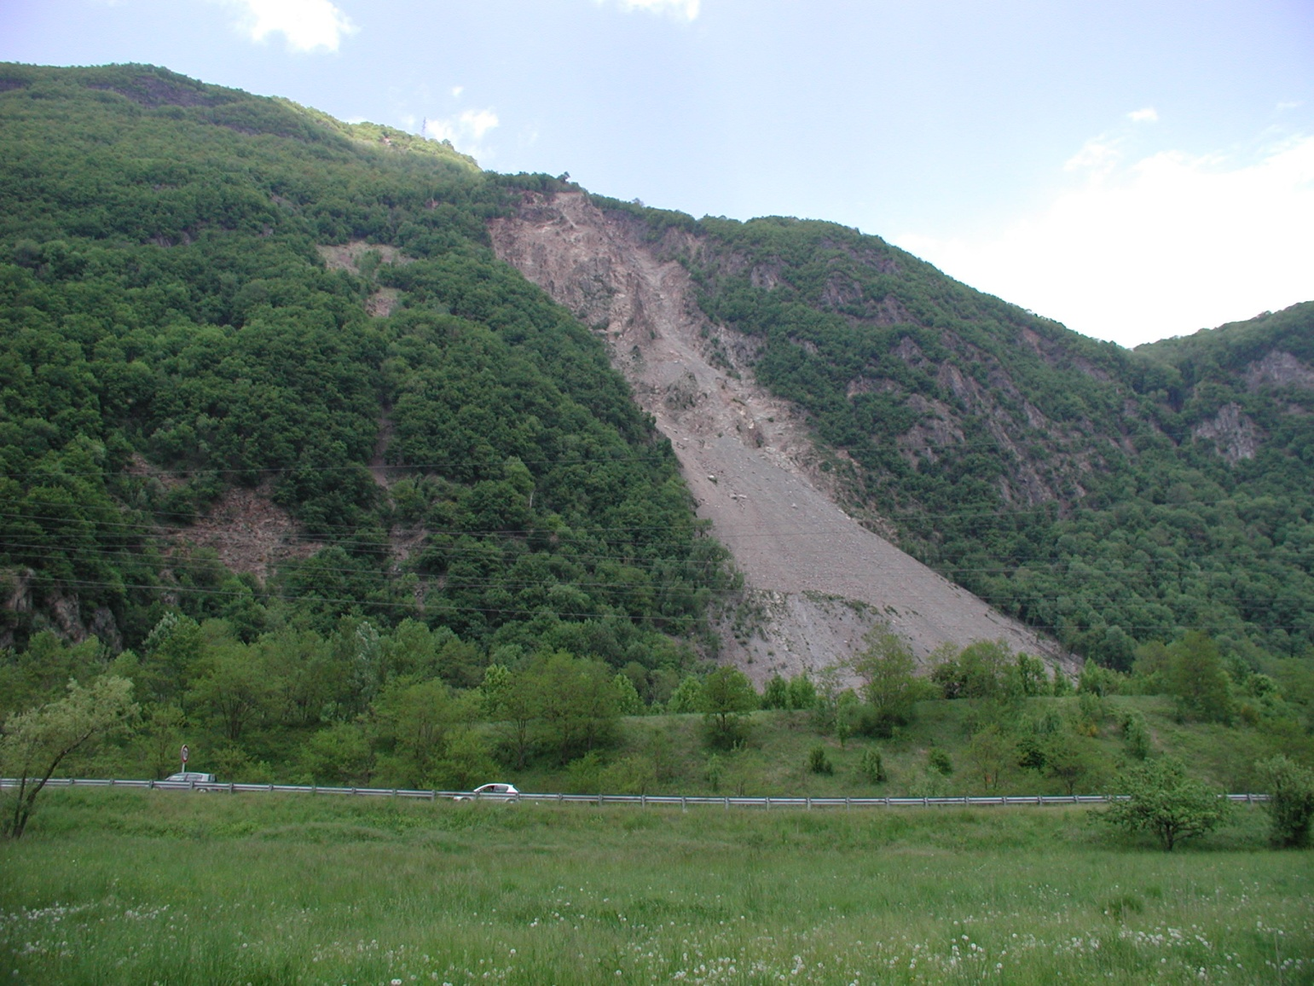
Séchilienne

Slide 25
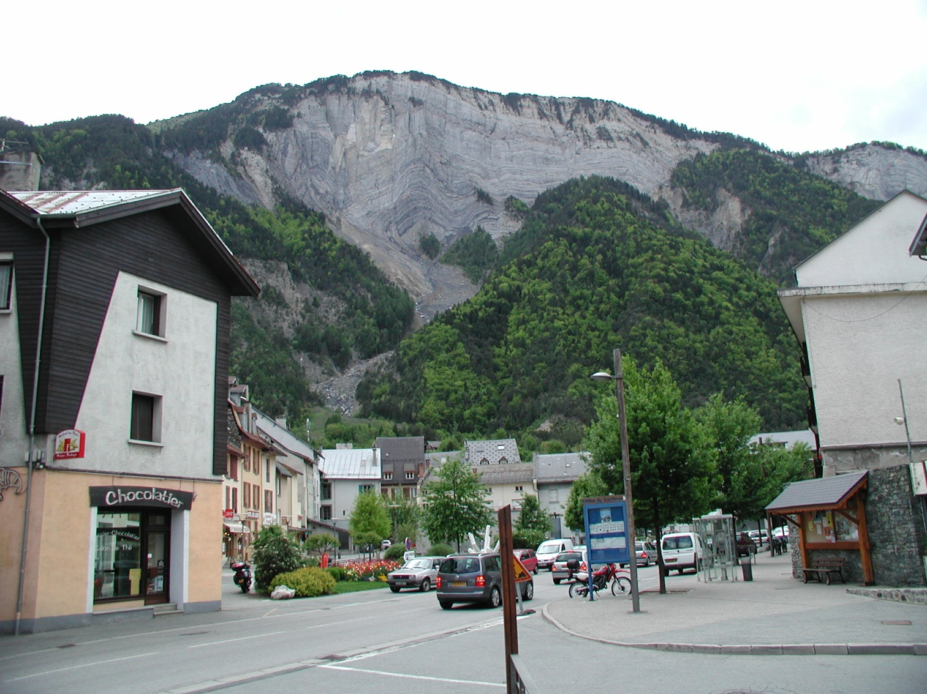
Bourg D’Oisans

Slide 26
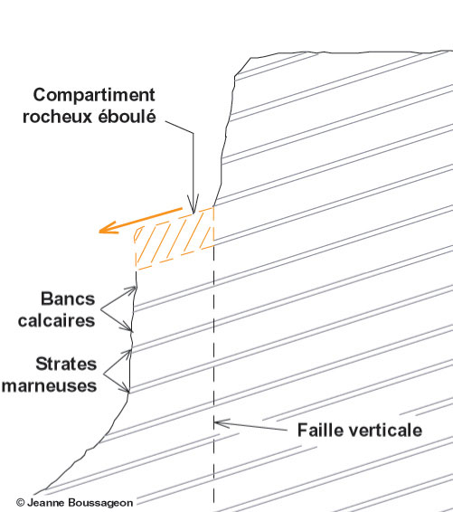
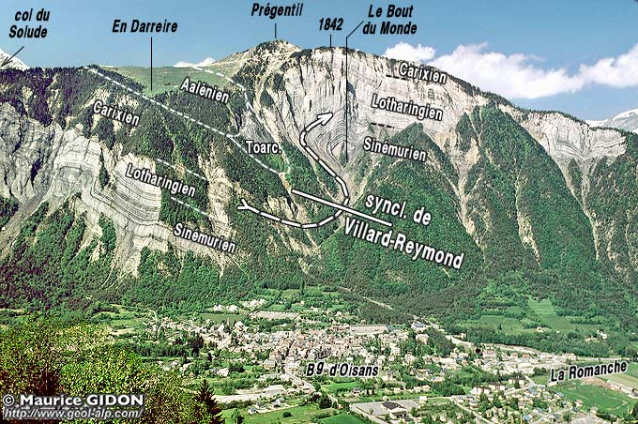
Falaise de Prégentil

Slide 27
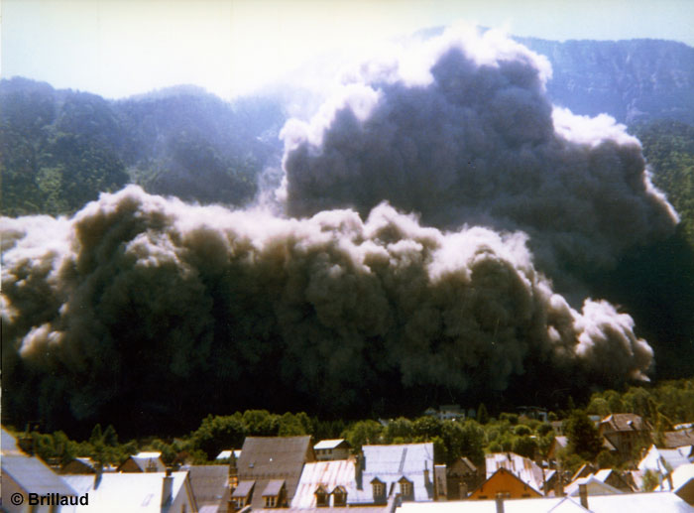
Falaise de Prégentil

Slide 28
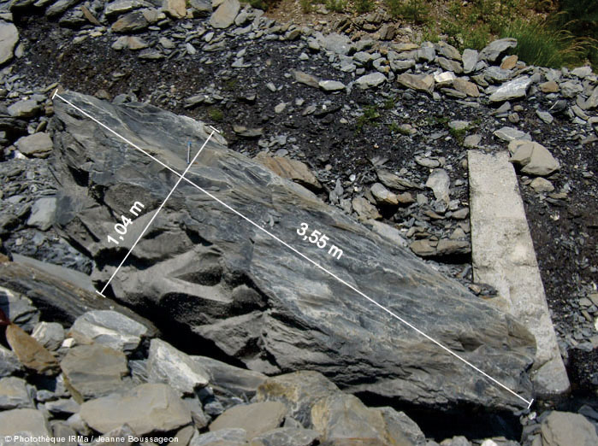
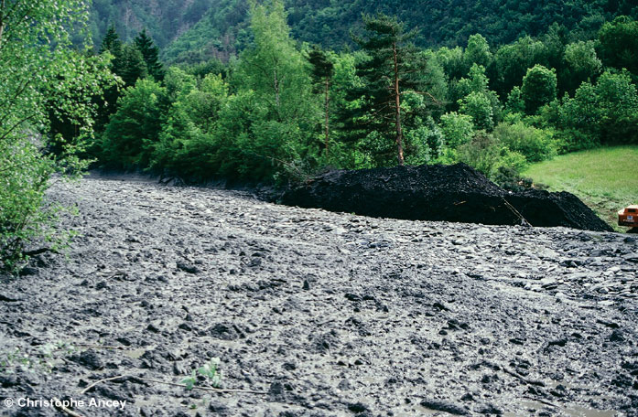
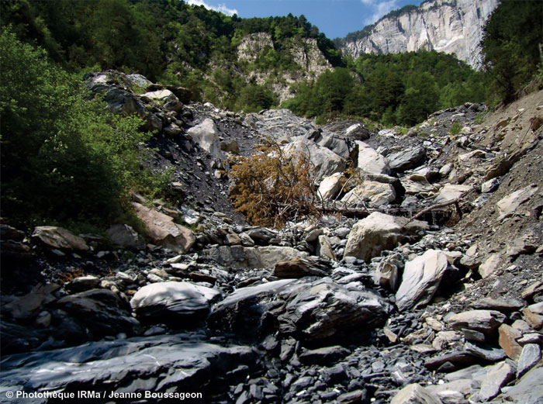
Torrent du Saint-Antoine

Slide 29
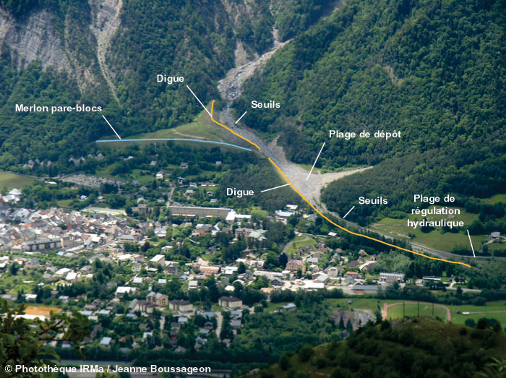
Torrent du Saint-Antoine

Slide 30
Charmonetier Rockfall

Slide 31
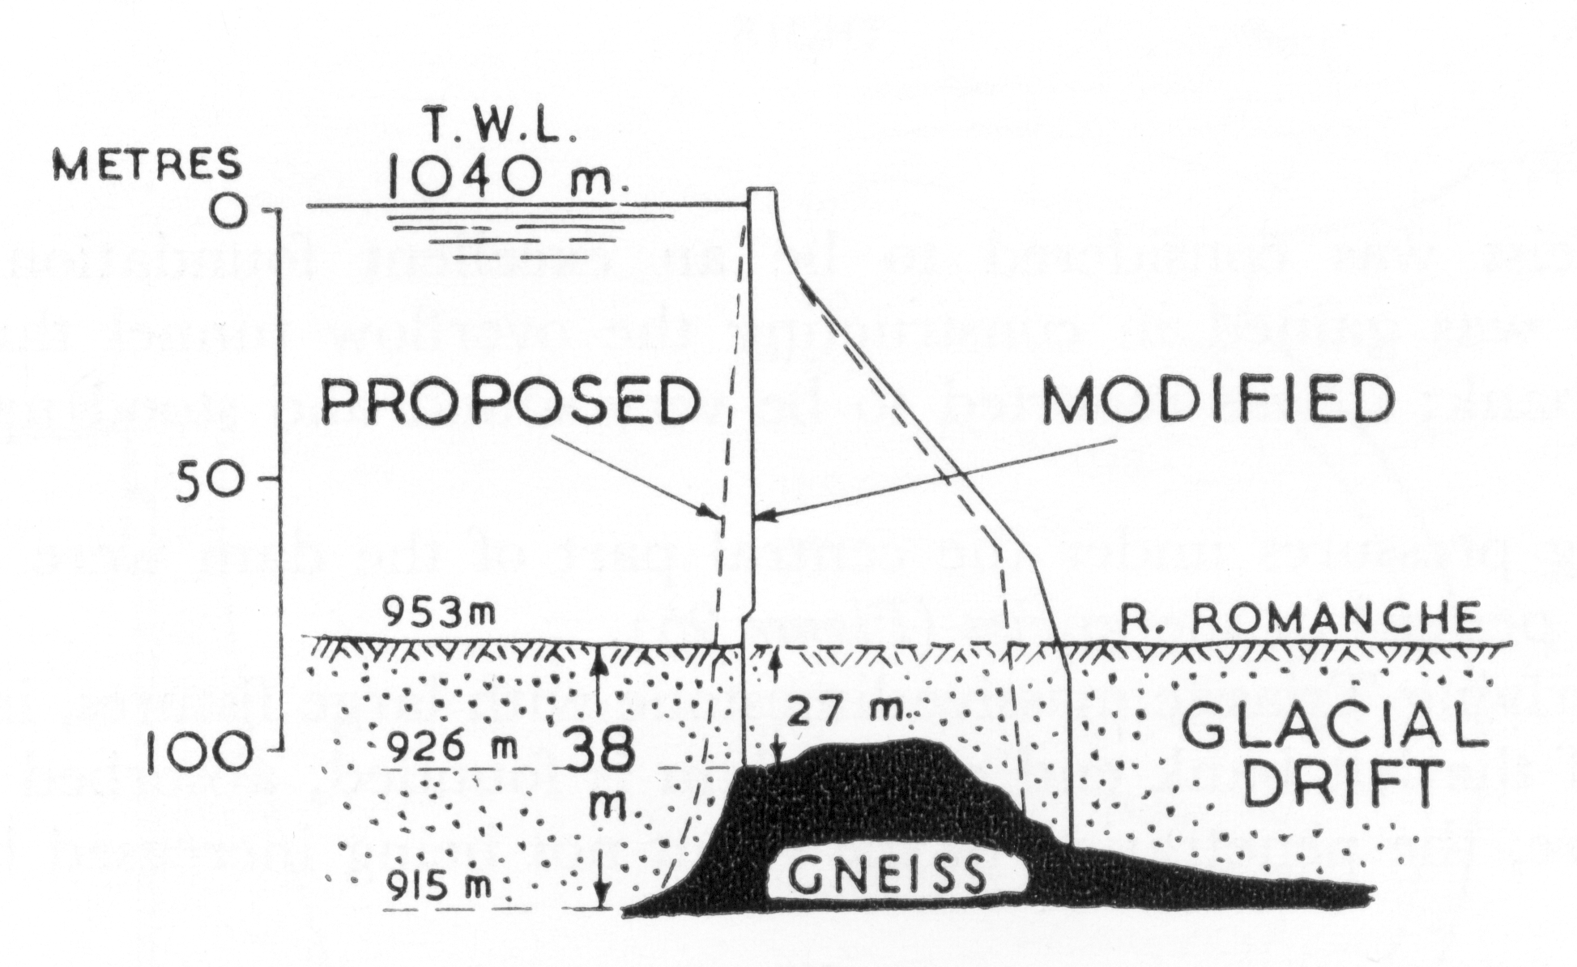
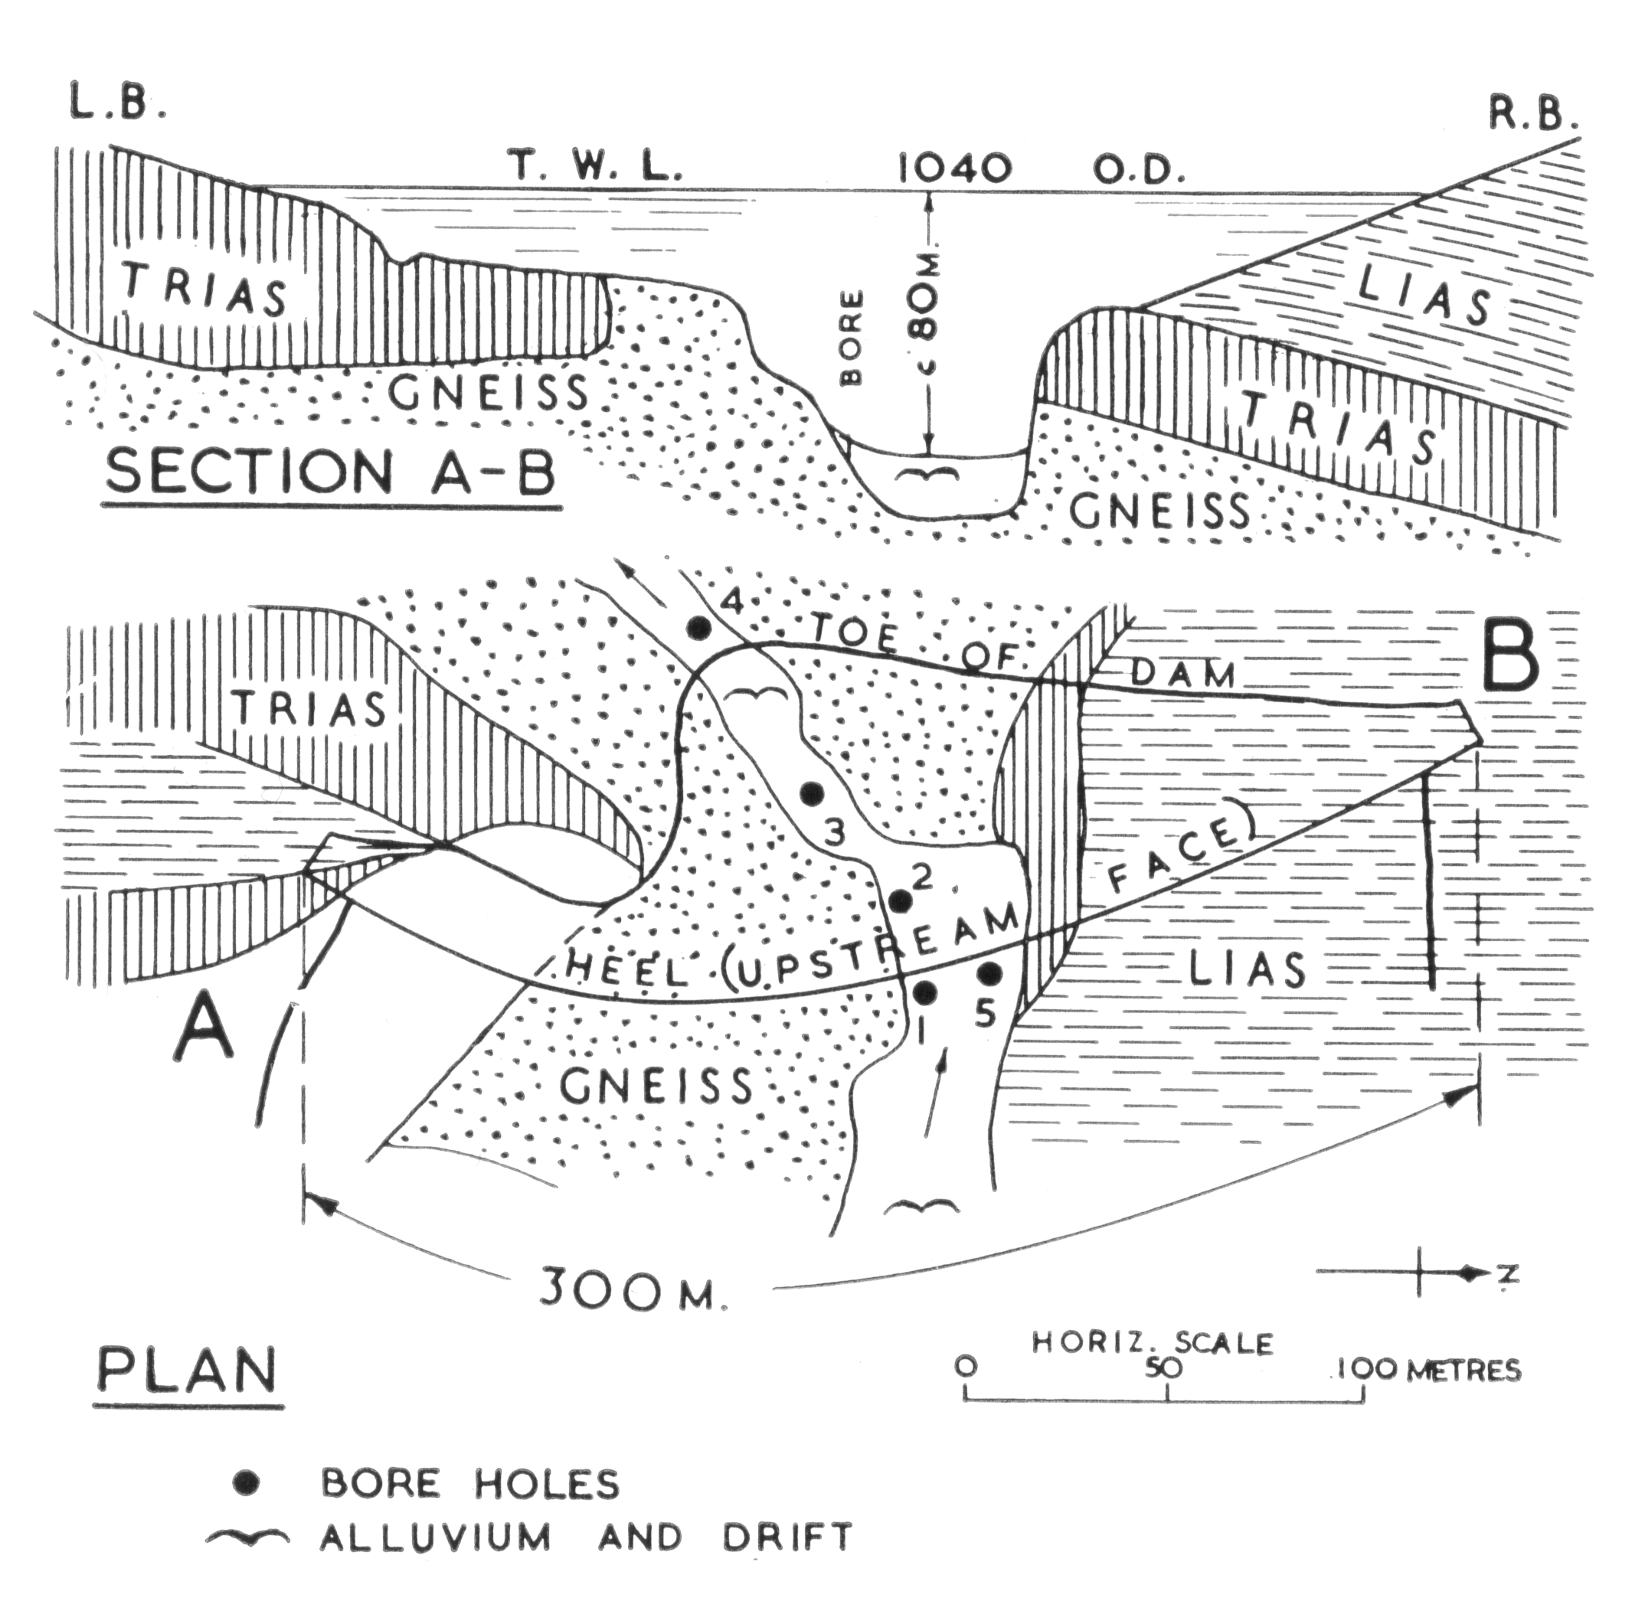
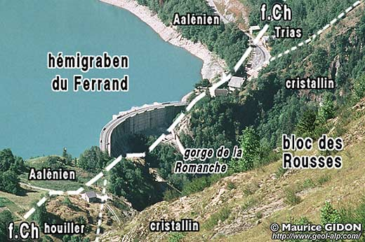
Barrage de Chambon

