Slide 1
The Development of Fieldwork Problem-Based Exercises in the Applied Geosciences
David Giles
Principal Lecturer in Engineering Geology
School of Earth & Environmental Sciences
University of Portsmouth

Slide 2
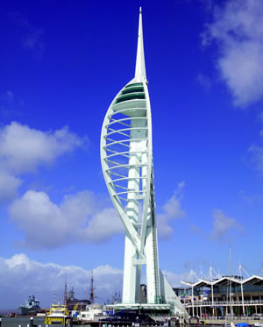
Outline
Applied Geoscience Courses @ Portsmouth
Fieldwork Programme
The Problem-Based Exercises
The Student Experience
Student Feedback & Critique

Slide 3


Acknowledgments
Small-Scale Learning and Teaching Research and Development Projects: 2005
Theme: Bringing the ‘Real World’ into the GEES Student Learning Experience
The Development of Fieldwork Problem-Based Learning in the Applied Geosciences

Slide 4
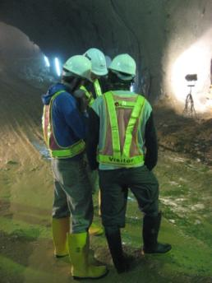
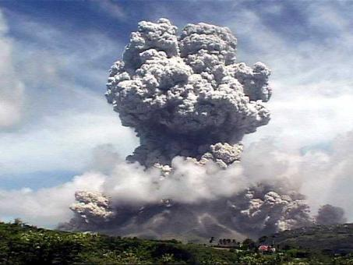
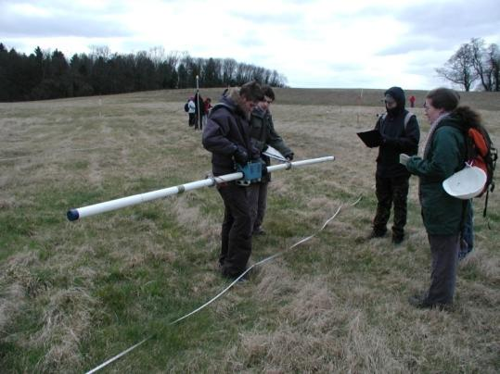
Applied Geoscience Honours Degrees
BSc Geological Hazards
BEng Engineering Geology & Geotechnics
All courses fully accredited by the Geological Society of London
Earth and Environmental Sciences
45 years of Engineering Geology at Portsmouth
Notes:
4

Slide 5
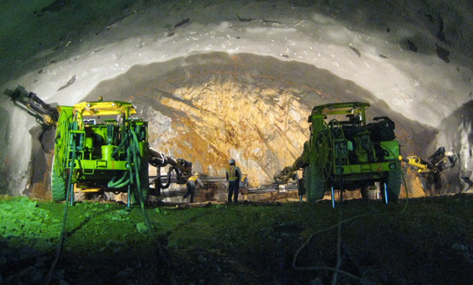
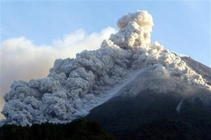
Applied Geoscience Masters
MSc Geological & Environmental Hazards
MSc Contaminated Land
MSc Engineering Geology
MSc Crisis & Disaster Management
(run jointly with School of Business)
Notes:
5

Slide 6
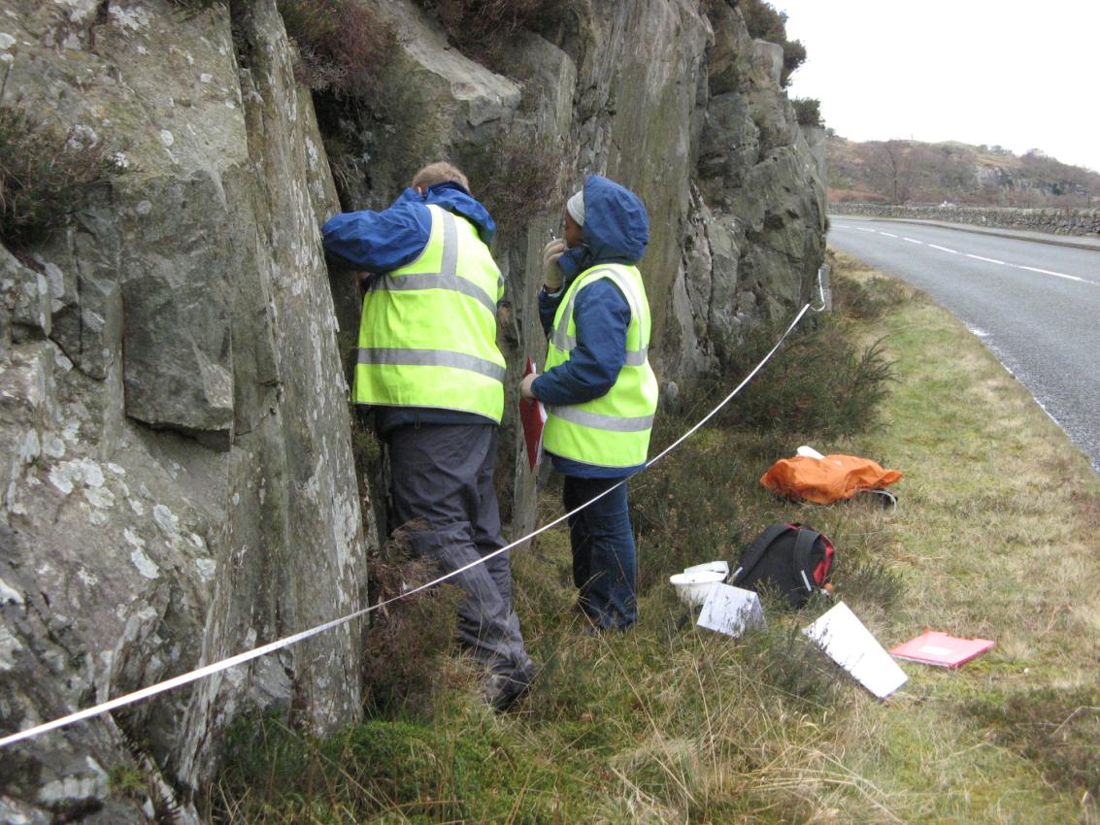

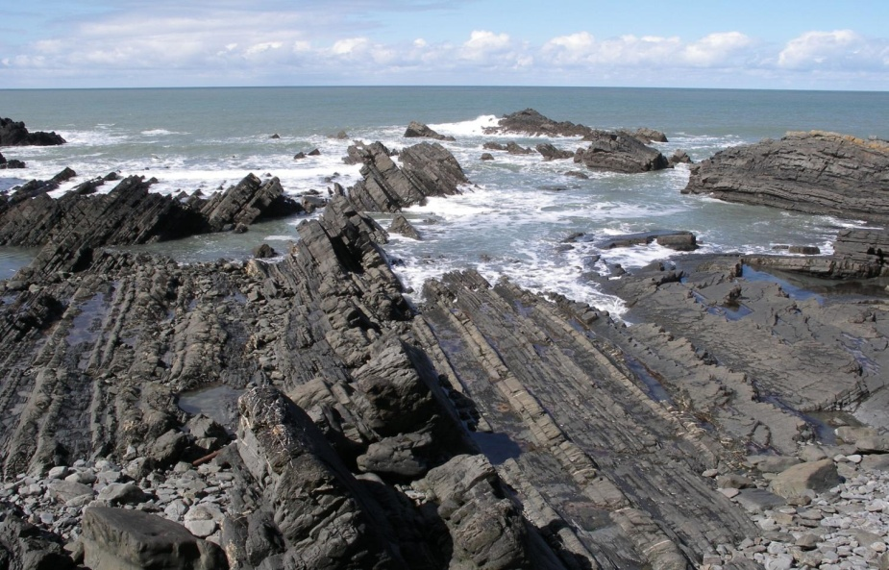
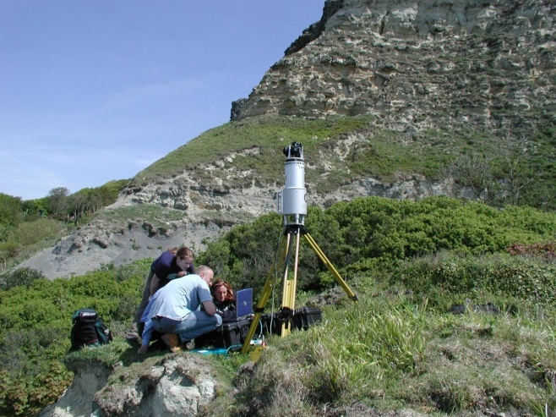
Fieldwork
Current programme
Central Spain
SE Spain
Isle of Wight
Cyprus
Germany
Italy
Hong Kong
Cornwall
Scotland
Greece
French Alps
Provence
etc

Slide 7
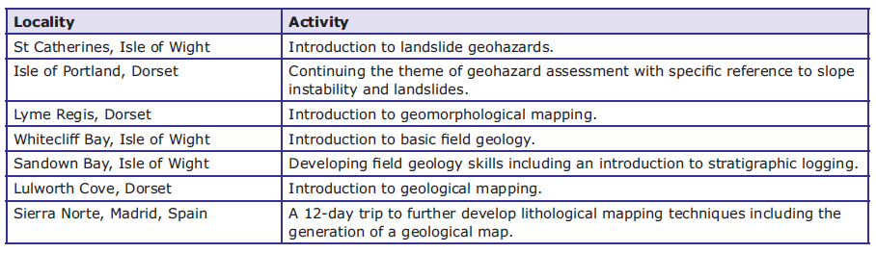
Level 1 Applied Geoscience Programme

Slide 8
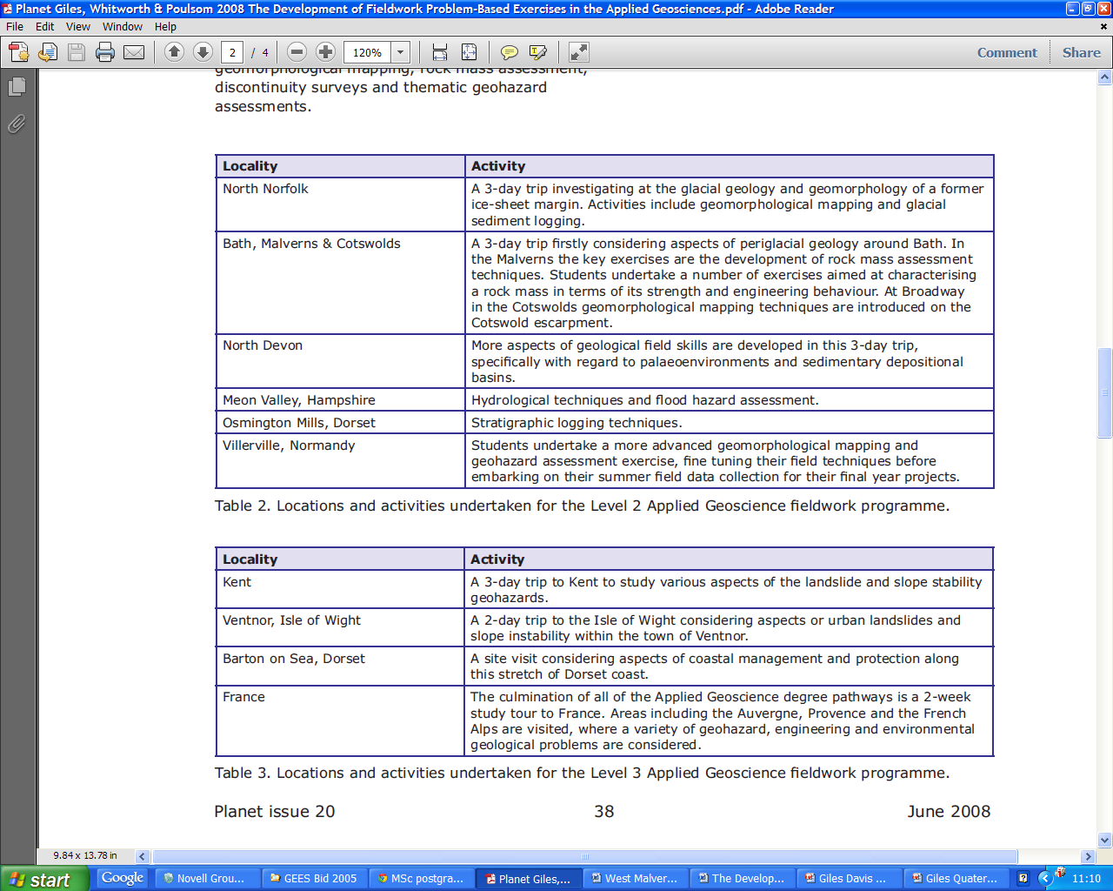
Level 2 Applied Geoscience Programme

Slide 9
Level 3 Applied Geoscience Programme

Slide 10
Problem Based Exercise Format
Briefing – Map Base - Equipment
Team Selection – Task Allocation
Field Data Acquisition
Ground Model Development
Problem Solution - Debriefing

Slide 11
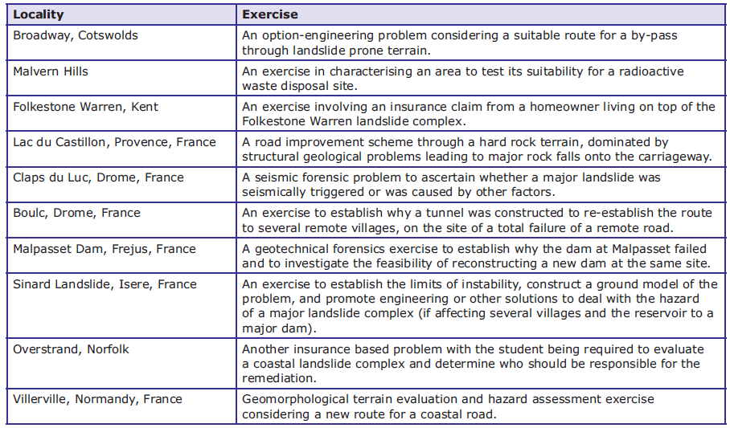
Problem-Based Exercises

Slide 12
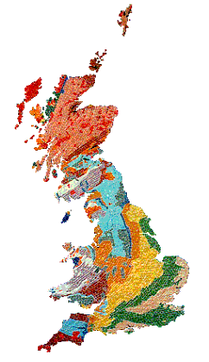
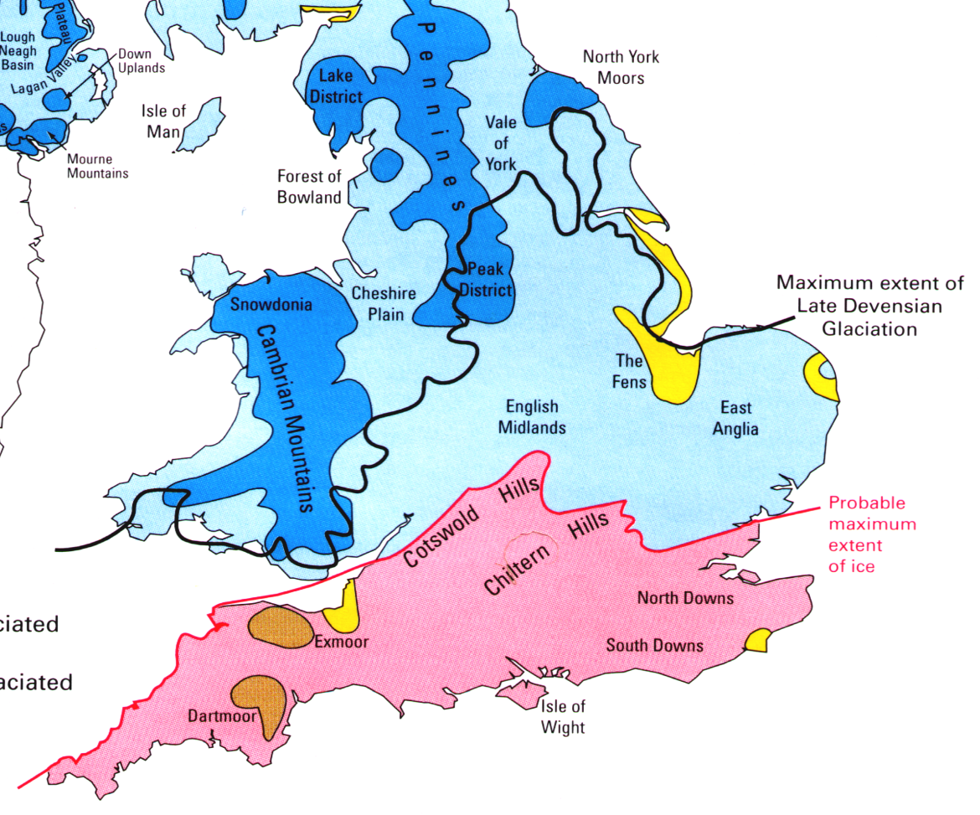
Malverns
North Norfolk

Slide 13
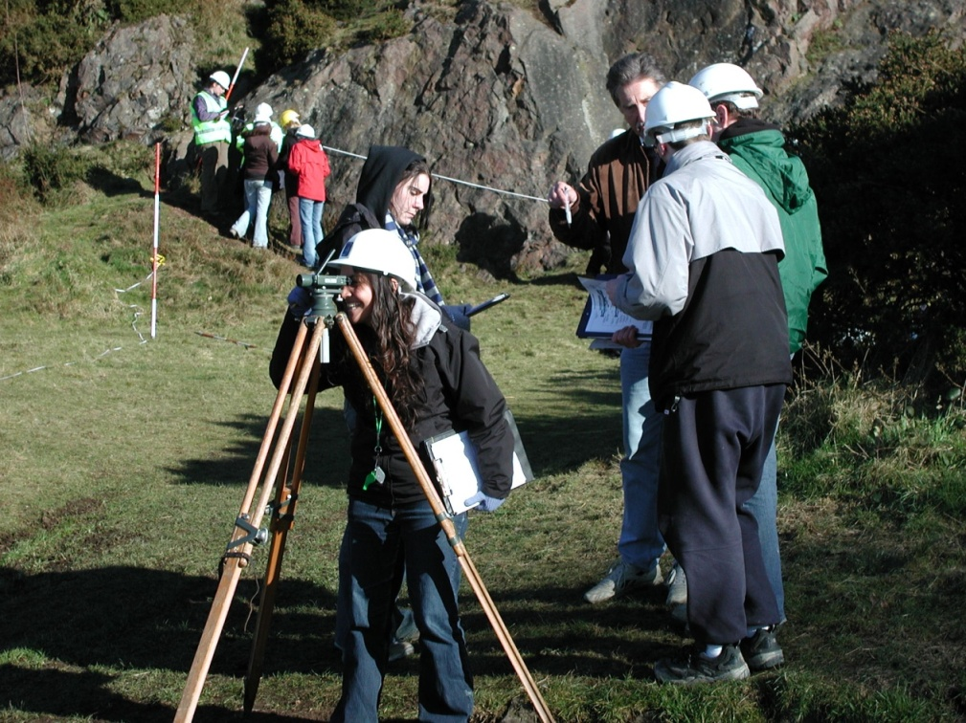
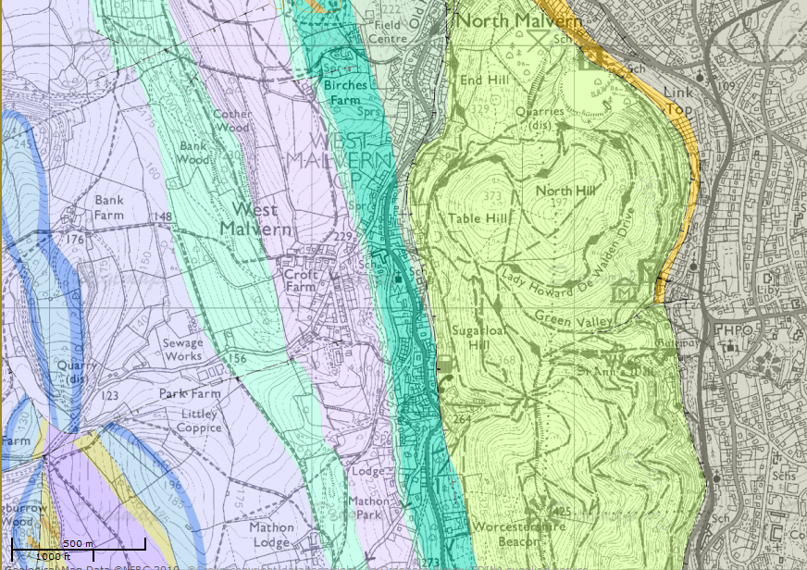
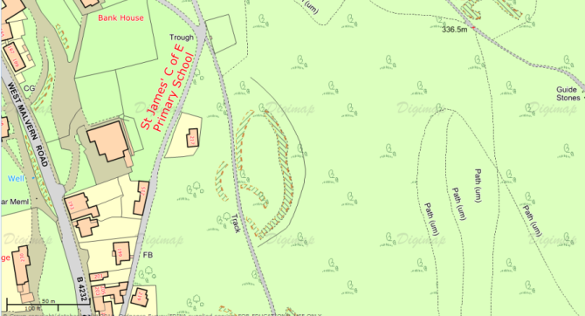
West Malvern
An exercise in characterising an area to test its suitability for a radioactive waste disposal site

Slide 14
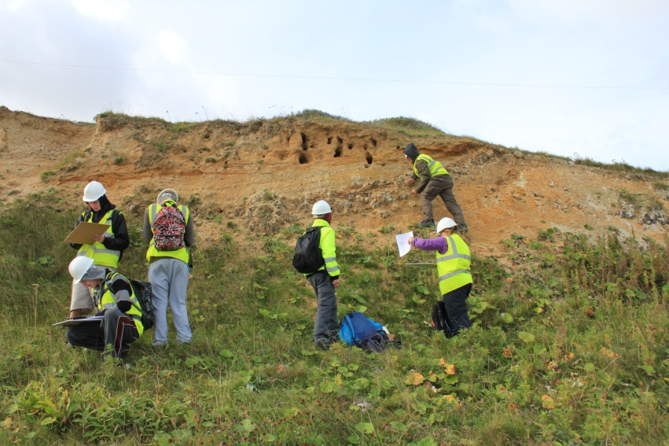
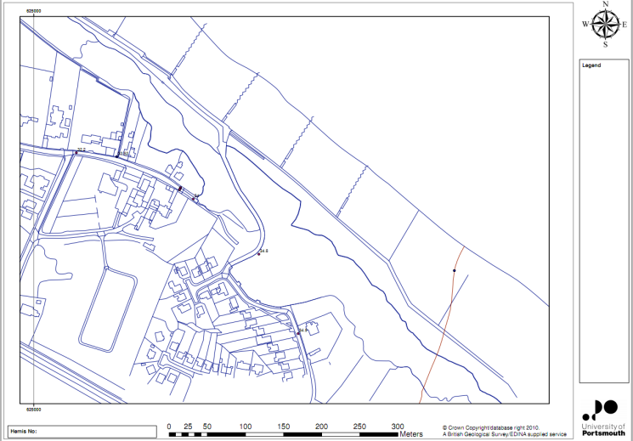
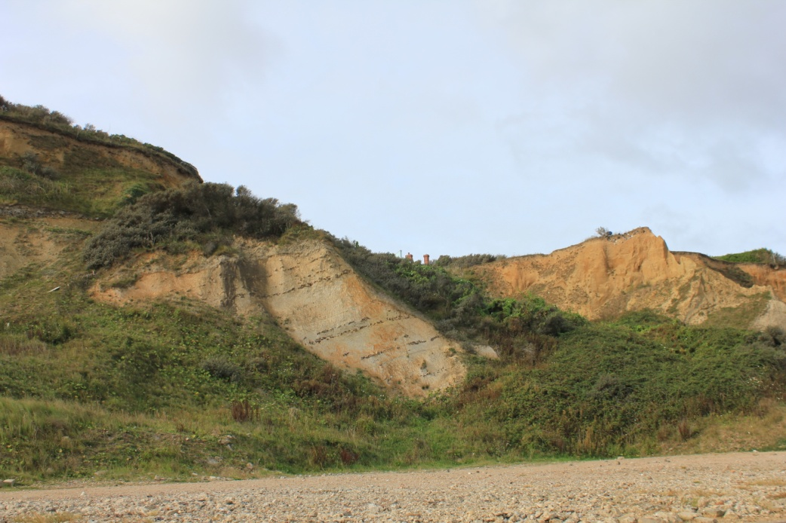
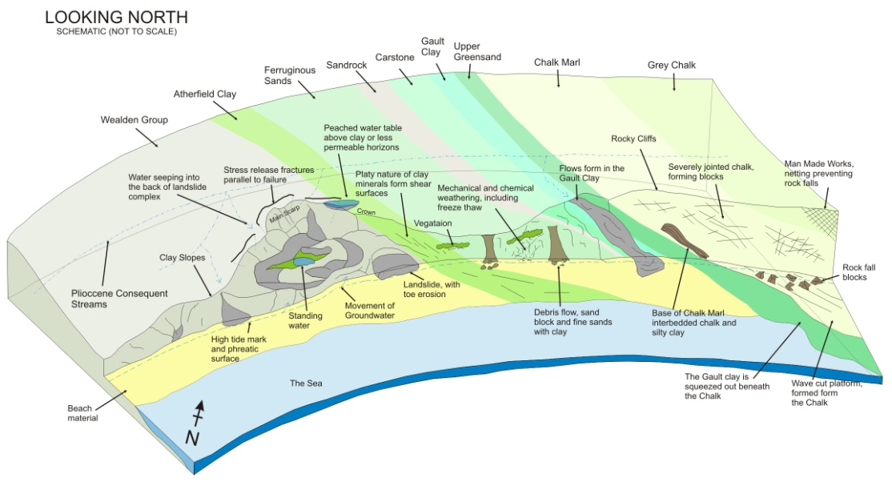
Overstrand
An insurance based problem evaluating a coastal landslide to determine who should be responsible for the remediation

Slide 15
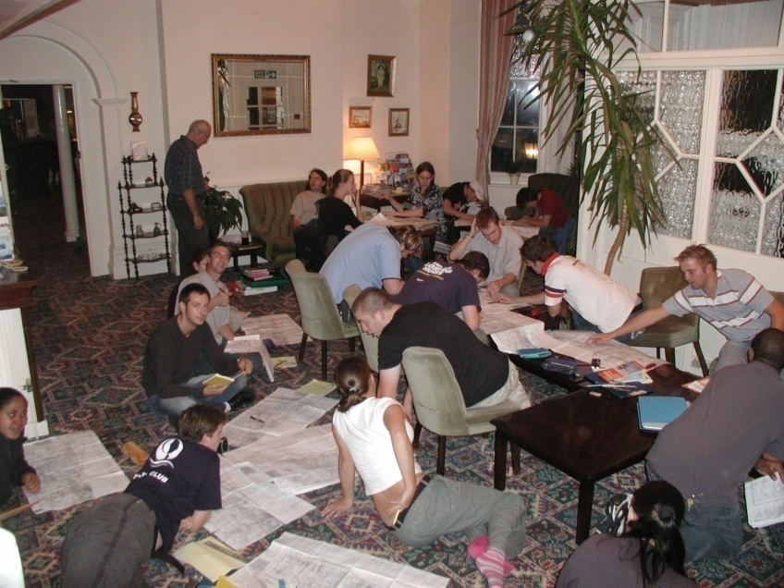
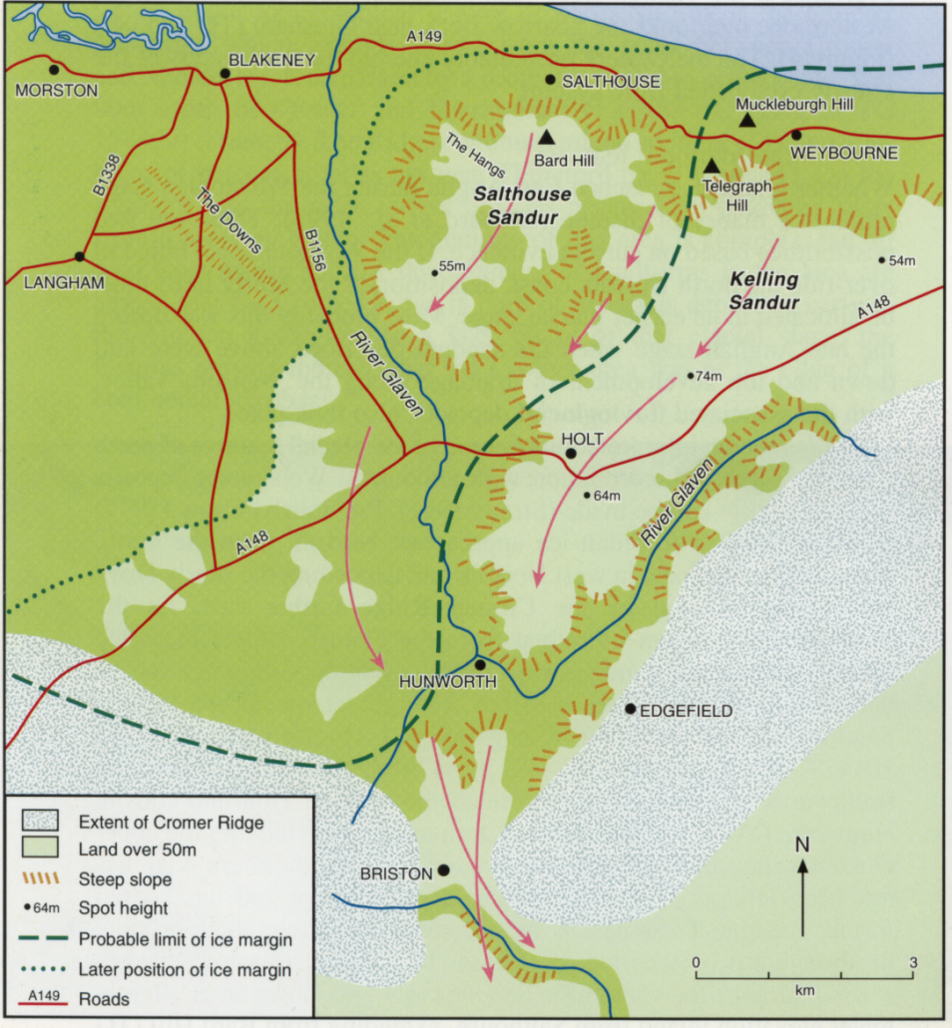
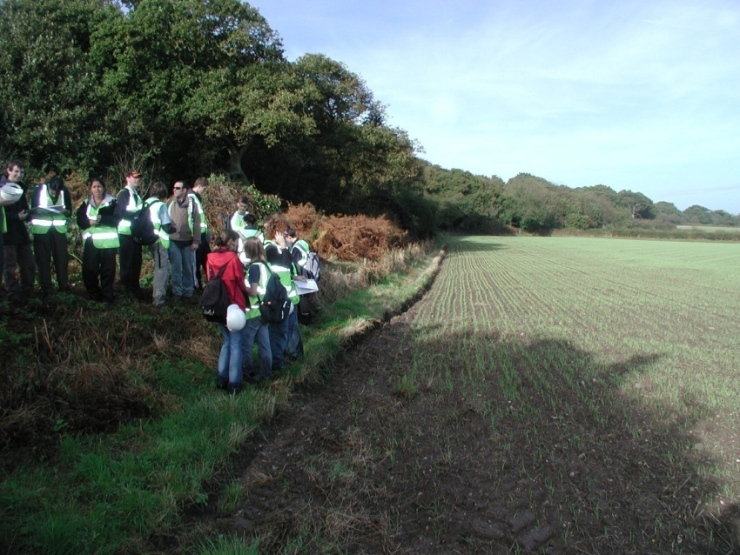
North Norfolk
E M Bridges (1998) Classic Landforms of the North Norfolk Coast
Investigation of the glacial geology and geomorphological reconstruction of a former ice-sheet margin

Slide 16
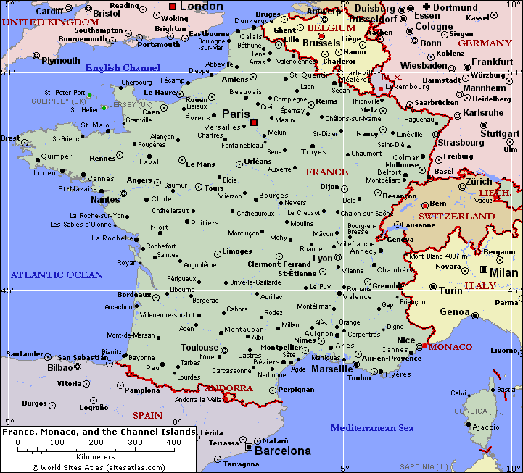
Villerville
Mont Dore
Die
Sinard
Castellane
Malpasset

Slide 17
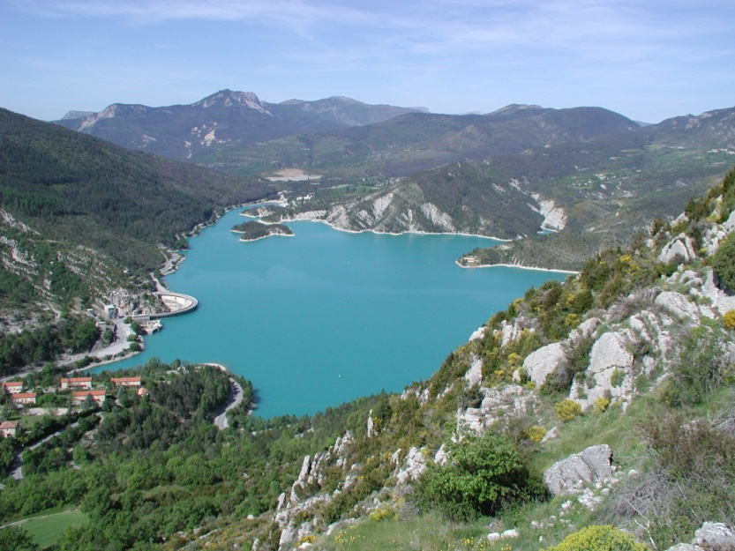
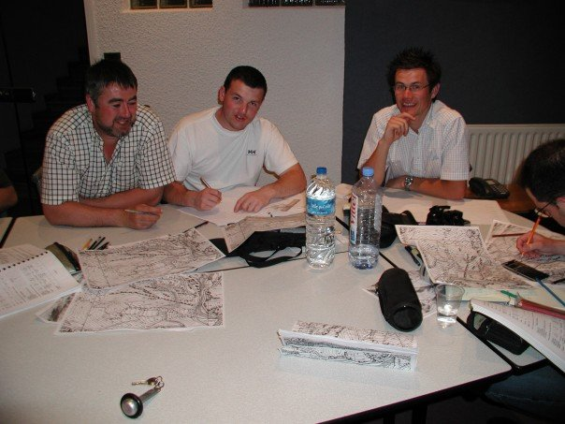
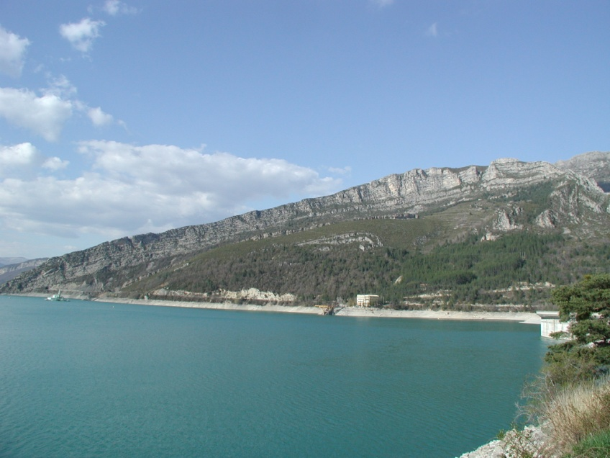
Castellane
A road improvement scheme through an area dominated by structural geological problems and major rock falls

Slide 18
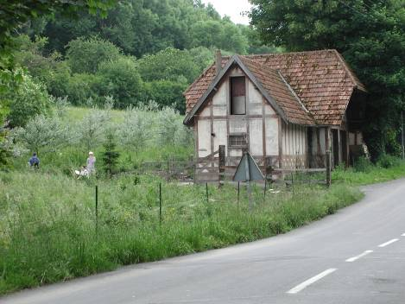
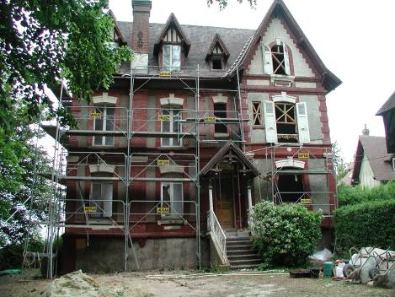
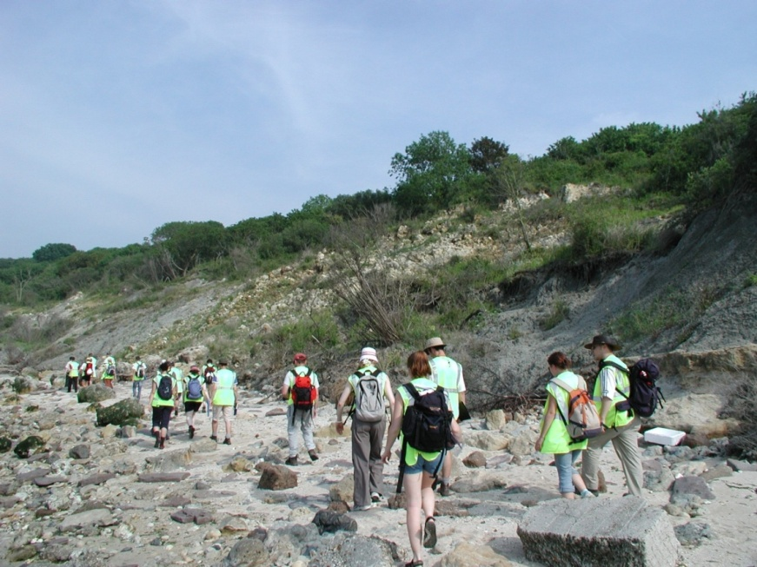
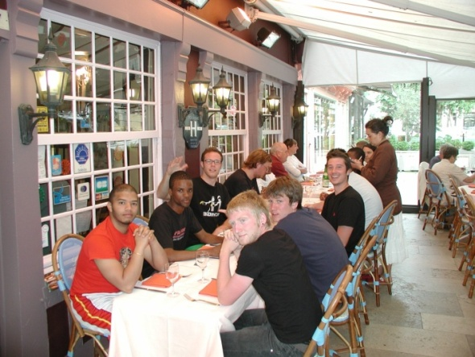
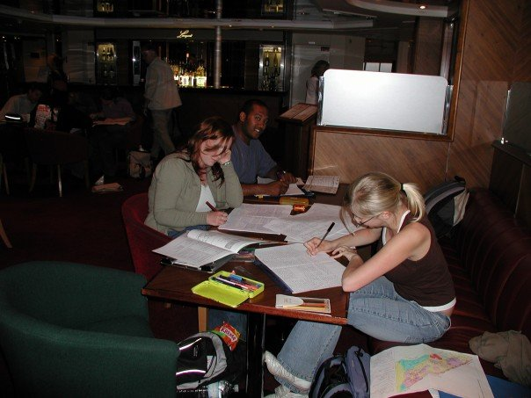
Villerville
Geomorphological terrain evaluation and hazard assessment exercise considering a new route for a coastal road

Slide 19
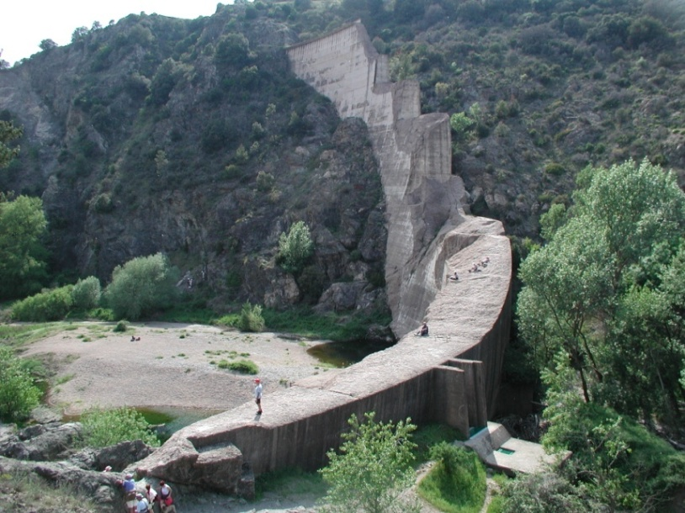
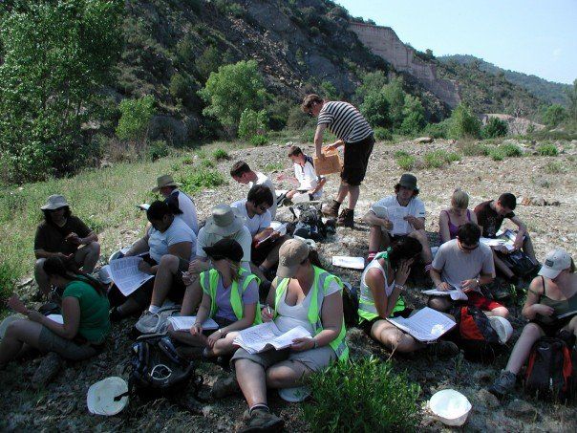
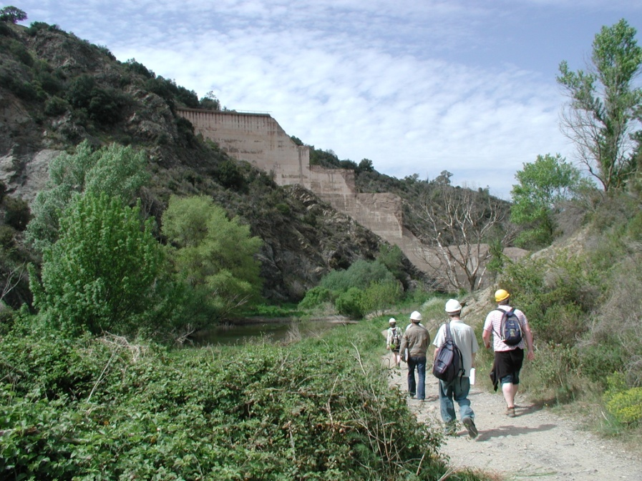
Malpasset
A geotechnical forensics exercise to establish why the dam at Malpasset failed

Slide 20
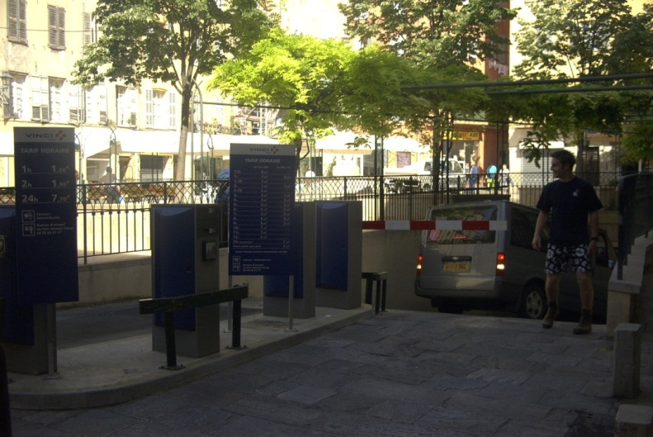
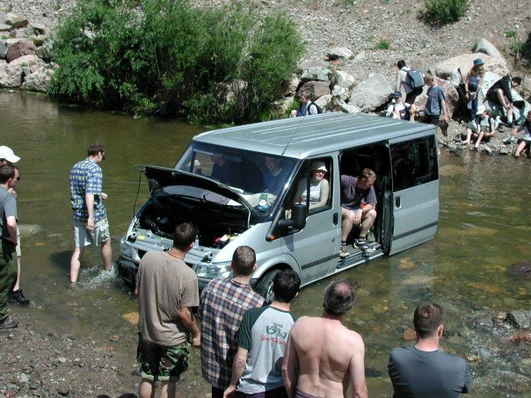
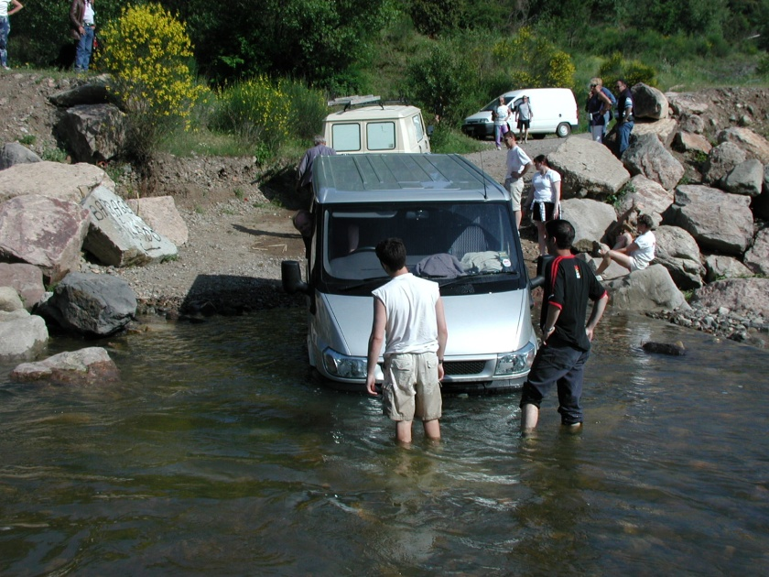
Malpasset @ Malpasset
Problem solving beyond the field exercise

Slide 21
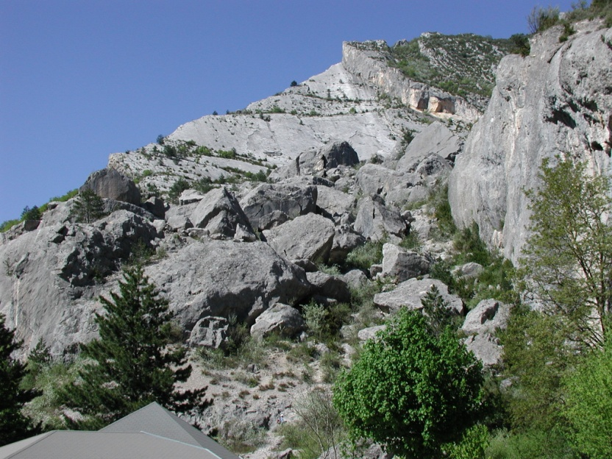
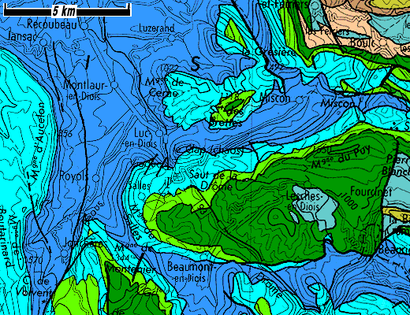
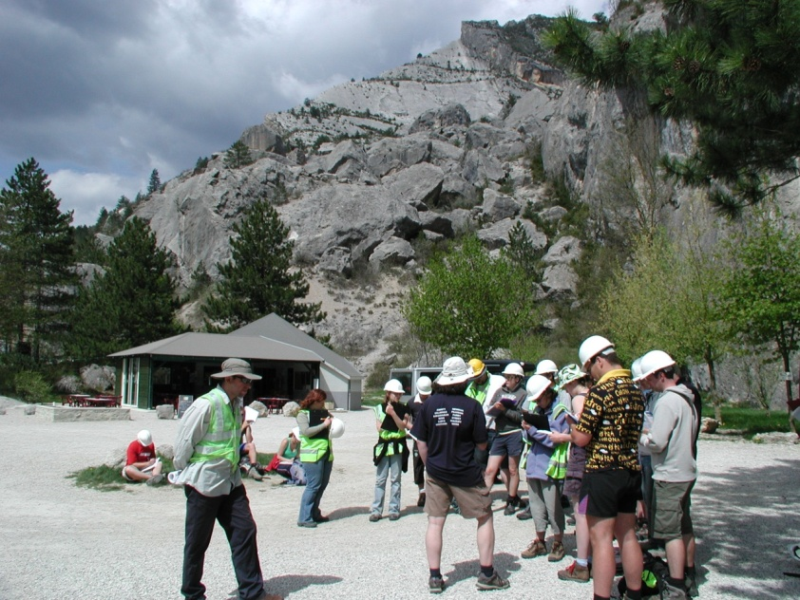
Claps du Lucs
A seismic forensic problem to ascertain whether a landslide was seismically triggered or was caused by other factors

Slide 22
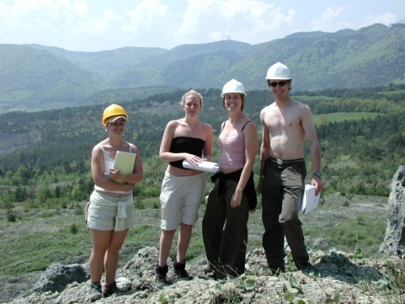
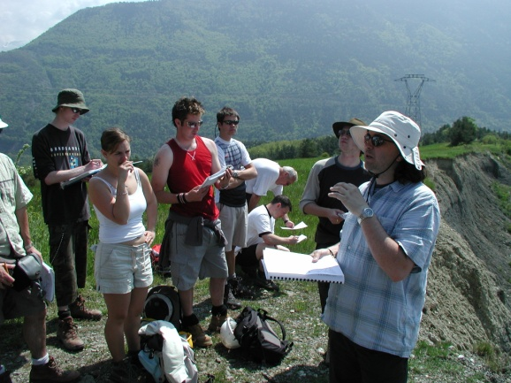
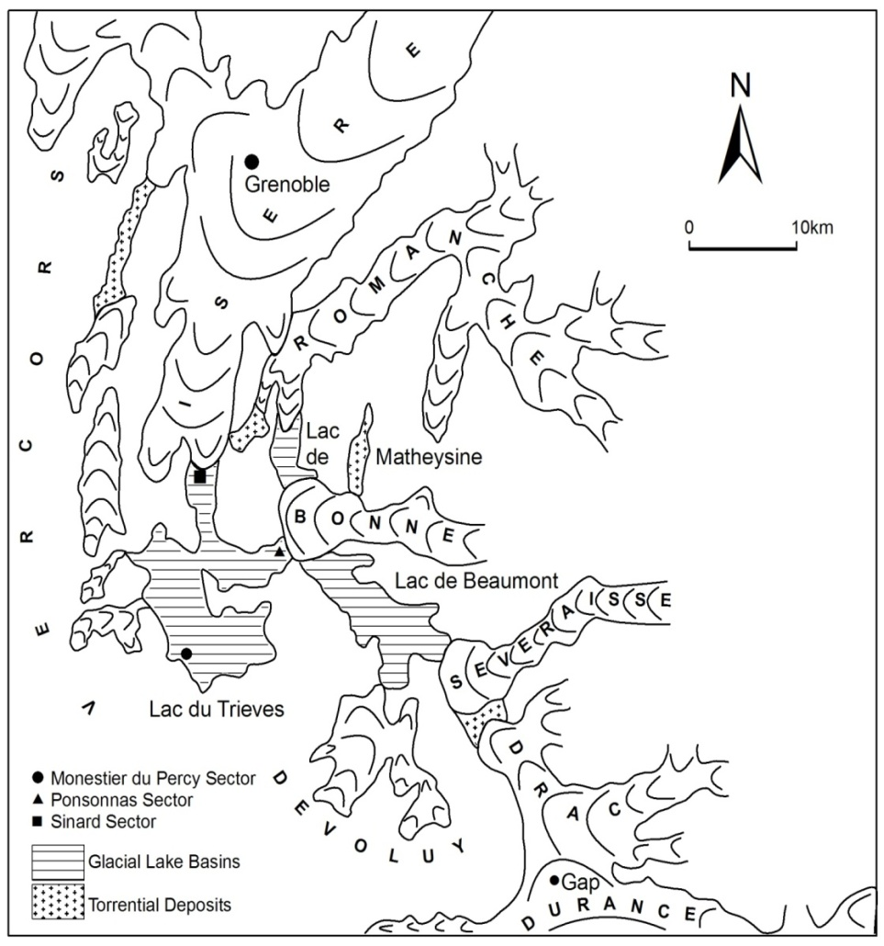
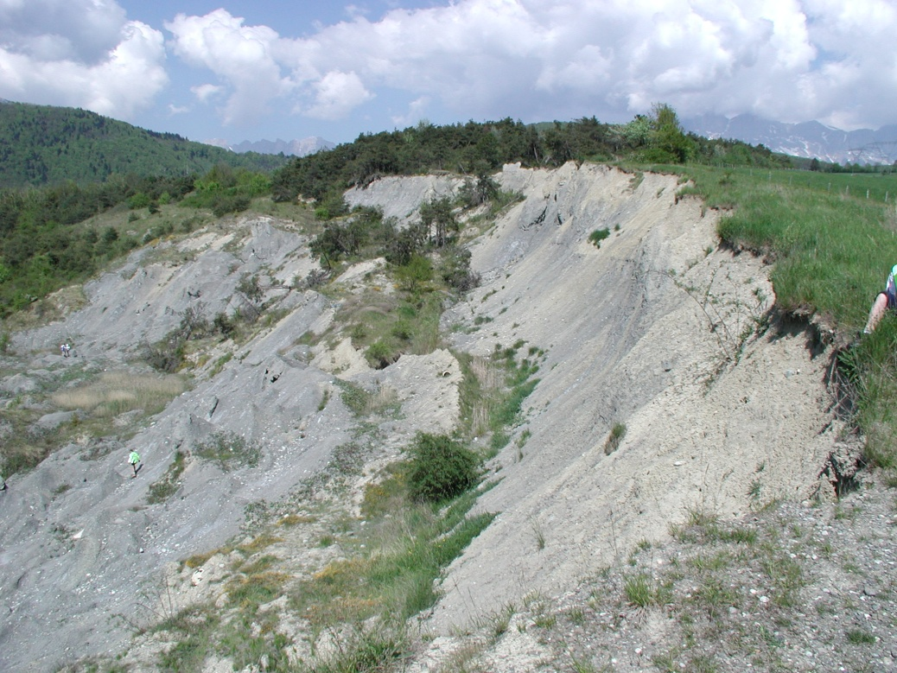
Sinard
Sinard
An exercise to establish limits of instability, construct a ground model & promote solutions to deal with the hazard

Slide 23
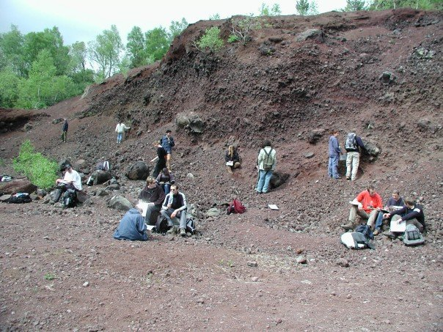
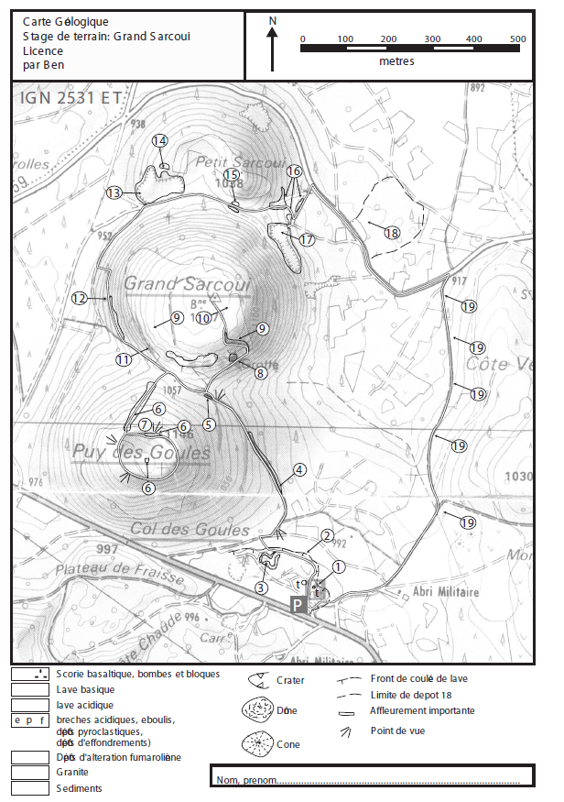
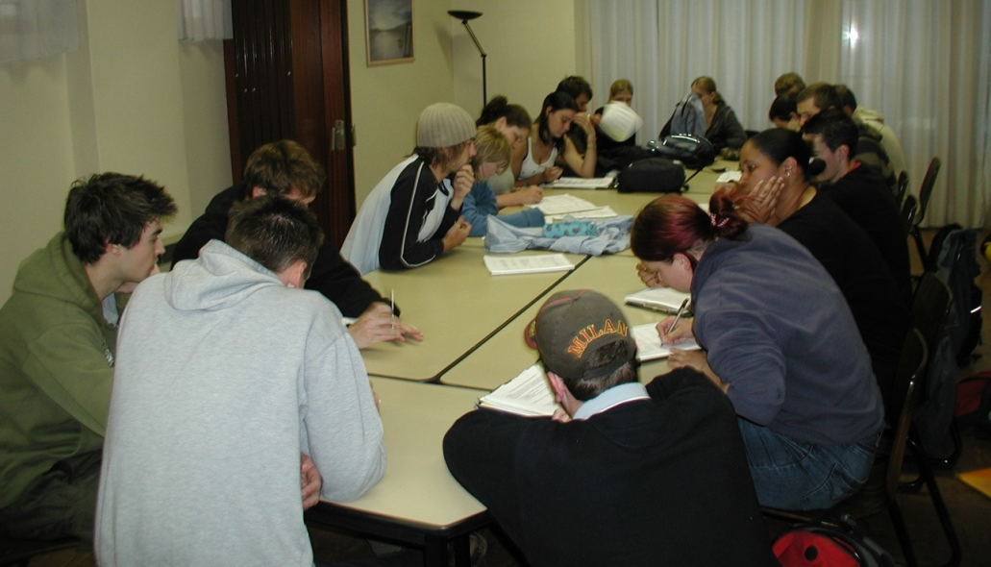
Grand Sarcoui
A volcanic hazard assessment exercise set in French. Each team contained a member who had studied French

Slide 24
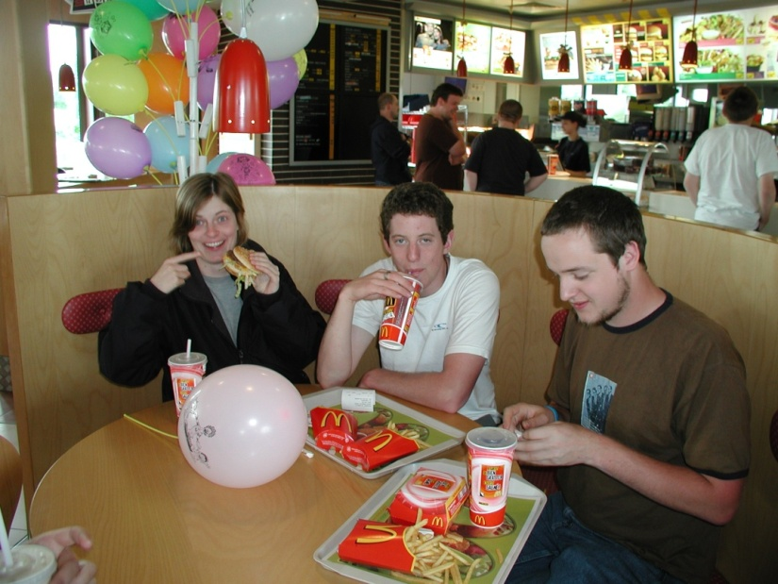


The Student Experience

Slide 25




The Student Experience

Slide 26


Student Feedback
Flogs
  What I enjoyed and thought was good about the field day:
  What I didn’t enjoy about the field day:
  How I would improve the field day if I was running the course:

Slide 27


Localities

Slide 28
References
Giles, D. P., Whitworth, M. C. Z. & Poulsom, A.J. (2008). The development of fieldwork problem-based exercises in the Applied Geosciences. Planet, (20), 37-40.
Giles, D.P. (in press). A Field Guide to the Engineering Geology of the French Alps, Grenoble. Quarterly Journal of Engineering Geology and Hydrogeology.

